Slide 1
Waters of Eurasia in the 21st century
Anastasia Likhacheva
Deputy director, Research fellow
Center for Comprehensive European and International Studies
NRU HSE

Slide 2
Case study
Focus on current evolution of 20 years status quo
Water problem as a pivotal factor of Central Asian sustainability
Macro-analysis
Downstream states: Kazakhstan, Uzbekistan, Turkmenistan
Upstream states: Kirgizstan and Tajikistan
Case of Irtysh basin (China, Kazakhstan and Russia) is not included in this research.
SCO is not considered as a particular object.

Slide 3
Outline
Water-energy deadlock in Central Asia: history and causes
Power misbalance in CA & Concept of hydro-hegemony
External hegemons for CA
Russia and/Vs China
Iran
Rogun & Kambarata
Decision Matrix
Conclusions

Slide 4
A.Wolf`s conflict framework
Three factors, which lead to escalation of water conflicts:
New independent states
Unilateral actions of basin states, which change water allocation downstream
General political tensions between basin states.
All three factors take place in Central Asia.

Slide 5
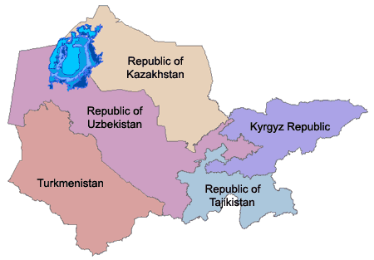
Background of the problem
Soviet period
administrative borders between the Central Asian Soviet republics were considered to be provincial
60 reservoirs with a total storage volume of 64.5 km are found in the Aral Sea basin.
Syr Darya runoff 100% regulated; Amu Darya runoff 80 % regulated
(i) Water allocation quotas for each republic and every irrigation project established and strictly controlled by the USSR Government,
(ii) planned deliveries of energy to the Kyrgyz and Tajik Soviet Republics for use in the winter.
Post-Soviet period
Date | Initiative
October 10-12, 1991 | Ministerial conference in Tashkent
February 18, 1992 | Agreement on Cooperation in Joint Management, Use and Protection of Interstate Sources of Water Resources between 5 republics. the principal source of the current water problems in Central Asia.
1998 | Energy-water agreement was signed by the four countries (Kazakhstan, Kyrgyzstan, Tajikistan and Uzbekistan) sharing the Syr Darya
1998- 2002 | The 1998 Agreement acts
2004-2006 | ad-hoc annual bilateral or multi-lateral energy-water agreements
October 2008 | The coldest winter in several decades. The deepest water-energy crisis at that moment. Point of no-return.

Slide 6
Institutions and common initiatives
The International Fund for the Saving of the Aral Sea (IFAS) founded by the Central Asian Presidents. Represents a single cooperative structure that includes all five countries
The Interstate Commission for Water Coordination (ICWC), formally under IFAS, is an important structure for the resolution of operational water distribution issues on the Amu Darya and Syr Darya under the 1992 Agreement
The ICWC Scientific and Information Centre (SIC),
Offices of the two Basin Water Management Organizations (for the Syr Darya and the Amu Darya)
When it comes to the major problems on the Amu Darya and Syr Darya, the influence of international projects and organizations has been minimal.

Slide 7
Conceptual framework
 | Downstream | Upstream
When | Spring-summer | Winter
Purpose | Irrigation | Power generation
Source of energy | Hydro-carbons | Hydro-power
Consequences of non-cooperative actions | Floods in winter Lack of water during irrigation period Environmental problems (salinization of soils) | Lack of energy in winter (blackouts and cold cities) Economic pressure and blockage.
Upstream-downstream «purpose» conflict
Conflict of water-use concepts (payment in currency/barter/no payment)
Conflict of young independent states
Conflict of authoritarism and sub-national cooperation
Acute ethnic conflicts in all 5 republics

Slide 8
Climate and environment framework
Aral sea catastrophe (1973,2000,2012) and salinization of soils
Melting Pamir glaciers
25% drop in Pamir glaciers between 1957-2000. In Tajikistan till 2025 ice space will decrease by 20%, ice water will decrease by 25%
Total water flows of Tajik major rivers decreased by 7%
Climate change: colder and longer winter, dryer summer

Slide 9
Stakeholders in CA water-energy disputes - 3 layers
Regional influence
Afghanistan 2014
Intraregional disputes
Neighbors hegemons & CA republics relations
Relations between regional and global hegemons on CA republics
Cheap hydroelectricity
Afghanistan 2014
Upstream-downstream
deadlock

Slide 10
Hydro-hegemony (M. Zeitoun`s concept)
‘Dominance’ is deﬁned as leadership buttressed by coercion. In contrast,
‘Hegemony’ is leadership buttressed by authority.
A successful hegemonic strategy builds cohesion and compliance by attraction rather than intimidation, but relies on an effective mix of the two.

Slide 11
IR and water conflicts
Within structural realist framework several options are possible:
Downstream hegemon - established basin regime, formal agreements, which protect hegemon interests
Upstream hegemon - formal agreements are rare, basin regime is less probable
No hegemon - status quo or rising instability, high risk of political conflicts
Central Asia faces this challenge of no-hegemon situation for two last decades and there is no evidence that this hegemon will occur in recent years
External hegemons (development of the concept)

Slide 12
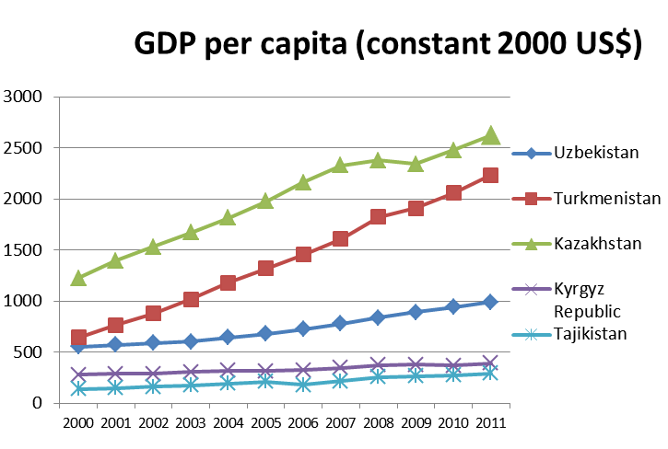
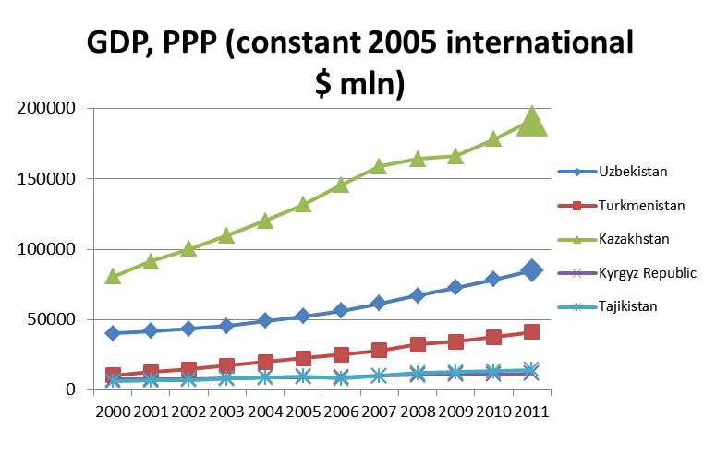
No-hegemon in Central Asia
Downstream countries better perform economically, but among them Uzbek-Kazakh rivalry is far from defining a hegemon
Poor Tajikistan and Kirgizstan control the majority of Uzbek, Kazakh and Turkmen water flow
Population | 1992 | 2002 | 2012 | 2050
Uzbekistan | 21,500 | 25,275 | 28,077 | 35,438
Kazakhstan | 16,431 | 14,902 | 16,381 | 21,210
Tajikistan | 5,519 | 6,286 | 7,079 | 10,745
Kyrgyzstan | 4,476 | 5,003 | 5,448 | 7,768
Turkmenistan | 3,882 | 4,600 | 5,170 | 6,639
Central Asia | 51,808 | 56,065 | 62,155 | 81,799
1992-2010 | 20.0%
2010-2050 | 31.6%

Slide 13
New vision

Slide 14
Why Central Asia: key reasons for “stakeholders”
Hegemons` demand for:
Cheap hydro-energy;
Sustainability of the region related to Afghan threat 2014;
Cheap water (for Iran nuclear sector).
Central Asian republics` demand for:
Multi-vector foreign policy;
Foreign direct investments;
Strong external support in intra-regional disputes.

Slide 15
New phase started in 2012
Fall. Russian initiative (6 treaties signed by V.Putin with Kyrgyzstan, financial aid to Kyrgyz and Tajik military reform)
Chinese role in this new broader context, new treaties with Uzbekistan for $5.6 bln.
Spring. Iran`s initiative in Tajikistan

Slide 16
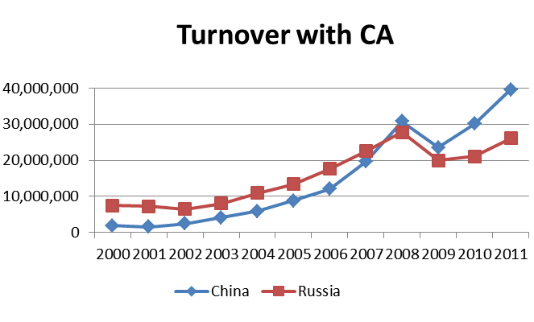
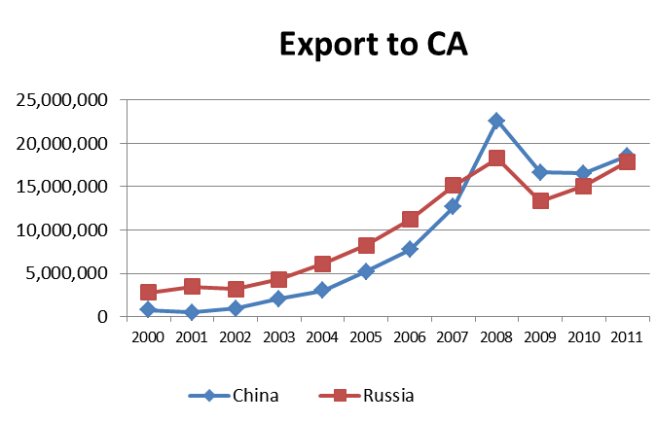
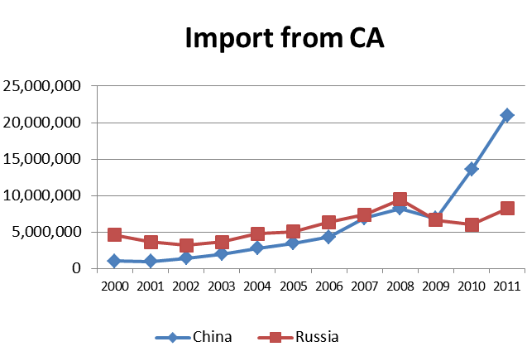
Russia and/Vs China in Central Asia
 | Import |  | Export |  | Turnover
 | Russia | China | Russia | China | Russia | China
Kazakhstan | 5.0 | 15.3 | 12.9 | 9.6 | 17.9 | 24.9
Kyrgyzstan | 0.4 | 0.1 | 1.2 | 4.9 | 1.5 | 5.0
Tajikistan | 0.1 | 0.1 | 0.7 | 2.0 | 0.8 | 2.1
Turkmenistan | 0.2 | 4.7 | 1.1 | 0.8 | 1.4 | 5.5
Uzbekistan | 2.5 | 0.8 | 2.0 | 1.4 | 4.4 | 2.2
Central Asia | 8 | 21 | 18 | 19 | 26 | 40

Slide 17
Russia and China as energy importers
Both countries demonstrate rising demand for Central Asian hydro-energy as well as on traditional oil and gas resources.
Russia has used to import electricity from Kazakhstan for its South Siberian and Ural regions. Carbon fuels are mostly imported for European re-export.
Chinese import of electricity is oriented for Xinjiang Province, while gas pipelines lie till mega-cities on the East coast. There is no stimulus to stretch electrical lines over at least 6000 km.
Both Russia and China are interested in producing hydro-energy on controlled hydropower stations in Central Asia in order to export it to South Asia (both within CASAREM project and by independent grids).

Slide 18
Russia and upstream states
Steps towards Central Asia and its water
Joint electric lines with Central Asian circle (through Kazakhstan)
Kambarata-1,2
Soviet heritage in terms of soft power
Difficulties
Insufficient resources compared to China
Unstable partners in political issues
Damaged reputation after Rogun 10-years unfinished and quitted project
Methods
Close relation between hydro-power projects and military interest of Russia

Slide 19
China and upstream states
Steps towards Central Asia and its water
Major economic partner and investor
Investments in small and medium-sized hydropower projects;
Difficulties
soft-power in the region is weaker than an economic one (hard)
No security and political issues covered
Methods
Cheap credits
«All inclusive projects» (Chinese capital, workers, machinery and buyers)
Infrastructure projects tying up Tajikistan and Kirgizstan to new South markets

Slide 20
Russia, China and downstream states
Reservoir programs
Involvement in upstream projects (Mekong method)
Intra sub-region balancing (Kazakhstan Vs Uzbekistan)
Chinese policy of «locking the network»

Slide 21
Iran
Steps towards Central Asia and its water
Intentions to build a water-pipe and to import directly 1 bln cubic m. of water from Tajikistan in exchange of energy export, investments
Infrastructure and political cooperation within “pharcy family’
Difficulties
Strong sanction pressure, difficult internal situation;
Sunni-Shia issues
Caspian disputes

Slide 22
Rogun & Kambarata-1,2
 | Rogun | Kambarata-1,2
Location | Tajikistan | Kirgizstan
River | Vakhsh | Naryn
Main purpose | Initial purpose – Irrigation; Current purpose – power generation | Power generation
Particularities | Planned as a highest dam in the world; some works were started before the collapse of USSR. | Cascade dam, situated upper than Toktogulka and other power stations.
Estimated Capital expenditures | $2,2 bln | $2 bln
 | Risk of overexpenditures (over 50%) is considered as very high
Power capacity | 3600 MWt | 1900+360 MWt
Current situation | Tajik part is looking for investors | Treaties between Russia and Kirgizstan signed in 2012. Technical expertise will be launched soon.
Transboundary disputes | Uzbekistan continues to oppose Rogun project and demands for international guarantees. World Bank Expertise is in progress. | Downstream states are invited to participate in the project. Major concerns of Uzbekistan relate to the period of filling the reservoir

Slide 23
Non-cooperative strategies
 | Upstream states | Downstream states | Other stakeholders
Short-term political bargaining | Transit pressure | Economic pressure on upstream neighbors | -
 | Provision of international guarantees for projects on international rivers | Rely on powerful partners outside the basin to bloc upstream initiatives | Direct political impact
Long-term real solutions | Construction of independent sources of electricity | Construction of water reservoirs | Investments, technologies, demand, provision of security
 | Barter water-energy trade with new partners | Exploitation of groundwater aquifers
Violated conflict (or war) over water is not considered as a real opportunity despite I.Karimov`s declarations. Any regional or global hegemon is not interested in new armed conflict in the region bordering Afghanistan.

Slide 24
Cooperative strategy
 | Upstream states | Downstream states | Other stakeholders
Lost opportunity | Soviet style Agreement jointly for water and energy in all 5 republics |  | -
Possible current opportunity | Investment participation in opposite projects |  | Mediation
Future challenge | Sustainable economic cooperation on demand of neighbor hegemons |  | Political pressure

Slide 25
Examples of good cooperation on the use of transboundary water resources in Central Asia
In 2000, an agreement was signed between Kazakhstan and Kyrgyzstan on the use, repair and maintenance of dams and other water infrastructure used by both countries on the Chu and Talas rivers.
Kazakhstan: obligation to co-fund repair and maintenance of a number of canals, dams and water reservoirs owned by Kyrgyzstan but that are part of the common water distribution system serving both countries.
This agreement has been successfully implemented. The Chu Talas Water Management Commission set up by the two countries with assistance from the UNECE and the OSCE is based on two crucial principles:
the countries have agreed to follow inter-country water allocation schemes and schedules applied in the Soviet era;
the downstream country, i.e. Kazakhstan, must reimburse the upstream country (i.e. Kyrgyzstan), for a part of its maintenance and operation costs of water infrastructure proportional to the volume of the water delivered by that infrastructure.

Slide 26
Conclusions
20 years status quo over water evolves
Central Asian republics are developing multi-vector foreign policy (especially in investments issues)
There is no direct competition between Russian and China in Central Asian hydro-power projects at the moment
Realization of hydro-power projects will lead to increasing military influence of investor-states.
Simultaneously third parties joined the big game, and each country acts as a hegemon for Central Asian republics (for all or part of them)

Slide 27
Future development of the case-study
Role of non-neighbor actors: USA, European Union?
Role of neighbor actors, currently less involved in the region: India, Afghanistan and Pakistan?
SCO and CSTO as negotiation rooms?
Eurasian economic union and OBOR initiative?
ISIS factor?

Slide 28
Team discussion
Form 5 teams: China, Russia, CA – downstreamers, ca-upstreamers, EEU – 3 min.
Task 1. Clearly formulate your own interest in CA-water issue – 5 minutes
Task 2. Provide 3 instruments to smooth (or solve) the problem – 10 minutes
Task 3. Define resources that you are ready to spend (economic, political, military if needed) – 10 minutes
Task 4. Chose a playground for negotiations and rpove why: bilateral, new NGO, SCO, OBOR, EEU, EEU+, etc. – 10 minutes
Present your position.

Slide 29
Thank you for your attention!

