Slide 1
Maritime security issues in US-China relations
A.Pyatachkova,
NRU HSE “US and Global Governance” Research Group presentation in ECNU

Slide 2
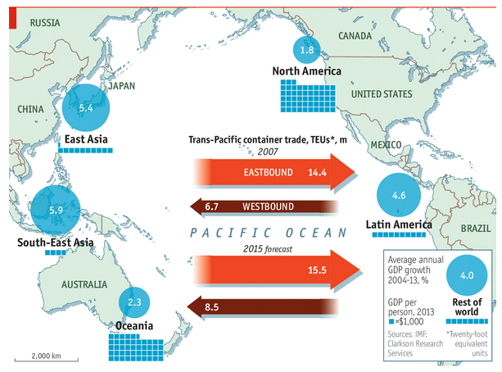
The role of maritime security in world economy and international relations
The Pacific Age (special report)/ The Economist, November 15, 2014 - http://www.economist.com/news/special-report/21631795-under-american-leadership-pacific-has-become-engine-room-world-trade

Slide 3
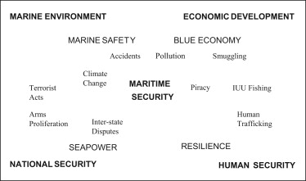
The notion of maritime security (C. Buerger)

Slide 4
The role of International Law
UNCLOS (1982)
Declaration on Conduct of Parties in SCS (2002)
Code on Conduct of Parties in SCS(?)
Regulation vs Different Interpretation

Slide 5
US and China interests*
 | Китай | США
Interests | unification of Taiwan with the mainland; territorial interest in the South China Sea, the East China Sea, and the Yellow Sea; safeguarding maritime resources; protecting maritime trade and infrastructure. To defend and facilitate these interests | protecting critical maritime-related infrastructures; preserving freedom of navigation; facilitating and defending commerce; safeguarding the ocean and its resources; protecting allies; strengthening maritime hegemony
Limits | Taiwan separatists still seek Taiwan independence; several countries claim sovereignty over China’s territorial waters; the US intends to intervene in territorial disputes; US military reconnaissance activities in China’s EEZ or close to its coast; US military exercises close to China’s maritime infrastructure, military bases, and important cities; illegal fishing; piracy; WMD and nuclear materials proliferation; organized crime; greenhouse gases and pollution. | terrorism; WMD proliferation; illegal seaborne immigration; blockades of important trading hubs and strategic chokepoints by hostile nations; illegal exploitation of resources; transnational crimes; piracy; PLA efforts to field robust anti-access/area-denial capabilities; maritime disasters such as typhoons, tsunami, earthquakes; greenhouse gases and pollution
*Fan Gaoyue. Maritime Interests: China-US Cooperation and Conflicts // Issues and Insights Vol.11-No. 10, 2011 - http://csis.org/files/publication/issuesinsights_vol11no10_English.pdf

Slide 6
US and China interests*
Общие | defending critical maritime-related infrastructures; protecting and facilitating maritime trade; protecting sea lines of communication and maintaining freedom of navigation; safeguarding the ocean and maritime resources. China and the US face the same threats and challenges: terrorist attacks; piracy; transnational crimes; WMD and nuclear materials proliferation; illegal seaborne immigration; illegal exploitation of resources; maritime disasters such as typhoons, tsunami, and earthquakes; greenhouse gases and pollution
Различные | Taiwan; territorial water disputes; the right of innocent passage; maritime hegemony.
*Fan Gaoyue. Maritime Interests: China-US Cooperation and Conflicts // Issues and Insights Vol.11-No. 10, 2011 - http://csis.org/files/publication/issuesinsights_vol11no10_English.pdf

Slide 7
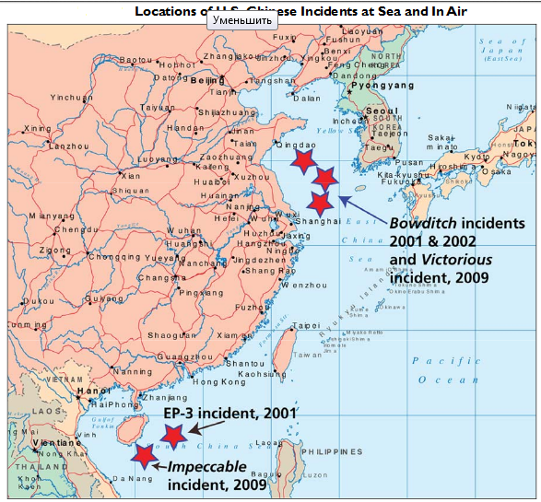
US-China Incidents at Sea and in the Air (examples)
Source: Mark E. Redden and Phillip C. Saunders, Managing Sino-U.S. Air and Naval Interactions: Cold War Lessons nd New Avenues of Approach, Washington, Center for the Study of Chinese Military Affairs, Institute for National Strategic Studies, National Defense University, September 2012.

Slide 8
Positive cooperation (examples)
Not only clash of interests, cooperation (mostly non-traditional treats)
Piracy (ReCAAP, etc.)
Container Initiative

Slide 9
Conclusions
The perception of maritime security in the US and China differs in terms of interpretation
There not only clashes of interests but also common interests of the US and China in maritime security sphere (non-traditional threats) and cooperation on them
However, most likely in the near future US-China interaction on maritime security will mostly develop as competition rather than cooperation

Slide 10
THANK YOU FOR ATTENTION!

