Slide 1
Shaping Consolidation: Influence of Political Polarization on Voting in the United Nations
APSA Virtual Research Meeting
Daniil Goncharenko, Lev Sokolshchik, Vadim Ustyuzhanin
HSE University
The publication was prepared within the framework of the Academic Fund Program at HSE University (grant №26-00-089 “Assessing the impact of domestic political polarization on the foreign policy of states and associations of the collective West in the medium and long term: challenges andopportunities for Russia and China”).

Slide 2
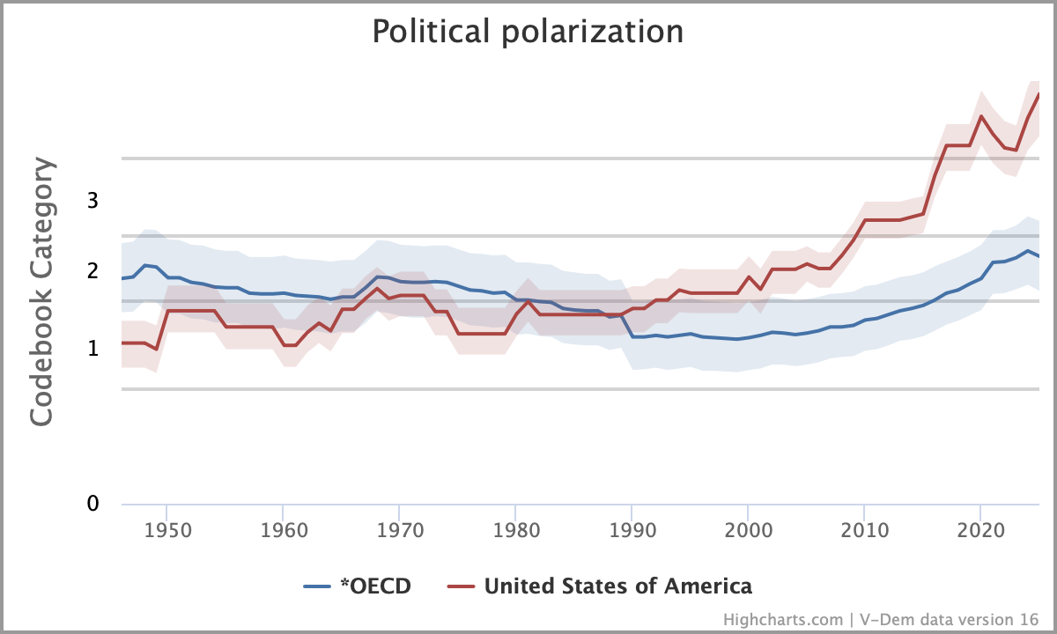
Conceptualization
Political (affective) polarization is a state of society, in which bipolar political groups have a negative perception and distrust towards each other, leading to animosity, extending beyond policy disagreement and affecting social relations (Iyengar, et al. 2012).

Slide 3
Relevance
Although there is a growing number of works suggesting that political polarization in the US undermines allies’ assessment of US credibility and assurance (Perrings, Hechter, and Mamada 2021; Dodge 2024), the evaluation of this effect has been made mainly through theoretical (Friedrichs and Tama 2022) or survey assessment (Myrick 2022).
At the same time, research has been conducted on the links of political polarization and decreased international cooperation and coordination, and general stability of the world order (Frieden 2021; Hefeker and Neugart 2023).
But these two frameworks were not yet tested on the voting patterns in the United Nations General Assembly – one of the key markers of international cooperation.

Slide 4
Q&A

