Slide 1
Prospects of regionalization in NEA in terms of security structure and cultural integration
GROUP 3
Ryo Takahama
Kyoko Fukuyama
Ekaterina Vaseneva
Polina Onikienko
Ekaterina Artemenko

Slide 2
RESEARCH QUESTION
What are the prospects of regionalization in Northeast Asia in security and cultural domains?

Slide 3
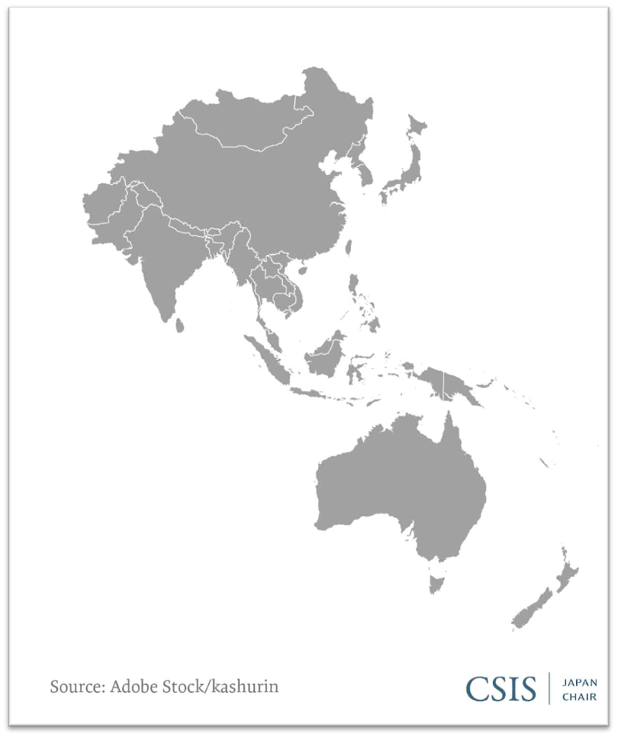
How to facilitate the process of regionalism in NEA
Multilateral security regime?
The Quad as an effort to create a multilateral security regime aimed at China’s containment
The Indo-Pacific as a symptom of regionalisation in Northeast Asia

Slide 4
From the Asia-Pacific to the Indo-Pacific
•An Pacific-Basin Community concept
•The proposal of Asia-Pacific Cooperation (APC)(1988)
•The establishment of the Asia-Pacific Economic Cooperation (APEC)(1989)
•The proposal of Asia-Pacific diplomacy (1992)
•The final report of the study group set by Prime Minister Kiichi Miyazawa
Japan’s “Free and Open Indo-Pacific strategy” proposal
PM. Abe’s speech in the TICAD (Aug. 2016)
Australia-India-Japan-U.S. Consultations on the Indo-Pacific
Abe-Trump Joint Press Conference in Tokyo (Nov. 6, 2017)

Slide 5
Opportunities
•Consolidation of US allies, including Japan and Korea
•Strengthening the Japanese-American alliance
•Containment of China
•Increased competition for infrastructure projects
•Creating a system of “balance of threats”, similar to the bipolar Cold War system
Threats
•The further expansion of China’s influence
•Escalation of territorial disputes in SCS and ECS
•The new juncture of the Sino-US trade war
•Polarization of the region
•Disruption of regional institutes for cooperation
•Deterioration of the North Korea’s denuclearization program
•Nuclear threat
•Strengths
•Synchronizing approaches to the Indo-Pacific
•Strengthening cooperation after the ascension of Joe Biden's administration
•Strengthening the Japanese-American alliance
•Common perception of China's threat
•Existence of territorial disputes with China
Weaknesses
•Lack of mutual trust
•Devergent approaches
•The question of leadership: Japan or the U.S.?
•Japan, Australia and India's hedging behaviour
•Undermining the ASEAN Centrality
•Envisaging the New Cold War

Slide 6
The Quad, the Indo-Pacific and regional institutions

Slide 7
Implications for Northeast Asian Countries
Russian perspective
01
promoting ASEAN centrality
North Korea denuclearization
Alienating India within its «non-alingment» policy
Cooperating in implementing nor «rules-based order» but the«institution-based order»
02
03

Slide 8
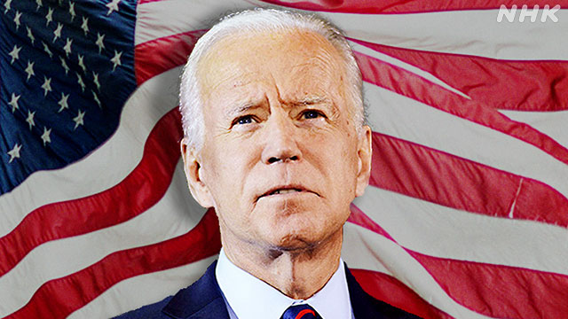
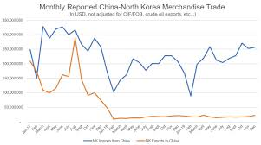
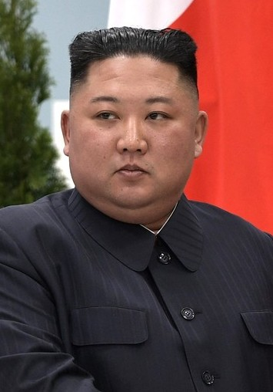
Establishing a Regional Framework for a Multilateral Regime to Control the North Korean Nuclear Power

Slide 9
The Present Risks with the North Korean System
★As of early 2020, it is estimated that North Korea has an arsenal of approximately 30-40 nuclear weapons.
★North Korea has the possibility to spread the nuclear arms for the other countries which aim for the nuclear powers. e.g.) Syria

Slide 10
Suggestions which NEA and the U.S. made before
The United States tried to make North Korea to join NPT (1985)
North Korea allows a team from the International Atomic Energy Agency (IAEA)
"Agreed Framework"
….etc
New: Feb 19th, 2021 The U.S., the South Korea, and Japan agreed the idea to aim for
denuclearization

Slide 11
NOT NUCLEARIZATION, BUT CONTROLLING
Establishing a Regional Framework for a Multilateral Regime to Control the North Korean Nuclear Weapons
×denuclearization
・・・takes much time, difficult to decide when and where to proceed, unrealistic ( considering the history)

Slide 12
This is my difficulty to write an essay
HOW should NEA cooperate?
Which country should mainly lead this Regional Framework to success ?

Slide 13
How to facilitate the process of regionalism in NEA
Multilateral security regime, realistic?
Bilateral approach to advance regionalism in NEA
Russo-Japan security corporation

Slide 14
Contemporary challenges to the security policy of Japan in post-Corona era
Global Power Transition
US domestic constraints
US-led containment of China
The signs of relative weakening of the US-Japan alliance after Covid-19
The US’s inward-looking atitudes accelerated by the pandemic
Free and Open Indo-Pacific strategy will cause security dilemma

Slide 15
Japan’s motivation to incorporate Russia into its security framework
01
To supplement its security partner
Japan’s desire to strengthen its national security by diversifying security partners
02
To neutralize emerging Sino-Russo front line
Beijing and Moscow share a hostile view of the US-led global system that is so vital to Japan
03
To seek an alternative energy route
Japan hopes to reduce energy vulnerability by diversifying energy routes

Slide 16
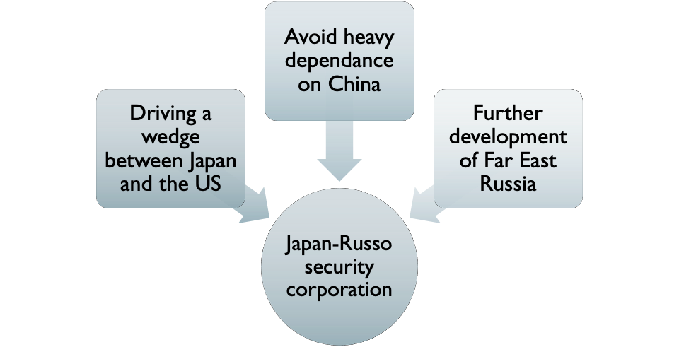
Russia’s interests in active engagement with security corporation with Japan

Slide 17
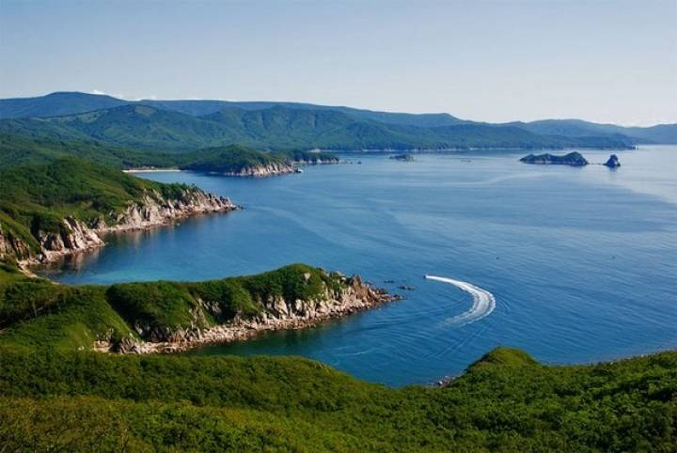
TOURISM AS A CULTURAL INTEGRATION
Russian Far East
‘The closest Europe’ for the countries of NEA; pure Asia for the European part of Russia.
Has a significant potential for the development of all types of tourism and a low level of its use.
Characterized by unique natural and climatic features, rich historical heritage and promising territorial location.
Cross-border tourism in Russian Far East and Northeast Asia regionalization

Slide 18
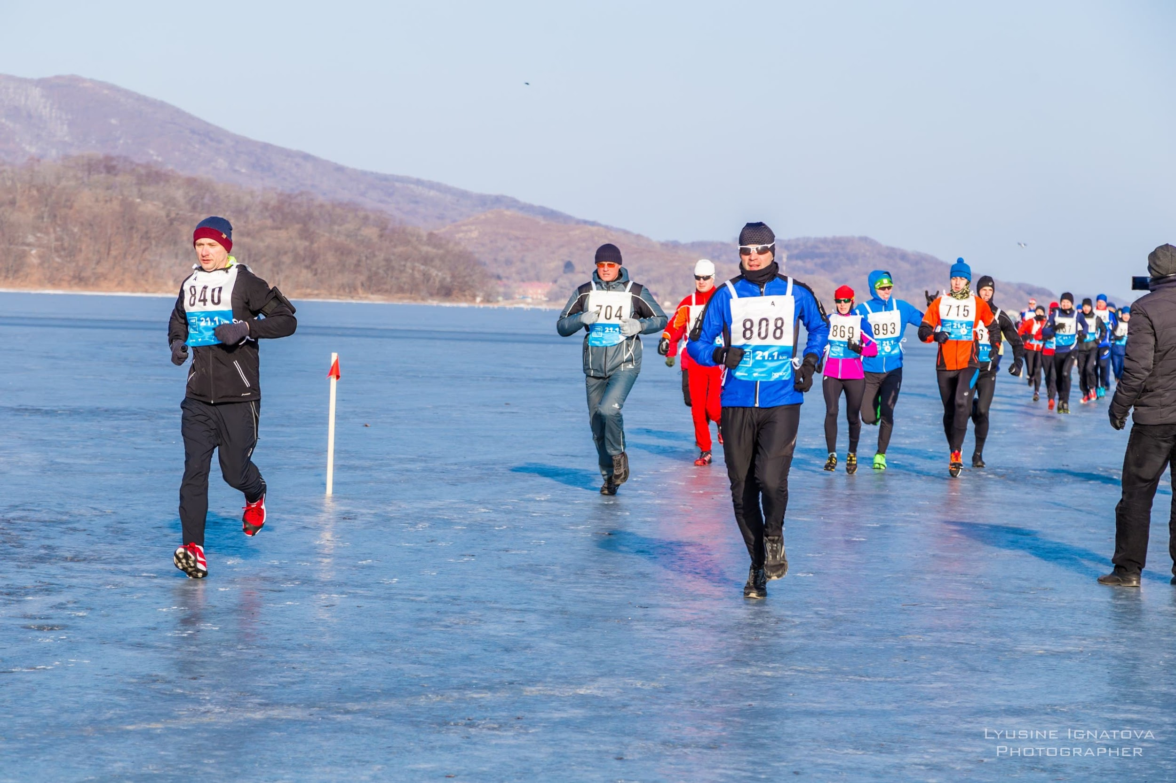
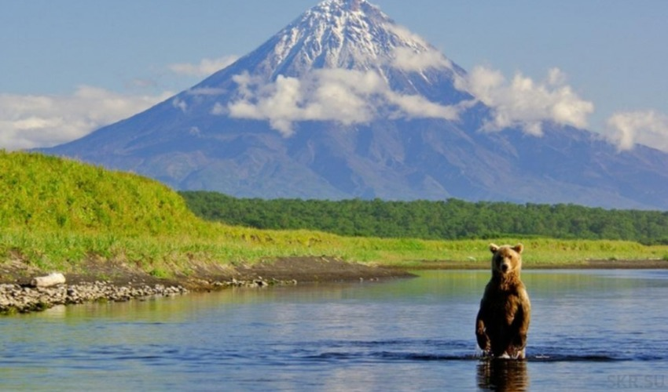
INBOUND TOURISM
Russian Far East and NEA countries
Adventure tourism
Culinary tourism
Cultural tourism
Ecotourism
Event tourism
Incentive tourism

Slide 19
MAIN TENDENCIES AND MAIN CHALLENGES IN TERMS OF TOURISM
Russian Far East and NEA countries
Overall in 2019 (on Primorsky Region example):
PRC - 382.4 thousand visitors.
The Republic of Korea - 245.6 thousand tourists (an increase of 41%).
Japan - 28.7 thousand visitors (65% higher compared to 2018).
Main challenges:
Inadequate infrastructure (not only within the regions, but also within the cities).
Lack of high-class hotels (in Vladivostok - only one 5 star hotel - LOTTE Vladivostok).

Slide 20
TOURISM AND COVID-19
Russian Far East and NEA countries
Statistics for the 1st quarter of 2020 (on Primorsky Region example):
China – 11.844 visitors (reduce of 4,43 times; the same quarter of 2019 – 52.455 visitors).
The Republic of Korea – 22.117 visitors (reduce of 2,08 times; 2019 – 45 965).
Japan – 4690 visitors (the only country, showed an increase; in 2019 – 3161 visitors).
After the COVID-19 pandemic is finally over, it is widely predicted that tourism from NEA countries in Russian Far East will return to its previous standards.

Slide 21
International student exchange
Russian Far East and NEA countries
Universities:
Far Eastern Federal University
North-Eastern Federal University named after M.K. Ammosov
Vladivostok State University of Economics and Service
Pacific State University
Komsomolsk-on-Amur State University
Amur State University named after Sholem Aleichem
Amur State University, Buryat State University
Pacific State Medical University
Far Eastern State Medical University
Amur State Medical Academy
Far Eastern State Transport University
Sakhalin State University
Kamchatka State University named after Vitus Bering
Kamchatka State University named after Vitus Bering
Transbaikal State University
Annunciation State Pedagogical University
Khabarovsk State University of Economics and Law
East Siberian State University of Technology and Management
https://hcfe.ru/study-in-the-far-east/universities-and-colleges/

Slide 22
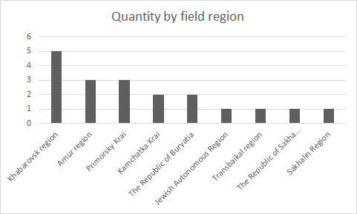
International student exchange
Russian Far East and NEA countries
https://hcfe.ru/study-in-the-far-east/universities-and-colleges/

Slide 23
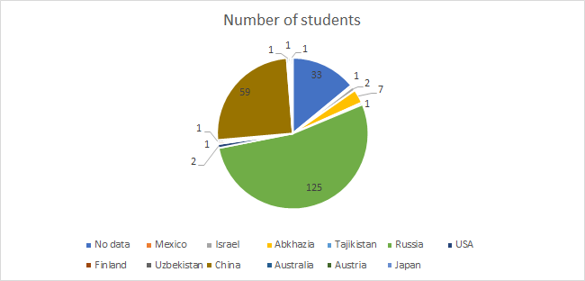
Statistics of Pacific State University
https://pnu.edu.ru/ru/ic/afg/statistic/country/

Slide 24
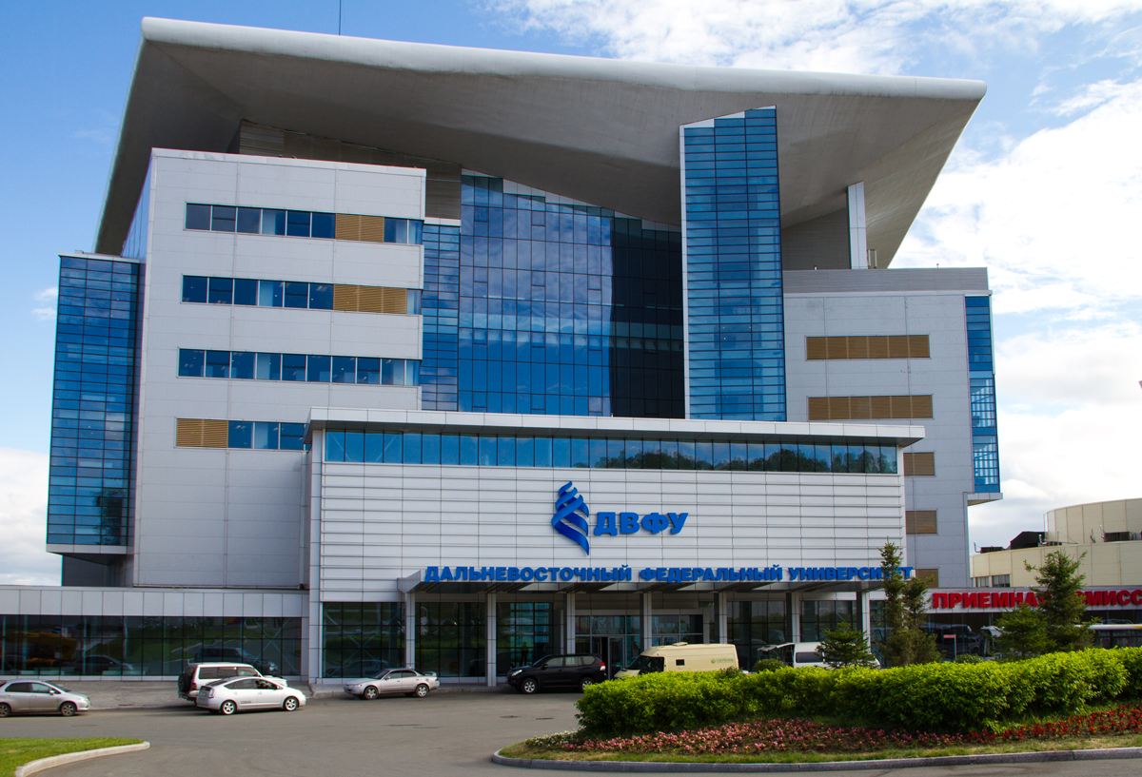
Far East Federal University
Tokai University Overseas Online Learning Program
the Open Doors International Olympiad
the Confucius Institute project
FEFU offices in Japan and China
https://www.dvfu.ru/international/

Slide 25
Functions of representative offices
1) Promoting the internationalization of the University and the expansion of its partner network in Japan and China;
2) Formation of a positive international image of the University, as well as assistance in increasing the recognition of its brand in the countries of NEA;
3) Interaction with Japanese educational institutions, authorities, representatives of the business community in order to develop cooperation with FEFU;
4) Promotion of FEFU educational products in Japan and China and informing Japanese and Chinese applicants about the opportunities to study at the University;
5) Organization and implementation of exchange programs for students, researchers and teachers between FEFU and foreign educational institutions;
6) Creation of conditions for the formation of scientific teams for joint scientific research with foreign partners;
7) Promotion of the study of the Russian language and culture in Japan and China;
8) Promotion of FEFU as a communication platform for Russia in the Asia-Pacific region;
9) Development of cooperation between Russian and foreign high-tech businesses to promote technology transfer, as well as expanding the opportunities for young FEFU professionals to acquire practical skills in the development and implementation of high technologies as part of educational internships
https://www.dvfu.ru/international/

Slide 26
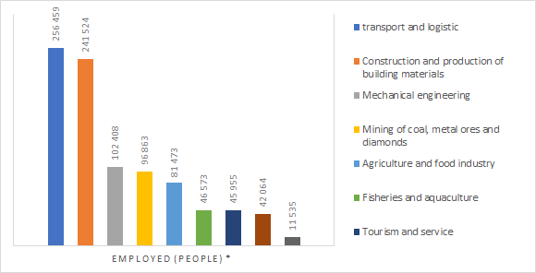
HOWEVER...
Attractiveness of the region
No activity in international student exchanges in other regions
https://hcfe.ru/study-in-the-far-east/navigator/

Slide 27
CONCLUSION
Bilateral corporation in the realm of security, especially Russo-Japan relation, is crucial to facilitate the process of regionalism in NEA.
Institutionalizing the multilateral security regime will play a key role in the regionalization in NEA.
Tourism and youth cooperation - parts of regionalization: extremely important economic and socioeconomic uniting factors, influencing the systems of countries’ multidirectional cooperation.
These are a serious global policy, thanks to which it is possible to resolve a number of international problems through "people's diplomacy".
International student exchange is really effective tool for creating a single cultural and economic region in Northeast Asia, but it still is not developed enough in Russian Far East.

Slide 28
THANK YOU FOR YOUR ATTENTION!
ご清聴ありがとうございました。
Спасибо за внимание!

