Slide 1
Trade and Economic Relations of Japan with the Countries of Northeast Asia in the Context of the COVID-19 Pandemic
By Aseev Artemy
Scientific supervisor: Prof. Ksenia A. Spitsyna

Slide 2
Objectives, subject, research question
Objectives:
Analyze the economic tendencies in NEA
Study the state of trade policy of Japan before the pandemic
The impact of pandemic on economy of Japan
And the effect on relations between NEA
Subject: trade and relations among NEA countries, Japan’s trade policy
The research question: are there protectionism features in Japanese trade relations with other NEA countries that may have merged due to the pandemic, and what is more important can it be considered as temporary trends in coronavirus circumstances or is it becoming a new economic reality for Japan and NEA region?

Slide 3
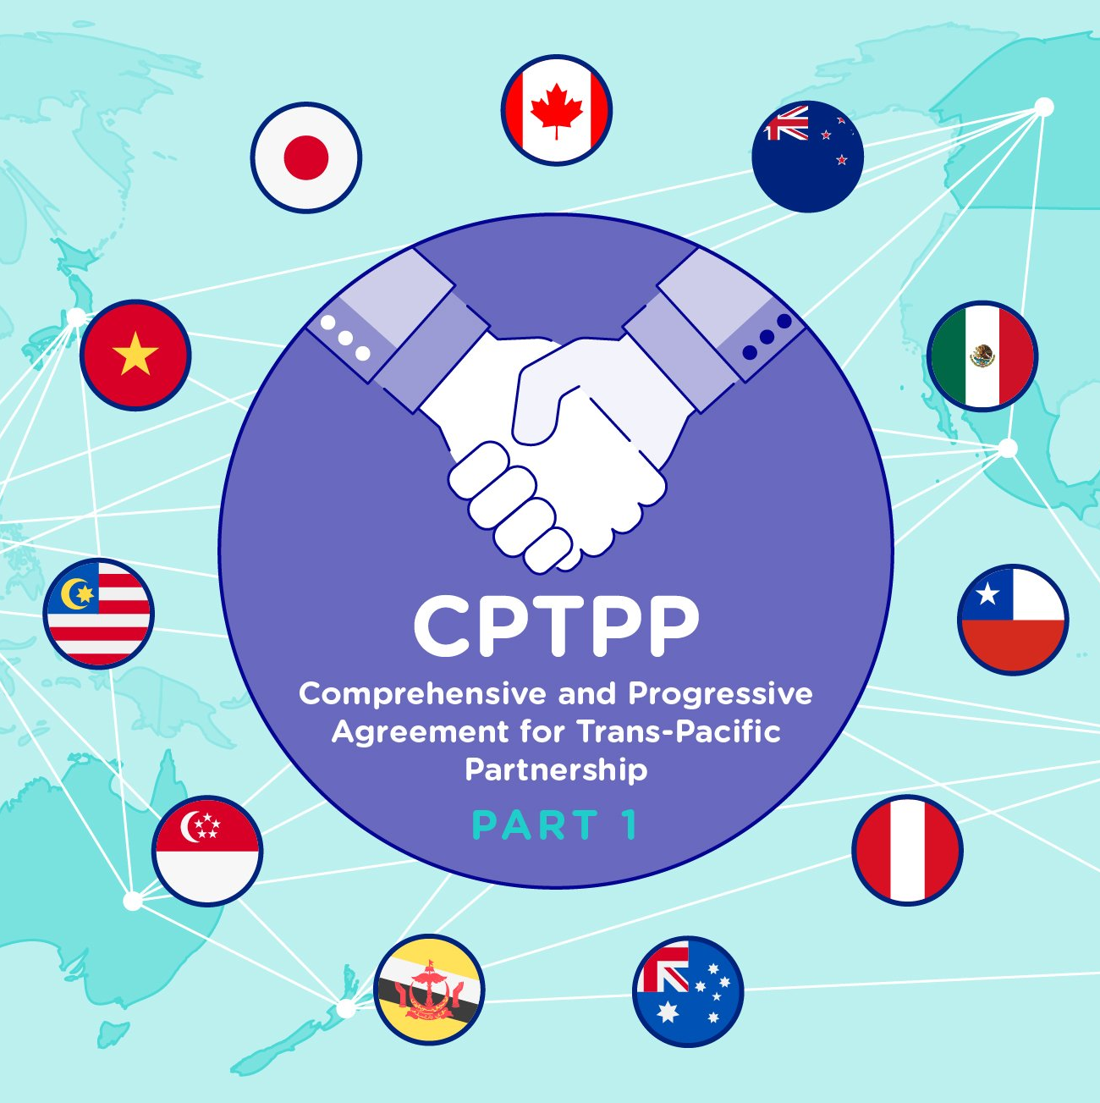
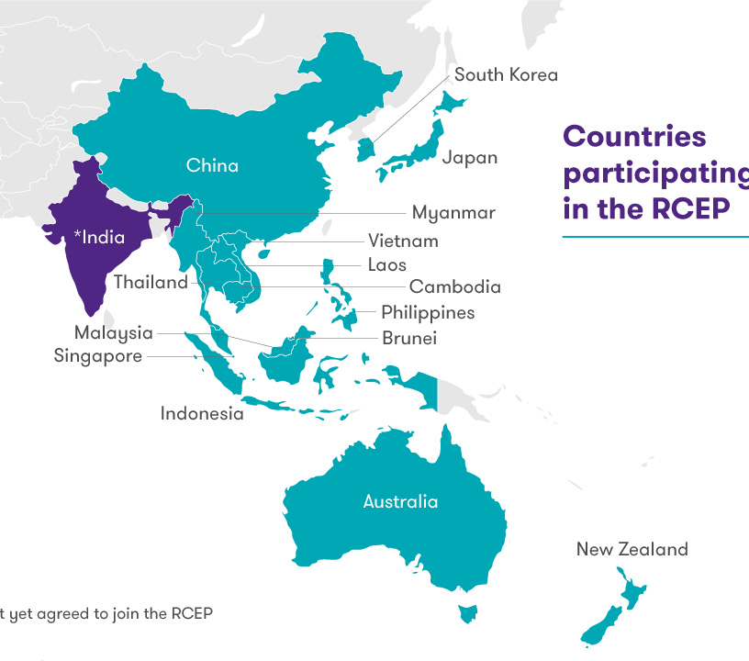
Introduction
Emergence of intra-Asian cooperation
The process of “decoupling” from global partners
Importance of RVCs for regional economy
CPTPP (Comprehensive and Progressive Agreement for Trans-Pacific Partnership)
11 countries of Asia-Pacific
High standards
RCEP (Regional Comprehensive Economic Partnership)
15 states (Asia + Australia, New Zealand)
Harmonization of rules of origin
Disruption of regional economy by the pandemic

Slide 4
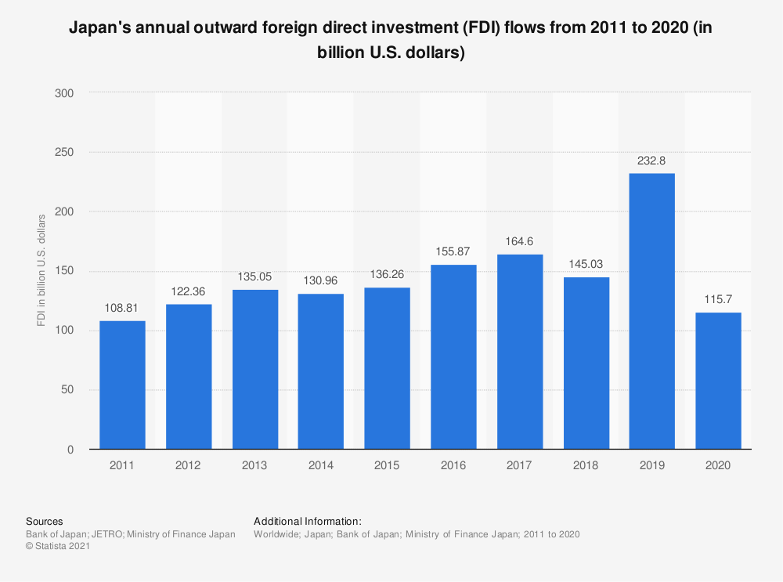
Pre-COVID situation in Japanese economy
Since the 1970-1980’s Japan constructs RSCs in SEA and China
Foreign economic activity as the moving force of Japanese economic growth
Half of the country’s GDP is based on foreign economic activity
Growing volume of FDI from Japan
However, there is protectionism for domestic market (FDI, agriculture)
These tendencies remain stable for the last few decades…

Slide 5
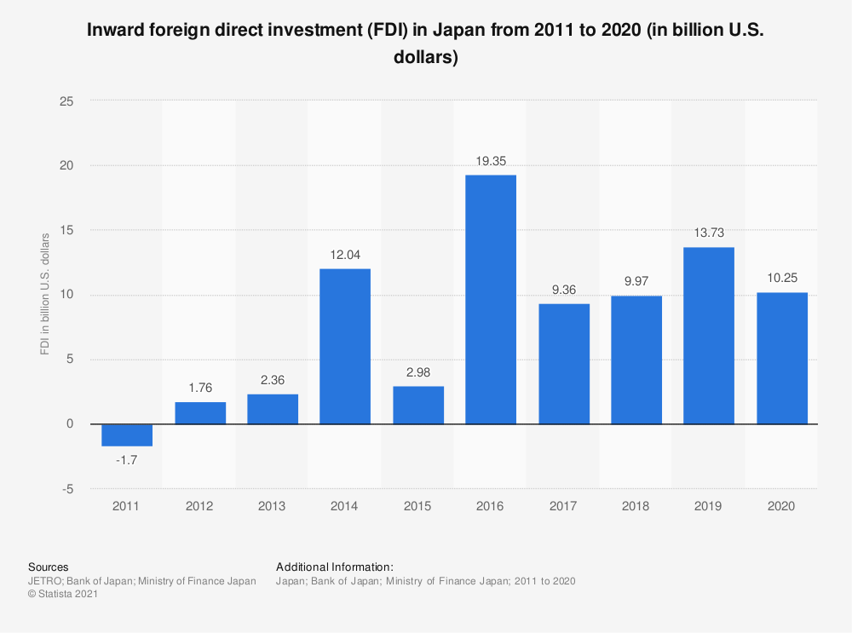
Pandemic impact on Japan’s economy
Global and domestic shock of supply
Disruption of RSCs
The export of Japanese engineering products decreased by 10-20%
A major drop in exports and imports, except for medical devices and masks
Overtaking the Chinese share in FDI to ASEAN countries
On the other hand, the flows of FDI to Japan have dropped significantly
- May 2020 – the amendments to the Law on Foreign Exchange and Foreign Trade

Slide 6
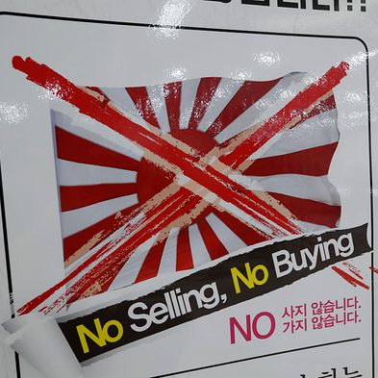
Aggravating tensions between Japan and South Korea
“Historical policy” of both governments
Territorial dispute over Dokdo\Takeshima islands
July 2019 – a trade war between Japan and ROK
Commercial disputes as the main background
Exclusion of ROK from the “whitelist” of Japan
ROK abandoned the General Security of Military Information Agreement (then backed it)
Nonetheless, the countries have agreed on participating in RCEP agreement
This case has shown the unpreceded level of rivalry in Asia. Trade tensions can still be considered as a core issue in relations between ROK and Japan, however the cooperation in RCEP framework is highly expected

Slide 7
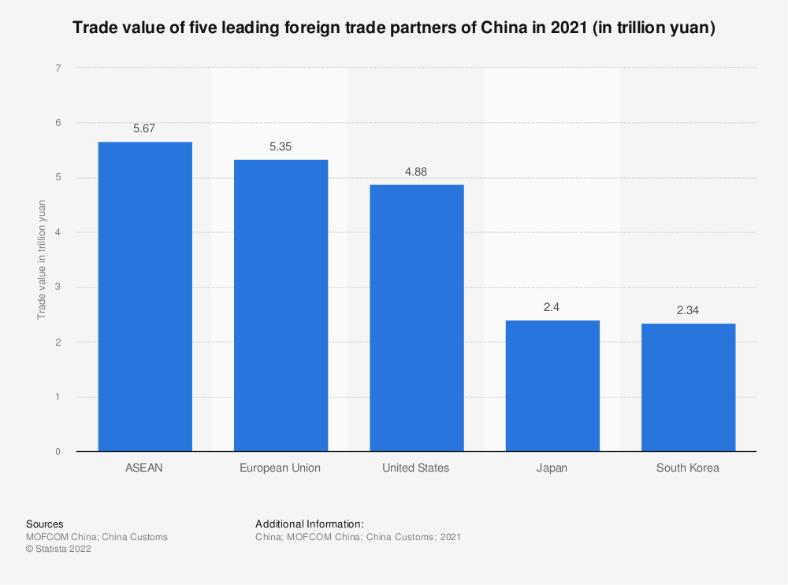
Trade and cooperation between China and Japan
The main trade partners
Disputes over CPTPP
In contrast, intensive cooperation and negotiations for RCEP
The process of “decoupling” brings Asian economies to intra-regional cooperation (closer Japan-PRC ties)
A reduction in the Chinese share of trade in the region
Competition between 3 leaders (Japan-ROK-China)
It is possible that China may become the center of trade and cooperation in Asia, thus mediating conflicts between rivaling states

Slide 8
Implications for a partnership with Russia
Low institutional base of cooperation between Japan and Russia
The pandemic has caused a significant drop in trade and FDI between countries
Sakhalin Energy Investment Company Ltd., – owed at 10% by Mitsubishi Group, and at 12,5% by Mitsui & Co.
On 2nd September 2021, Russian and Japan have signed an agreements for hydrogen, ammonia cooperation and Kamchatka LNG reloading
The main sector of economic partnership is hydrocarbon fuel. Russian level of engagement in regional economy is low, however, energy and raw materials are invariably in the focus of trade and economic cooperation

Slide 9
Conclusion
Intensifying competition between regional economic leaders, at the same time emerging cooperation under RCEP in the process of “decoupling”
The COVID-19 pandemic has aggravated the longstanding problems in the economy of Japan bringing another recession
Protectionism measures have become more prominent during the pandemic, however the core strategy on trade and economic partnership did not change significantly

Slide 10
Thank you for attention!

