Slide 1
COVID-19 pandemic and new economic realities in North-East Asia
Daniil Savchenko

Slide 2
Presentation plan
introduction
states ( Japan, PRC, ROK)
GPN
RCEP
conclusion

Slide 3
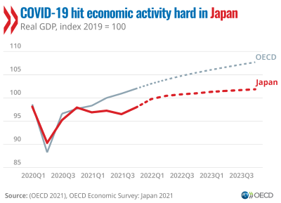
Japan
economy is recovering
GDP growth
broaden the digital transition
(OECD, 2021)

Slide 4
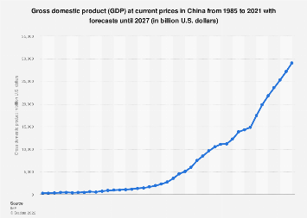
PRC
significant impact
GDP growth

Slide 5
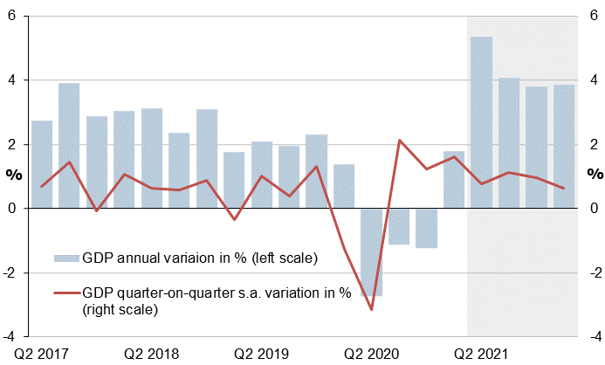
ROK
prompt and effective reaction
strong obstacles
digital technologies
(OECD, 2021)

Slide 6
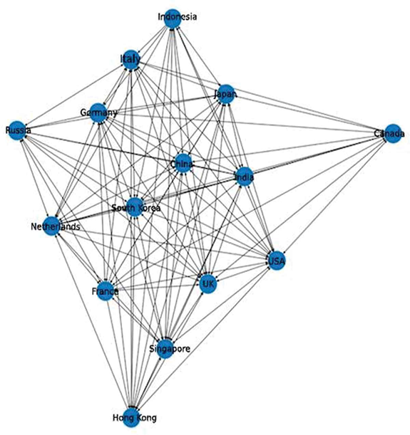
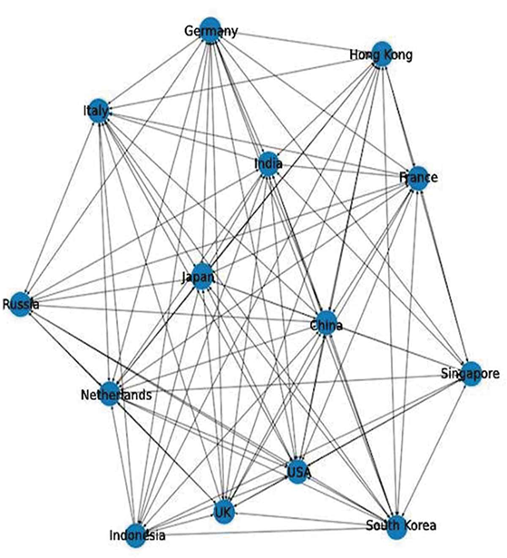
GPN
‘centre’ of the global supply chains
Covid-19 impact
notable changes
(Vidya & Prabheesh, 2020)

Slide 7
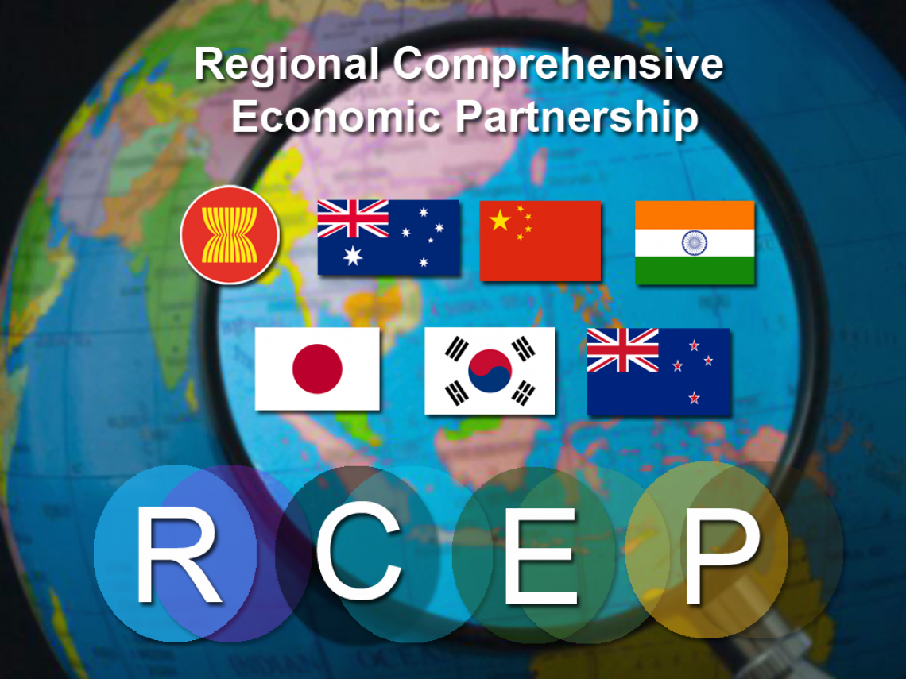
RCEP
assistance in recovery
three main points
deep connection

Slide 8
Conclusion
сountries coped with the pandemic quite successfully
economic situation in the region has changed
the role of RCEP

Slide 9
References
2022: PwC: Экономика Китая впервые опередит европейскую в 2022 году//available at: https://www.tadviser.ru/index.php/Статья:ВВП_Китая#.2..(accessed 20 February 2022).
Влияние пандемии на перспективы роста экономики в Китае//available at: https://www.project-syndicate.org/commentary/china-gr..(accessed 25 February 2022).
Dhar B. K. Impact of COVID-19 on Chinese Economy //Economic Affairs. – 2020. – Т. 9. – №. 3/4. – С. 23-26.
Japan: broaden the digital transition to strengthen economic recovery from COVID-19, says OECD//available at: https://www.oecd.org/newsroom/japan-broaden-the-digit.. /(accessed 20 February 2022). – 2020.
Petri P. A. et al. East Asia Decouples from the United States: Trade War, COVID-19, and East Asia's New Trade Blocs. – 2020. – №. WP20-09.
The Korean economy: resilient but facing challenges//available at: https://oecdecoscope.blog/2020/08/11/the-korean-econo..(accessed 22 February 2022).
Three Areas Where RCEP May Help the Region’s Post-Pandemic Recovery//available at: https://blogs.adb.org/blog/three-areas-where-rcep-may..(accessed 22 February 2022).
Vidya C. T., Prabheesh K. P. Implications of COVID-19 pandemic on the global trade networks //Emerging Markets Finance and Trade. – 2020. – Т. 56. – №. 10. – С. 2408-2421.

