Slide 1



Sustainable Banking
Introduction to Sustainable Banking
17 April - 17 June 2023

Slide 2
Course content
01
02
03
04
05
Sustainable Fintech
ESG Risk management
ESG in Retail Banking
ESG-banking: Organisation and products
Green and Social Loans
26.04.23
27.04.23
28.04.23
10.05.23
15.05.23
06
07
08
09
10
Sustainability-linked Loans
Sustainable Finance and Impact Investment
Sustainable Capital Market Instruments
ESG Ratings
Communications and advocacy in Sustainable Finance
18.05.23
22.05.23
23.05.23
25.05.23
29.05.23

Slide 3







Lecturers
Rosbank is on the leading banks in Russia
Included in the list of 13 systemically important financial instutations¹
TOP most reliable banks²
Alexey Ievlev
CORP DIR
37 000+ ATMs as a part of partner network, Including 1.5 thousand own
More than 10,000 corporate clients
Highest credit ratings from national and international rating agencies
RAEX | AKRA
ruAAA | AAA
Victoria Karpunina
Head of ESG-Banking
¹ Bank of Russia
² Forbes, 2022

Slide 4
Our goals
the Bank with a purpose to help our clients to transform achieve positive environmental and social impact by offering best-suited solutions and responsible products
is
Rosbank takes a considerate approach to ESG-issues in its core business by:
  Taking a risk-oriented approach in regards to environmental and social risks of our products;
  Increasing the quality and sustainability of our corporate portfolio;
  Developing and providing best-practice in responsible finance;
  Increasing our ESG-related indicators.

Slide 5
Our strengths
Rosbank is one of the pioneers in the development of environmentally sustainable and socially responsible finance in Russia
Sustainable finance
Responsible business
In-house ESG expertise based on international experience
Use of international standards and principles, including ICMA and LMA
Individual approach to our clients
ESG risk-oriented approach
Use of international standards and recommendations, including IMO, IFC and sector-specific standards
Implementation of responsible business approach and adaptation to climate change

Slide 6
01
Introduction to Sustainable Banking
Stakeholders, principles, regulations, instruments and trends

Slide 7
Sustainable development and main drivers

Slide 8
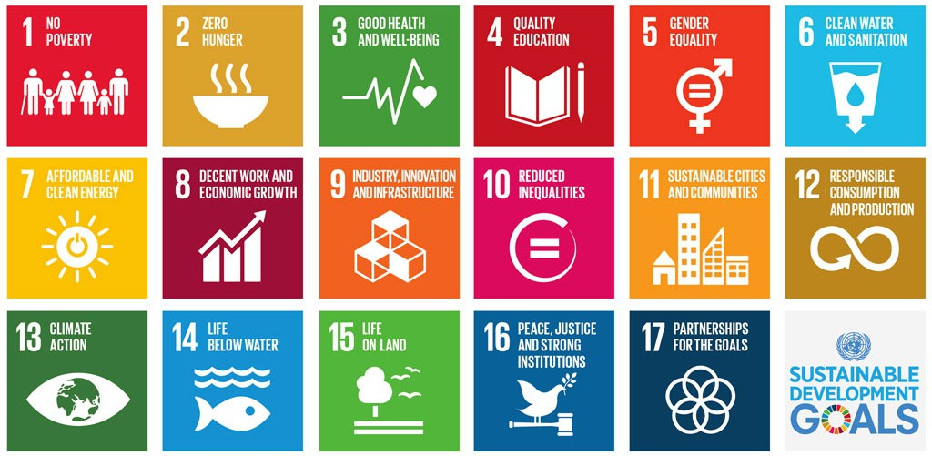
Sustainable Development
In 1987 Sustainable development was defined in the World Commission on Environment and Development's (Brundtland Comission) ´Our Common Future`report as 'development that meets the needs of the present generation without compromising the ability of future generations to meet their own needs'.
UN Sustainable Development Goals
2016-2030
PEOPLE
Social variables dealing with community, education, equity, social resources, health, well-being, & quality of life.
PLANET
Environmental variables relating to natural resources, water & air quality, energy conversation and land use
PROFIT
Economic variables dealing with the bottom line, cash flow

Slide 9

Three Pillars of ESG
The term ESG was popularly used first in a 2004 report titled "Who Cares Wins", which was a joint initiative of financial institutions at the invitation of UN. ESG refers to a set of standards for a company’s behavior to screen companies maturity and potential investments.
ENVIRONMENT
Greenhouse Gas Emissions (GHG)
Water Consumption
Energy Consumption
Product Carbon footprint
Renewable energy usage
Packaging and waste
SOCIAL
Human rights
Diversity Equity and Inclusion
Investment in communities
Data privacy
Access to career development
Advocacy
Зашить голосовалку
Назовите наиболее
Существенные Аспекты ESG
GOVERNANCE
Board makeup and independence
Shareholder rights
Fair wage gaps
Justifiable executive compensation
Transparency in policy

Slide 10
Drivers of ESG in Russia
After the closure of access to Western funding and the exclusion of Russian companies from European and American ESG ratings, the position of Western investors and companies ceased to be decisive in the formation of the ESG agenda in Russia.
Will set the ESG agenda after 2022 (in 3-5 years)
78%
70%
57%
26%
22%
Source: Barometer of Sustainable Business Transformation Kept and Eplus, 2022

Slide 11
Drivers of ESG in Russia (Corporate)
01
ESG Corporate activity in Russia, 2022-2023.
Polyus: publication of climate strategy to achieve carbon neutrality by 2050.
INK: publication of climate strategy with goals up to 2030.
Severstal: release of ESG strategy until 2030.
Uralkali: implementation of a responsible supplier evaluation system (50% of suppliers to be evaluated by 2025).
Examples of responsible finance, 2022-2023 гг.
December 2022: AEP has issued green bonds for 9 bn rubles. Demand for them reached up to 73 bn rubles.
December 2022: Rostelecom has issued social bonds for 10 bn rubles to refinance their communication infrastructure.
July 2022: Dom.RF has issued social bonds for 6.7 bn rubles, as part of their affordable housing programme.
February 2022: DOM.RF has issued geen bonds for 5 bn rubles, as part of their green building initiative.
Sustainable development and climate change remain their relevancy as part of local and international regulation
02
Funding for decarbonisation and energy transition in Russia will reach 18.7 trillion rubles by 2030
03
Introduction of CBAM and other carbon taxes in Asia-Pacific countries may lead to potential costs up to $875 million

Slide 12
Drivers of ESG in Russia (Regulation)
Development of regulatory environment
Expansion of “Ecology” national project
Mandatory GHG (Greenhouse Gas emissions) reporting
Regulation and standardization of climate projects
GHG quotas on Sakhalin
Subsidies for recycling and future ban on single use packaging
Russian Climate Strategy
Is a Member of the United Nations Framework Convention on Climate Change
Is a signatory of the Paris Agreement on Climate Finance
Has developed a climate strategy to reduce GHG emissions by 2050
Goals:
To Achieve carbon neutrality by 2060.
To reduce GHG emissions by 70% by 2030 (1990 as base year).
Development of national ESG infrastructure
Bank of Russia has expanded the range of ESG-instruments
Development of carbon market
Development of National ESG-ratings
Establishment of ESG-alliance
Responsible Finance
Sustainable development is identified as one of key issues in financial sector by Bank of Russia
Launch of ESG sectors on SPB Exchange
Actualization of “Green Taxonomy”
ESG-bonds issuance has amounted up to 106 bn rubles.

Slide 13
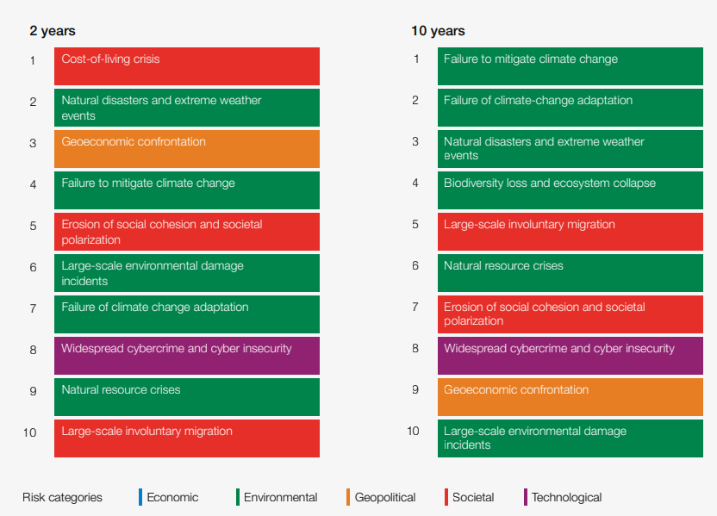
Why ESG factors are important
Global risks ranked by severity over the short and long term
Cost of living crisis and its economic and social implications dominate the global risks ranking in the next two years, while climate action failure dominates the next decade in a context of international economy.
Зашить голосовалку
Назовите наиболее
Существенные ESG риски

Slide 14
Context: Climate change risks
In 2016 World Economic Forum's annual meeting at Davos cited climate change as the biggest threat to the global economy.
From disruption to our products, services, supply chains, markets and asset values, to the acceleration of policy and regulatory change, we are waking up to the drastic action necessary to protect humanity, our planet, and our livelihoods.
Transition to a low-carbon economy will affect every single business and every one of our clients. Today, more than ever before, regulators need clarity, customers expect green standards to be met and employees choose to work for businesses that can demonstrate that their values and purpose are aligned.
Consequently, companies will need to implement change, manage risk and exploit new opportunities to protect their value and businesses for the future.
IMPORTANCE OF COMBATING CLIMATE CHANGE
31GT Greenhouse Gas emissions produced globally each year. That's equivalent to 8,139 coal power stations.
$4tn worth of assets will be at risk from climate change by 2030.
Physical consequences of climate change risk severely destabilizing social and economic structures across the world.

Slide 15
Sustainability in banking sector

Slide 16

Question:
Why do you think banks should care about ESG?

Slide 17
Financing of Climate Change in Russia
Total volume of necessary investments towards climate projects will reach 18.7 tn rubles by 2030 and 46,9 tn rubles by 2050.
01
02
Green Infrastructure
Technological development towards low-carbon economy
7.1 tn rub.
3.7 tn rub.
5.6 tn rubles are to be financed by the corporate financial institutions
03
04
Low-carbon and green energy
New technologies towards decarbonisation
5.5 tn rub.
2.4 tn rub.

Slide 18
ESG ecosystem of financial institutions
Society
Regulators/standard setters
The Government
Central bank
Stock exchanges
Suppliers/
third-party providers
ESG ratings and rankings:
Rating agencies
ESG indices
ESG data provider
Organisations & initiatives
Financial institutions
Organisations (UN, WEF, WB, OECD, ISSB)
Initiatives (UNGC, SASB, GRI, TCFD, ISSB)
Clients:
Corporates
Retail
FI
Other financial institutions:
Competitors
Correspondent banks
Investors
Shareholders
Employees

Slide 19
Principles of Responsible Banking
Created by the United Nations in partnership with founding banks in 2019, designed to be integrated into banks’ strategies and across their portfolio of activities, bringing purpose, vision and ambition on sustainable finance to the core of the organization.
01
Alignment
align our business strategy to be consistent with and contribute to individuals’ needs and society’s goals (the Sustainable Development Goals, the Paris Climate Agreement and relevant national and regional frameworks).
Impact and Target Setting
continuously increase our positive impacts while reducing the negative impacts on, and managing the risks to, people and environment resulting from our activities, products and services.
publish targets to have the most significant impacts.1
Clients and Customers
work responsibly with our clients and our customers to encourage sustainable practices and enable economic activities that create shared prosperity for current and future generations.
04
Stakeholders
engage and partner with relevant stakeholders to achieve society’s goals.
Governance and Culture
implement commitment to these Principles through effective governance and a culture of responsible banking.
Transparency and Accountability
periodically review individual and collective implementation of these Principles and be transparent about and accountable for our positive and negative impacts and our contribution to society’s goals.
05
02
06
03

Slide 20
Net-zero Banking Alliance
NZBA is the flagship climate initiative under the Principles for Responsible Banking to accelerate science-based climate target setting and develop common practice:
129 Banks
Transition the operational and attributable GHG emissions from their lending and investment portfolios to align with pathways to net-zero by 2050 or sooner.
Set 2030 targets (or sooner) and a 2050 target, with intermediary targets to be set every 5 years from 2030 onwards.
Annually publish absolute emissions and emissions intensity in line with best practice and within a year of setting targets, disclose progress against a board-level reviewed transition strategy setting out proposed actions and climate-related sectoral policies.
Take a robust approach to the role of offsets in transition plans.
41 Countries
$74 tn Total
Assets
41% of Global
Banking Assets

Slide 21
Sustainable Banking – Core business
Commitment To
Sustainable Development
Sustainable banking is a strategy that refers to banking and investment practices that pursue profit, while prioritizing social responsibility and environmental sustainability
Wholesale
Responsible Loans
Capital Markets
Investment
Retail
Green products
Financial education
Diversity and Inclusion
Social Responsibility
Sustainable procurement
Responsible Employer
Direct ESG impact
ESG/Climate Risk Management

Slide 22
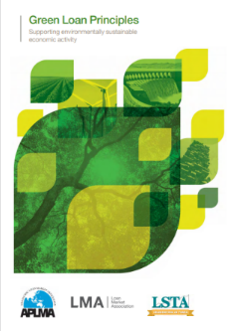
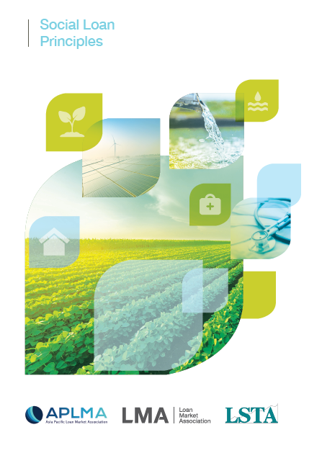

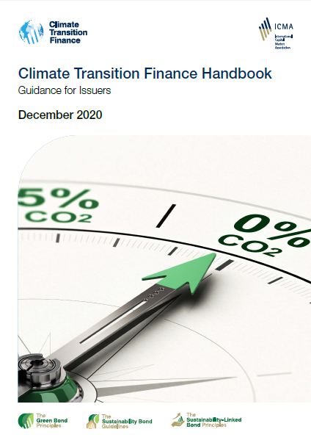
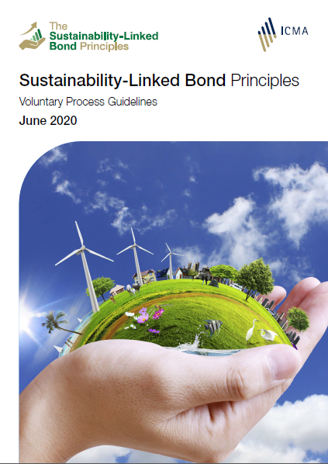
Responsible Wholesale
Regulation on responsible finance in Russia
Russian “Green” taxonomy*
In November 2021, the State Development Bank VEB.RF published the Russian Green Taxonomy. The Russian taxonomy covers waste management, energy, construction, industry, transport, water supply, biodiversity, and agriculture. The energy criteria include science-based thresholds for electricity generation, based on the recommendations of the technical expert group (EU TEG) on sustainable finance for the EU Taxonomy of sustainable activities.
* Taxonomy was updated in march 2023 with actualized scope of green projects
Bank of Russia security issuance standards
The Bank of Russia has prepared amendments to securities issuance standards in regards to issuance of sustainability bonds, as well as sustainability-linked and climate bonds.
Responsible bond issue regulation will factor in the first national taxonomy of green projects and the national verification of sustainable financial instruments, as well as comply with international principles and standards in the field of sustainable financing, such as ICMA and CBI.
There are two major types of lending:
Sustainability products: any type of lending instrument that focuses on financing green and/or social projects
Sustainability-linked products: lending instrument that incentivizes the borrower to achieve ESG targets
Loans
Bonds

Slide 23
Sustainable Development in Business
01
02
Placement and maturity
Transparency
  Areas of influence
  The company has assessed material topics and built a materiality matrix. A list of social and environmental topics on which the company has the greatest impact
05
  Non-financial reporting
  The Company discloses material non-financial information on a regular basis.
  The next step is an independent assurance of non-financial reporting.
Commitment
  Responsible financing
  Based on the ESG rating or KPI, SLL is structured in the company's strategy in the field of SD, its monitoring is carried out according to the data of audited non-financial reporting
  The right choice of a lender (for a bilateral deal) or a sustainability coordinator (for a syndicate) is very important. Her recognition depends on him.
03
04
Strategy
Recognition
  Goals and strategy
  Having a strategy is the next stage in the maturity of the ESG function. The company not only reports on its social and environmental impact, but also has formulated goals.
  Ratings
  Ratings are not a prerequisite, but they increase the market's confidence in the quality of the strategy, reporting and assessment of the level of ESG risks, as they allow you to determine the company's place in comparison with competitors in the industry.

Slide 24
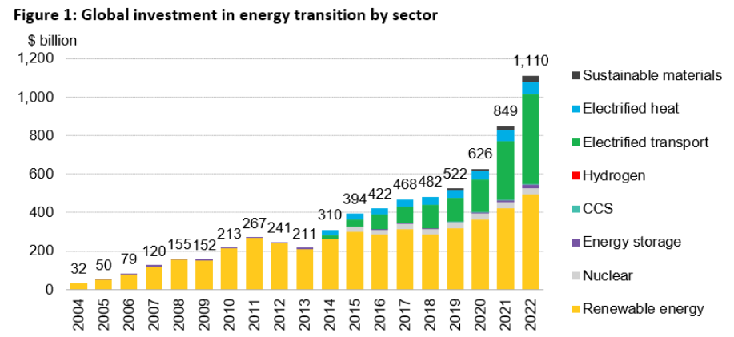
Responsible Finance in the World
Global sustainable debt issuance by year, USD billion
Factors driving the slowdown:
the end of the pandemic COVID 19
rising interest rates.
Defying supply chain disruptions and macroeconomic headwinds, 2022 energy transition investment jumped 31% to draw level with fossil fuels.
Source: Bloomberg NEF
Notes:
Global investment in the low-carbon energy transition totaled $1.1 trillion in 2022 – a new record and a huge acceleration from the year before – as the energy crisis and policy action drove faster deployment of clean energy technologies, according to a new report from research firm BloombergNEF (BNEF).
Despite 2022’s impressive results, global investment in lower-carbon technologies remains woefully short of what is needed to confront climate change. For the world to get on a 2050 “net-zero” CO2 emissions trajectory, such investment must immediately triple, BNEF estimates. Including the additional $274 billion invested in the power grid, energy transition investment hit $1.38 trillion in 2022. By comparison, the world must invest an annual average of $4.55 trillion for the remainder of this decade in order to get on track under BNEF’s Net Zero Scenario.

Slide 25



Sustainable banking in Russia
ROSBANK
Responsible Banking - 2021
SLL: signed a 2-year USD 300 mln syndicated loan agreement linked to 3 sustainability KPIs.
SLL: signed in June 2021 a PXF agreement linked to sustainable development indicators in the amount of USD 1.25 billion.
GB: issued a 7-year green bond in the amount of USD 1 billion (70 bln RUB) on Moscow stock Exchange.
At least:
1.85
₽ tn of ESG-related loan portfolio in Russia*
106
₽ bn Investor demand based on Russian bond market
34
% Growth in sales of electric vehicles
Sustainability bond – 2023
Clean transport
Energy efficiency
Financing of SMEs to mitigate negative social factors
  * Source: Expert RА, Interfax, INFRAGREEN

Slide 26
What happens with mismanagement of ESG factors
Examples of E&S risks in banking sector
Case 1: Watchdog bans HSBC climate ads in fresh blow to bank’s green credentials
“The ruling by the Advertising Standards Authority (ASA) followed dozens of complaints over posters that appeared on high streets and bus stops in the lead-up to the Cop26 climate change conference in Glasgow last October.
The watchdog said the adverts, which highlighted how the bank had invested $1tn in climate-friendly initiatives such as tree-planting and helping clients hit climate targets, failed to acknowledge HSBC’s own contribution to emissions.”
Case 2: German officials raid Deutsche Bank's DWS over 'greenwashing' claims
German prosecutors raided asset manager DWS and the headquarters of its majority owner Deutsche Bank over allegations of misleading investors about "green" investments, the prosecutors said.
The German prosecutors said "sufficient factual evidence has emerged" that environmental, social and governance (ESG) factors were taken into account in a minority of investments "but were not taken into account at all in a large number of investments", contrary to statements in DWS fund sales prospectuses.
ESG mismanagement can have devastating financial impacts:
2010 BP recorded a $53.8 billion pre-tax charge for the Deepwater oil spill.
2015 Volkswagen's misconduct cost the company €27.4 billion when it manipulated 11 million diesel vehicles to pass emissions tests.
2023 Johnson & Johnson said it would pay an $8.9 billion settlement over claims that its talc-based baby powder caused cancer. The company ended sales of the powder as it faced thousands of lawsuits over the alleged health hazards.

Slide 27
What to expect in the future

Slide 28
Top 10 global ESG trends
Integrating ESG into business – ESG concepts are expected to be further integrated into the ways companies conduct business in 2023
Valuing human capital – ESG labor and employment implications will continue to evolve
Responding to climate change – other environmental issues, including biodiversity and environmental and energy justice, will increasingly make the ESG conversation more complex
Safeguarding natural systems – the nature agenda is now top of mind after COP15 agreed to the Kunming-Montreal Global Biodiversity Framework with goals till 2030/2050
Building sustainable and resilient supply chains. Pursuing value chain transparency and navigating value chain risks will become significant areas of focus
Enabling sustainable consumptions and production
Applying technologies to sustainability. Tracking and using credible ESG data from a wide range of sources will become increasingly essential
Respecting fundamental rights
Shaping policy, regulations, and norms. The global ESG regulatory mosaic will become increasingly more complicated, creating potential conflicts and risks
Moving toward stakeholder capitalism

Slide 29
Key ESG trends in Russia
Strategy
Transparency
Actualization of green taxonomy and development of social taxonomy
National project “Clean Air”
Adaptation to climate change
Expansion of Sakhalin experiment
Adoption of digital solutions
Development of non-financial reporting standards and recommendations
Requirement to report on ESG and climate by major companies
Verification and Regulation
Development of new regulation on climate change and other ESG-issues
Development of national ESG-ratings

