Slide 1

There is No Economy –
Except for Global Economy
FROM SHOCKS TO
“Soft” stagflation
2020 – 2024
November 29, 2023
Leonid Grigoryev
www.leonidgrigoryev.com
Moscow, 29.11.2023

Slide 2

Issues and problems of 2023
Dynamics of the world cycle – 2007 – 2022, annual growth rates. World = GDP and Exports. GDP of the USA, China, EU and England, Brazil, India, Russia, including forecast for 2025
2
Source: IMF

Slide 3

Covid-19 -2020; Financial rain 2020-2021; Commodity cycle -2021 - 2022; Interest shock to undercut inflation spiral - 2022 – 2023.
Reconfiguration of global trade goes on with high costs.
Uncertainty and global sanctions” “tax brake” for real investments.
Climate programs go, but time is lost and costs of adaptation go up.
The USA are “pregnanCovid-19 -2020; Financial rain 2020-2021; Commodity cycle -2021 - 2022; Interest shock to undercut inflation spiral - 2022 – 2023.
Reconfiguration of global trade goes on with high costs.
Uncertainty and global sanctions” “tax brake” for real investments.
Climate programs go, but time is lost and costs of adaptation go up.
The USA are “pregnant” with elections …
EU&UK pay costs of turmoil, climate change and forced speeding up
China is trying to create New Normal “by touching the stone”.
IMF (October) hopes: “From disinflation to sustainable growth”, while “Growing global divergences”.
Structural changes, geopolitical conflicts take more time, than hoped...
World is in the bad shape but Global Economy must go on!
t” with elections …
EU&UK pay costs of turmoil, climate change and forced speeding up
China is trying to create New Normal “by touching the stone”.
IMF (October) hopes: “From disinflation to sustainable growth”, while “Growing global divergences”.
Structural changes, geopolitical conflicts take more time, than hoped...
World is in the bad shape but Global Economy must go on!
Issues and problems of 2023
3
Issues and problems of 2023
Global Governance was greatly weakened by 2020.
Covid-19 -2020; Financial rain 2020-2021; Commodity cycle -2021 - 2022; Interest shock to undercut inflation spiral - 2022 – 2023.
Agenda 2030 has not advanced much by 2020
Slowdown of capital formation was clear in 2012 - 2019 globally
Reconfiguration of global trade goes on with high costs.
Uncertainty and global sanctions” “tax brake” for real investments.
Climate programs go, but time is lost and costs of adaptation go up.
The USA are already “pregnant” with elections …
EU&UK pay costs of turmoil, climate change and forced speeding up
China is trying to create New Normal “by touching the stone”.
62%
Источник: Federal Reserve Economic Data

Slide 4
Issues and problems of 2023
4
What is happening now?
Energy swings and Climate protection take more time, finance and wisdom than it had been expected
Shocks of 2020 – 2023 have created serious uncertainty and installed new brakes: uncertainty, conflicts, populism, “sanctions for all”.
Climate agenda meets some resistance inside OECD, as expected…
Social problems – it appears – have formatted “rich countries’ trap” and political (electoral) instability, country after country…
Structural changes in Energy is a driver but not strong enough
IMF (October) hopes for: “From disinflation to sustainable growth”, but underlines “Growing global divergences”.
Structural changes, geopolitical conflicts take more time, than hoped...
World is in the bad shape but Global Economy must go on!
Difficult time for politicians, elections – electorates look exhausted.
62%

Slide 5
Modern system of traps
Poor countries are still often in “poverty traps”…
Middle income countries are struggling with enigmatic “middle income trap or traps”
China has made huge steps ahead, but it has still a lot to do…
China and the US appears are driven by domestic objectives…
World Bank cares for Poor, IMF – for stability,
World Bank, IEA and UN – for Energy and Climate…
SDG is a lame duck… - see our “Energy Trilemma”
Nobody cares for catching up of middle income countries…
Well developed countries and their elites – it seems – have recently entered the period “rich countries trap” of their relative richeness.
They have over $40 th. GDP ppp per head, aging population, inequality, budget problems, old infrastructure, and trying some “missions impossible”.
Global cooperation actually has gone but main global problems can not be solved without common efforts. “Consensus 2015” was a “happy hour”.

Slide 6
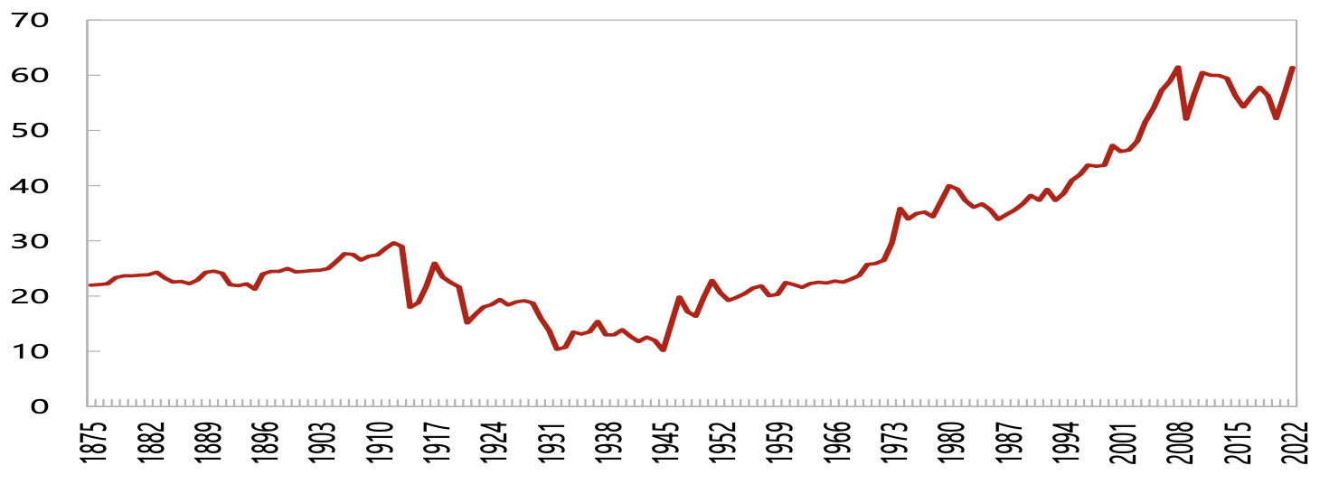
Issues and problems of 2023
6
Globalization Since 1875
International trade (in % of GDP)
62%
Source: Long Live Globalization: Geopolitical Shocks and International Trade. IMF Working Papers. (2023)

Slide 7

Департамент мировой экономики
Carbon Dioxide Emissions, 1990-2022
Источник: BP Statistical Review of World Energy 2022
Notes:
BP = 2022

Slide 8

Department of World Economy
Global emissions
Correlation: GDP per capita and emission per capita, two alternative measures, 106 countries, 1990 and 2017.
1990
Indicator |  | Production-based emissions per capita, t |  | Consumption-based emissions, per capita, t
GDP per capita, PPP (constant 2017 international $) | All countries (106) | 0,84 |  | 0,88
 | Developed countries (29) | 0,60 |  | 0,61
 | Developing countries (77) | 0,85 |  | 0,86
2017
GDP per capita, PPP (constant 2017 international $) | All countries (106) | 0,71 | 0,89
 | Developed countries (29) | 0,43 | 0,80
 | Developing countries (77) | 0,73 | 0,91
Sources: GDP per capita, PPP (constant 2017 international $) – World Bank World development indicators database; Production-based emissions, per capita, ton, calculated as Production-based emissions, ton (OurWorldInData database) divided by Population (IMF database); country groups by the UN classification.

Slide 9
Issues and problems of 2023
Interest rates on 10-year bonds, %,
2012 – 2023
9
62%

Slide 10
Issues and problems of 2023
10
Inflation (CPI). Total annual growth rate (%), Q1 2018 – Q3 2023
62%

Slide 11
Issues and problems of 2023
11
Average and population-weighted average GDP values (PPP 2017) per capita in each cluster, thousand dollars, 1992-2019
1992 |  |  |  |  |  | 2019
Cluster | States Number | Average GDP per capita (PPP 2017), thousand dollars | Population, bln people | Bottom line | Upper line | States Number | Average GDP per capita (PPP 2017), thousand dollars | Population, bln people | Bottom line | Upper line
 |  |  |  | from | to |  |  |  | from | to
1 | 29 | 41,2 | 0,82 | 25001 |  | 34 | 57,2 | 1,06 | 36060
2 | 15 | 18,9 | 0,32 | 15001 | 25000 | 20 | 28,4 | 0,45 | 21636 | 36058
3 | 19 | 11,9 | 0,44 | 10001 | 15000 | 20 | 17,1 | 1,92 | 14425 | 21635
4 | 29 | 7,3 | 0,35 | 5001 | 10000 | 30 | 11,3 | 0,98 | 7213 | 14423
5 | 31 | 3,5 | 0,68 | 2301 | 5000 | 27 | 5,2 | 2,36 | 3319 | 7212
6 | 20 | 1,9 | 2,42 | 1301 | 2300 | 16 | 2,5 | 0,31 | 1876 | 3317
7 | 14 | 1,0 | 0,18 |  | 1300 | 10 | 1,4 | 0,23 |  | 1875
 | 157 |  | 5,22 |  |  | 157 |  | 7,33
62%
Note: 2019 cluster boundaries are shifted upward by 44.2% relative to 1992 in accordance with per capita GDP growth excluding China
Source: recalculated by the authors based on updated World Bank data based on “The World Economy in a Period of Great Turmoil.” 2022. chapter. 1.

Slide 12
Issues and problems of 2023
12
GDP per capita of the major European powers and their colonies, 1913–2020, $ thousand (different)
Metropolis | Main colony | Metropolis, GDP per capita, $ thousand | Colony, GDP per capita, $ thousand |  | Colony, GDP per capita, $ thousand
Metropolis | Main colony | 1913 | Independence year | 2020 | 1913 | Independence year | 2020
UK | India | 5.0 | 10.5 | 45.9 | 0.9 | 1.0 | 6.5
France | Algeria | 3.2 | 12.9 | 46.7 | 0.6 | 2.3 | 11.3
Spain | Equatorial Guinea | 2.1 | 9.3 | 38.3 | 0.5 | 2.0 | 17.9
Belgium | Congo Dem. Rep. | 4.3 | - | 52.6 | 0.6 |  | 1.1
Netherlands | Indonesia | 3.5 | 9.4 | 59.3 | 0.8 | 1.2 | 12.1
Portugal | Angola | 1.3 | 10.4 | 34.1 | 0.6 | 1.7 | 6.4
62%
Source: S. Broadberry, K.H. O’Rourke, The Cambridge Economic History of Modern Europe, 2010; Maddison database, World Bank (WB) database

Slide 13
Issues and problems of 2023
The growth rates and IMF forecasts for 2020 - 2021 -2022 - 2023, 2024
13
 | 2019 | 2020 | 2021 | 2022 | F. from Jan 2020 to 2020 | F. from Jan 2020 to 2021 | F. from Jan 2021 to 2021 | F. from Jan 2021 to 2022 | F. from Jan 2022 to 2022 | F. from Jan 2022 to 2023 | F. from Oct 2023 to 2023 | F. from Oct 2023 to 2024
World output | 2.9 | -3.5 | 5.9 | 3.4 | 3.5 | 3.3 | 5.5 | 4.2 | 4.4 | 3.8 | 3.0 | 2.9
Advanced Economies | 1.5 | -4.9 | 5 | 2.7 | 1.9 | 1.4 | 4.3 | 3.1 | 3.9 | 2.6 | 1.5 | 1.4
USA | 2.3 | -3.4 | 5.6 | 2.1 | 2 | 1.6 | 5.1 | 2.5 | 4 | 2.6 | 2.1 | 1.5
Europe | 1 | -7.2 | 5.2 | 3.5 | 1.7 | 1.2 | 4.2 | 3.6 | 3.9 | 2.5 | 0.7 | 1.2
Germany | 0.3 | -5.4 | 2.7 | 1.8 | 1.2 | 1.5 | 3.5 | 3.1 | 3.8 | 2.5 | -0.5 | 0.9
France | 1.2 | -9 | 6.7 | 2.6 | 1.3 | 1.4 | 5.5 | 4.1 | 3.5 | 1.8 | 1.0 | 1.3
UK | 0.9 | -10 | 7.2 | 4.0 | 1.8 | 1.5 | 4.5 | 5 | 4.7 | 2.3 | 0.5 | 0.6
Developing states | 4 | -2.4 | 6.5 | 4.0 | 4.8 | 4.8 | 6.3 | 5 | 4.8 | 4.7 | 4.0 | 4.0
China | 5.9 | 2.3 | 8.1 | 3.0 | 5.9 | 5.8 | 8.1 | 5.6 | 4.8 | 5.2 | 5.0 | 4.2
India | 4.3 | -8 | 9 | 6.8 | 6.9 | 6.1 | 11.5 | 6.8 | 9 | 7.1 | 6.3 | 6.3
Russia | 1.5 | -3.6 | 4.5 | -2.1 | 1.6 | 2.4 | 3 | 3.9 | 2.8 | 2.1 | 2.2 | 1.1
Brazil | 1.8 | -4.5 | 4.7 | 2.9 | 2 | 2.4 | 3.6 | 2.6 | 0.3 | 1.6 | 3.1 | 1.5
62%
F. - forecast
Source: IMF

Slide 14
Issues and problems of 2023
Gross capital investment, 2007-2022 (estimation), %
14
62%
Source: IMF

Slide 15
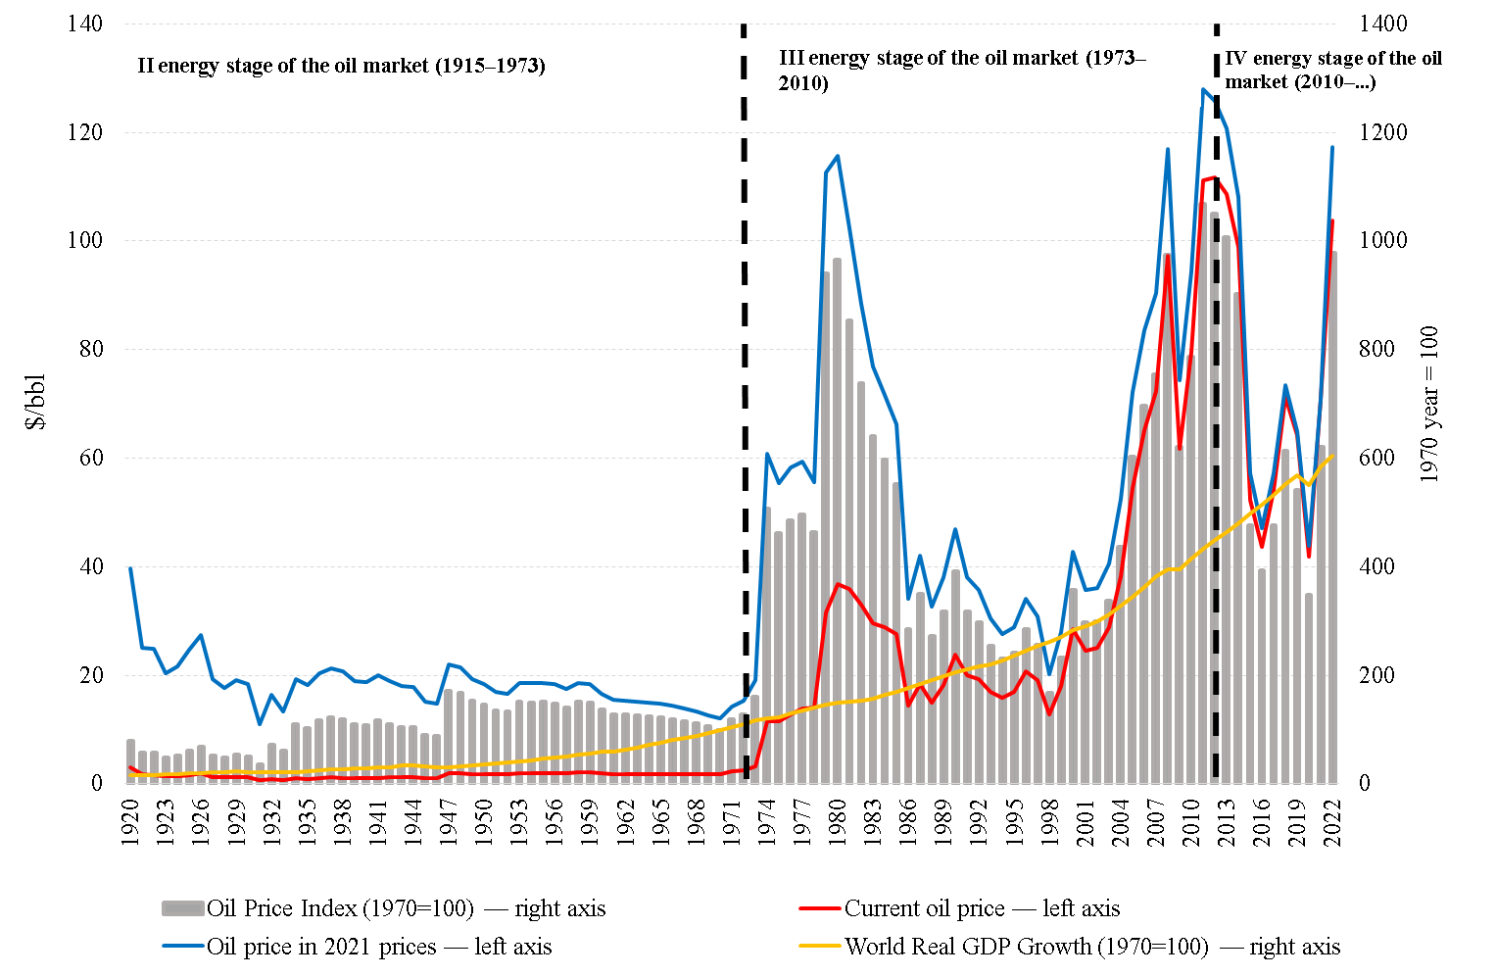
Issues and problems of 2023
15
Energy stages
62%

Slide 16
GDP and Primary Energy Consumption, annual growth rates, 1991 – 2022
 | GDP (PPP const, 2017, World Bank) |  |  |  |  |  |  | Primary energy consumption
 | 1991-2002 | 2003-2008 | 2009 | 2010-2019 | 2020 | 2021 | 2022 | 1991-2002 | 2003-2008 | 2009 | 2010-2019 | 2020 | 2021 | 2022
World | 2,8 | 4,4 | -0,7 | 3,6 | -3,1 | 6 | 3,3 | 1,5 | 3,1 | -1,5 | 1,6 | -4,5 | 5,8 | 1,1
OECD | 2,6 | 2,5 | -3,4 | 2,1 | -4,5 | 5,4 | 2,9 | 1,3 | 0,5 | -4,9 | 0 | -8 | 4,7 | 0,9
USA | 3,1 | 2,5 | -2,5 | 2,3 | -3,4 | 5,7 | 2,1 | 1,3 | 0,1 | -5 | 0,2 | -8,1 | 5,3 | 2,7
EU | 2,1 | 2,3 | -4,3 | 1,6 | -6 | 5,4 | 3,6 | 0,3 | 0,4 | -6 | -0,8 | -9 | 5,6 | -3,5
Japan | 1,1 | 1,2 | -5,4 | 1,2 | -4,5- | 1,6 | 1,0 | 1,4 | -0,3 | -8,8 | -1,5 | -7,9 | 3,8 | -0,6
Non-OECD | 3,3 | 7,1 | 2,7 | 5 | -1,9 | 6,5 | 3,7 | 1,7 | 6,1 | 1,6 | 2,8 | -2,2 | 6,5 | 1,3
Brazil | 2,5 | 4,2 | -0,1 | 1,4 | -3,9 | 4,6 | 2,9 | 3,5 | 3,7 | -0,8 | 1,4 | -3,4 | 5 | 4,3
Russia | -2,5 | 7,1 | -7,8 | 2 | -2,7 | 4,8 | -2,1 | -2,7 | 1,4 | -5 | 0,7 | -5,6 | 8,7 | -8,2
India | 5,4 | 7,1 | 7,9 | 6,7 | -6,6 | 8,9 | 7,0 | 4,4 | 6,3 | 7,5 | 4,7 | -6 | 10,7 | 5,6
China | 10,1 | 11,3 | 9,4 | 7,7 | 2,2 | 8,1 | 3,0 | 4,5 | 11,4 | 4,4 | 3,5 | 2,4 | 7,1 | 0,9
Energy consumption (%) minus GDP (p,%)
World |  |  |  |  |  |  |  | -1,4 | -1,3 | -0,9 | -2 | -1,4 | -0,2 | -2,2
OECD |  |  |  |  |  |  |  | -1,3 | -2 | -1,5 | -2,1 | -3,5 | -0,7 | -2,1
Non-OECD |  |  |  |  |  |  |  | -1,6 | -1 | -1,1 | -2,2 | 4,1 | -13 | -2,4
Source: World Bank. BP

Slide 17
Oil and Gas Consumption, annual growth rates, 1991 – 2022
 | Oil consumption |  |  |  |  |  |  | Gas consumption
 | 1991-2002 | 2003-2008 | 2009 | 2010-2019 | 2020 | 2021 | 2022 | 1991-2002 | 2003-2008 | 2009 | 2010-2019 | 2020 | 2021 | 2022
World | 1,4 | 1,4 | -1,3 | 1,5 | -9,3 | 6 | 3,1 | 2,1 | 3,1 | -2,1 | 2,9 | -2,1 | 5,3 | -3,1
OECD | 1,2 | -0,4 | -4,4 | 0,2 | -12,5 | 6,4 | 3,3 | 2,7 | 1,6 | -3 | 2,1 | -2,3 | 2,3 | -0,9
USA | 1,2 | -0,7 | -4,3 | 0,8 | -11,8 | 8,7 | 1,9 | 1,5 | 0,2 | -1,8 | 3,2 | -2 | -0,4 | 5,4
EU | 0,5 | -0,3 | -5,3 | -0,7 | -13,5 | 5,8 | 3,3 | 2,1 | 1,9 | -6,1 | -0,1 | -2,9 | 4,6 | -13,5
Japan | 0,4 | -2,2 | -9,4 | -1,7 | -11,4 | 2,2 | 0,0 | 3,5 | 4,5 | -6,7 | 1,6 | -3,4 | -0,2 | -3,0
Non-OECD | 1,7 | 3,9 | 2,6 | 3 | -6,5 | 5,7 | 3,0 | 1,5 | 4,7 | -1,1 | 3,6 | -1,8 | 7,8 | -4,9
Brazil | 3,4 | 2,2 | -0,9 | 1,6 | -4,8 | 5,5 | 4,9 | 13,6 | 10 | -19,5 | 5,6 | -10,1 | 29,1 | -20,9
Russia | -5,5 | 2 | -3 | 2 | -4,6 | 6,1 | 2,5 | -0,8 | 1,9 | -5,9 | 1,1 | -7,4 | 12,4 | -14,0
India | 5,7 | 4,5 | 5,2 | 4,8 | -9,3 | 3,8 | 8,1 | 7,2 | 7,1 | 22,8 | 1,9 | 0,6 | 3,1 | -6,3
China | 7 | 7,2 | 4,3 | 5,4 | 1,6 | 7,2 | -4,0 | 5,5 | 18,6 | 10,1 | 13,1 | 7,2 | 12,8 | -1,2
Oil/Gas consumption (points %) minus GDP (points %)
World | -1,4 | -3 | -0,7 | -2 | -6,2 | 0 | -0,2 | -0,7 | -1,3 | -1,4 | -0,7 | 1 | -0,7 | -6,4
OECD | -1,4 | -2,9 | -1 | -2 | -8 | 1 | 0,4 | 0,1 | -0,9 | 0,3 | 0 | 2,2 | -3,1 | -3,8
Non-OECD | -1,5 | -3,2 | -0,1 | -2 | 8,4 | -12,2 | -0,7 | -1,7 | -2,4 | -3,8 | -1,5 | 3,7 | -14,3 | -8,5
Source: World Bank. BP

Slide 18
Coal consumption and Electricity generation, annual growth rates, 1991 - 2022
 | Coal consumption |  |  |  |  |  |  | Renewables consumption
 | 1991-2002 | 2003-2008 | 2009 | 2010-2019 | 2020 | 2021 | 2022 | 1991-2002 | 2003-2008 | 2009 | 2010-2019 | 2020 | 2021 | 2022
World | 0,9 | 5,9 | -1,5 | 0,9 | -3,9 | 6,3 | 0,6 | 6 | 14,8 | 14,8 | 13,5 | 9,7 | 15 | 13,0
OECD | 0,2 | 0,7 | -10,5 | -2,9 | -15 | 8,3 | -3,5 | 6,4 | 14,9 | 12,7 | 10,6 | 8,1 | 7,9 | 11,1
USA | 1,1 | 0,4 | -12 | -5,4 | -18,9 | 15,2 | -6,7 | 3,4 | 12,8 | 13,3 | 9,5 | 7,2 | 12,8 | 12,8
EU | -2,6 | -0,9 | -11,3 | -3 | -19,2 | 13,2 | 2,0 | 13,5 | 19,6 | 12,7 | 9,4 | 7,4 | 2,9 | 9,5
Japan | 2,4 | 2,7 | -16,1 | 1,4 | -6,7 | 5,2 | -0,3 | 4 | 6,9 | –0,9 | 14,3 | 10 | 9,9 | 11,4
Non-OECD | 1,6 | 9,3 | 2,9 | 2,2 | -1,1 | 5,8 | 1,6 | 5 | 14,5 | 21,5 | 19,7 | 11,8 | 24,2 | 15,2
Brazil | 2,1 | 1,8 | -19,3 | 3,4 | -10,7 | 21,6 | -17,8 | 2,1 | 12,9 | 11,4 | 10,5 | 1,2 | 9,5 | 7,2
Russia | -4,6 | -0,5 | -8,5 | -0,8 | -8,2 | 4 | -6,8 | 9,8 | 22,4 | 1,2 | 18,4 | 70,9 | 53,9 | 30,5
India | 3,9 | 7 | 8,2 | 4,7 | -5,7 | 15,8 | 4,1 | 54 | 25,2 | 13,7 | 16,3 | 6,8 | 13,2 | 18,0
China | 3,7 | 12 | 4,8 | 1,5 | 0,6 | 4,9 | 1,0 | 70,1 | 43,6 | 62,1 | 29 | 15,5 | 33,1 | 18,1
Coal consumption/Electricity generation (p %) minus GDP (p %)
World | -1,9 | 1,5 | -0,8 | -2,7 | -0,8 | 0,3 | -2,7 | 3,2 | 10,4 | 15,5 | 9,9 | 12,8 | 9 | 9,7
OECD | -2,4 | -1,8 | -7,1 | -5 | -10,5 | 2,9 | -6,4 | 3,8 | 12,4 | 16,1 | 8,5 | 12,6 | 2,5 | 8,2
Non-OECD | -2,1 | -6,8 | -14,7 | -10,4 | 3 | -12,3 | -2,1 | -8,3 | -21,6 | -24,2 | -24,7 | -9,9 | -30,7 | 11,5
Source: World Bank. BP

Slide 19
Issues and problems of 2023
Prices - oil, gas in Europe and Asia (dollars/bbl.o.e., left axis), coal (dollars/t., right axis), Q1 2019 – Q1 2023
19
62%
Source: IMF

Slide 20
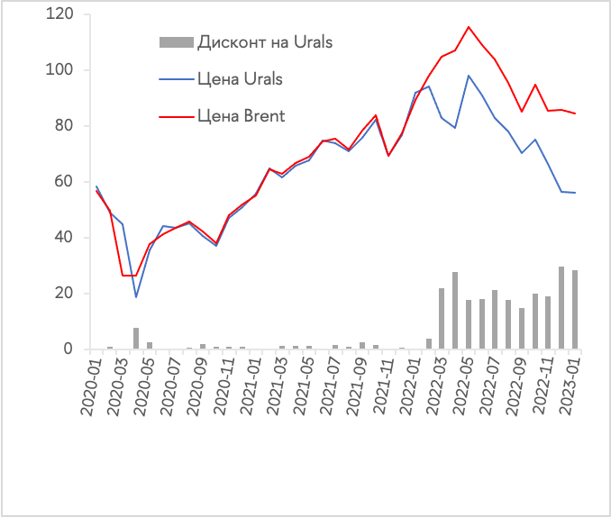
Issues and problems of 2023
20
Energy prices
Oil price dynamics
Brent and Urals grades, US dollars per barrel
62%
Dynamics of prices for oil, gas and coal, January 2010 = 100%
Source: World Bank

Slide 21
Issues and problems of 2023
21
Metals and food prices
62%
Source: World Bank

Slide 22
The New Economy of Oil. Impact on Business, Geopolitics and Society.
By John Mitchell and others, RIIA, London 2001
“Energy security: Objectives and instruments need to be redefined: the key economic concerns for importers are managing the effects of disruptions and minimizing long-term energy costs, not minimizing their energy imports. The threat of political sanctions has been reversed. It is exporting countries that now need to be concerned about sanctions aimed at their domestic and foreign policies by governments and public opinion in developed countries.” (p.2)
“…under the US system of government, sanctions can be initiated by the Congress for domestic political reasons, and not necessarily represent a careful calculations of national interests by US administrations.”(p. 201-202) – from Thomas Waelde “Legal Boundaries for Extraterritorial Sanctions”1997…

Slide 23
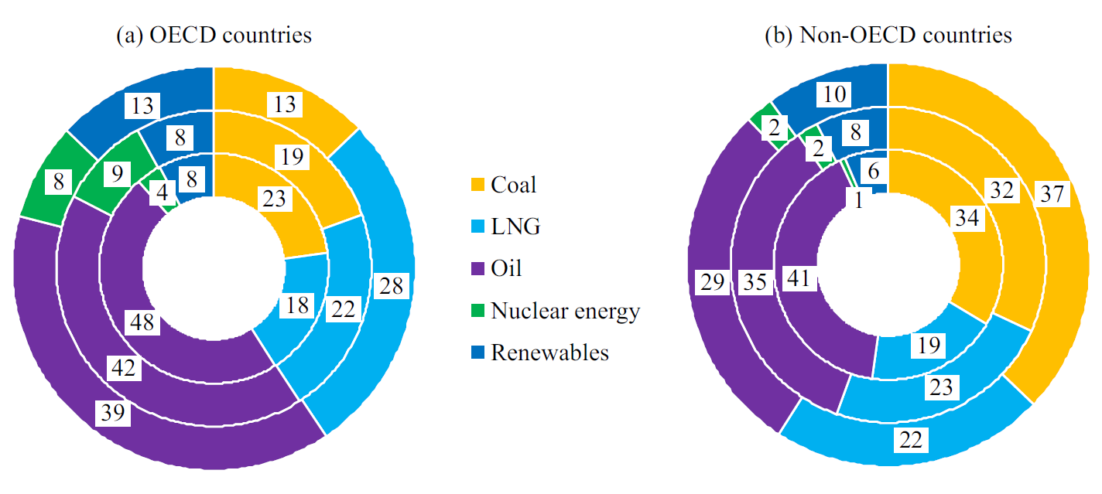
Fuel and energy balances, 1980-2019

Slide 24
Issues and problems of 2023
24
Debts since 1880 and purchases in 2020
62%
Source: IMF = October 2020

Slide 25
Issues and problems of 2023
Savings rate in some countries of the world, %
25
62%
Source: Eurostat, IBGE, INEGI, BEA

Slide 26
Share prices on stock exchanges in the UK, China, Germany, USA and developing countries
26
Source: investing.com

Slide 27
Issues and problems of 2023
Volume and monthly changes in Fed and ECB assets, trillion dollars and euros, March 2020 – March 2023
27
62%
Source: European Central Bank, Board of Governors of the Federal reserve System

Slide 28
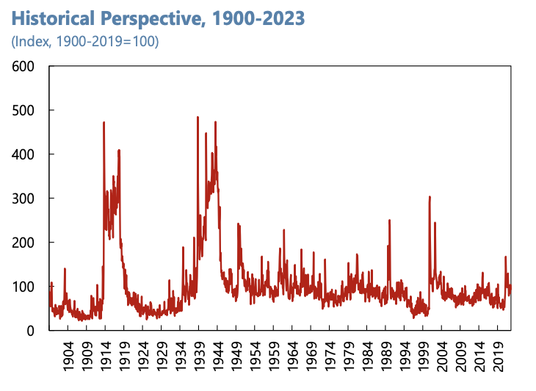
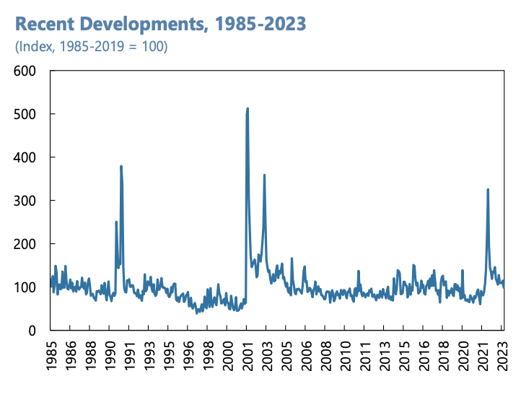
Issues and problems of 2023
28
Geopolitical Risk Index
62%
Source: Long Live Globalization: Geopolitical Shocks and International Trade. IMF Working Papers. (2023)

