Slide 1
Inflation, Debt and Financial Stability in China
Prof. Dashu Wang
Peking University
dwang@pku.edu.cn

Slide 2
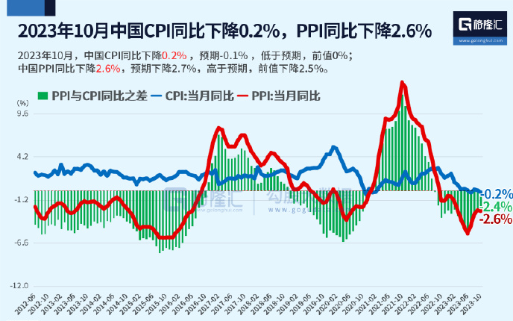
I．Inflation
Inflation has been under control for more than 10 years

Slide 3
Why under control ?
1.Digital economy
Digital Technology Enhances the efficiency of production, transportation, transaction and so on.
Fixed cost is large， but variable cost →0 if customers→∞
Supply easily finds demand

Slide 4
2. Economic slowdown.

Slide 5
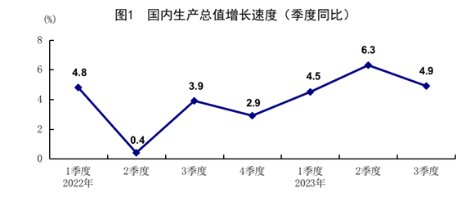
GDP （by quarter ）

Slide 6
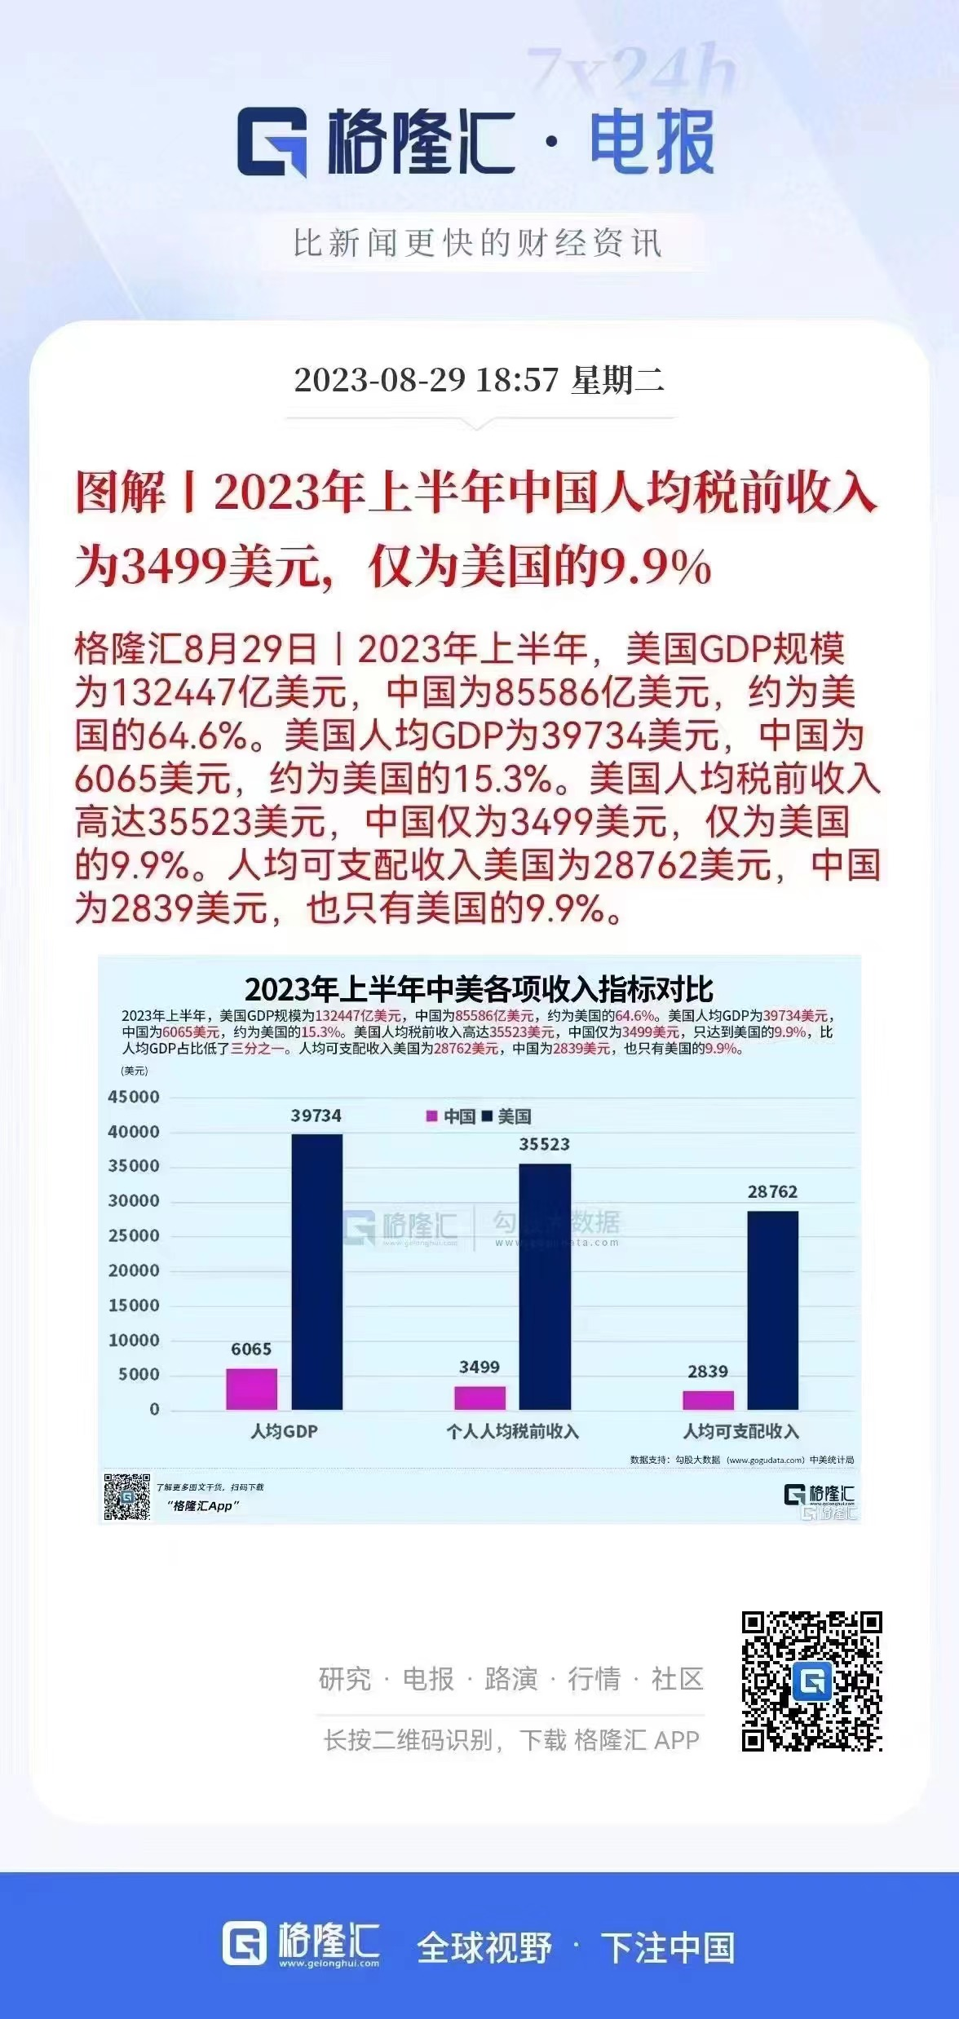

Slide 7
exchange rate： US﹩to RMB

Slide 8
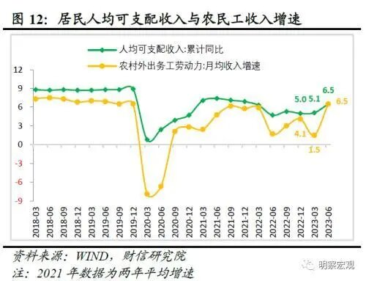
3. Income

Slide 9
4. Population

Slide 10
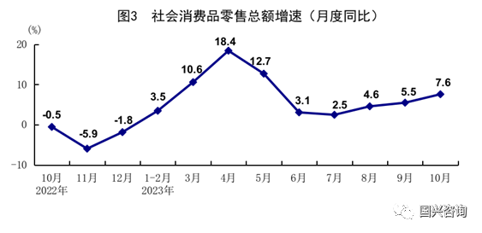
5. Consumption Retail sales （by month）

Slide 11
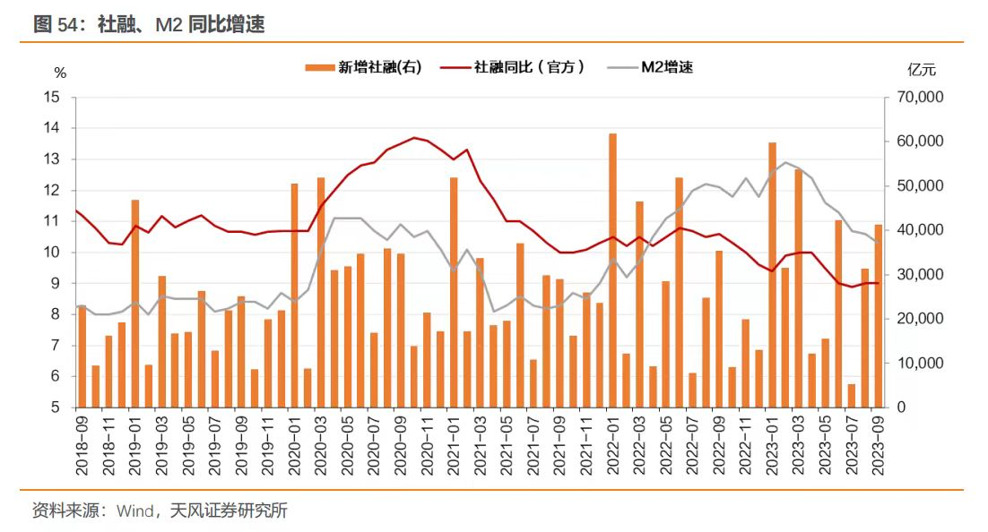
6. Money supply

Slide 12
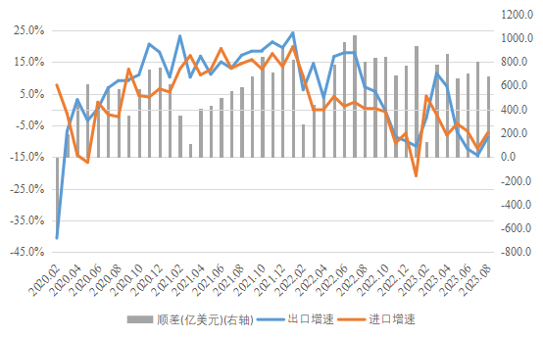
7. foreign trade

Slide 13
Trade partners

Slide 14
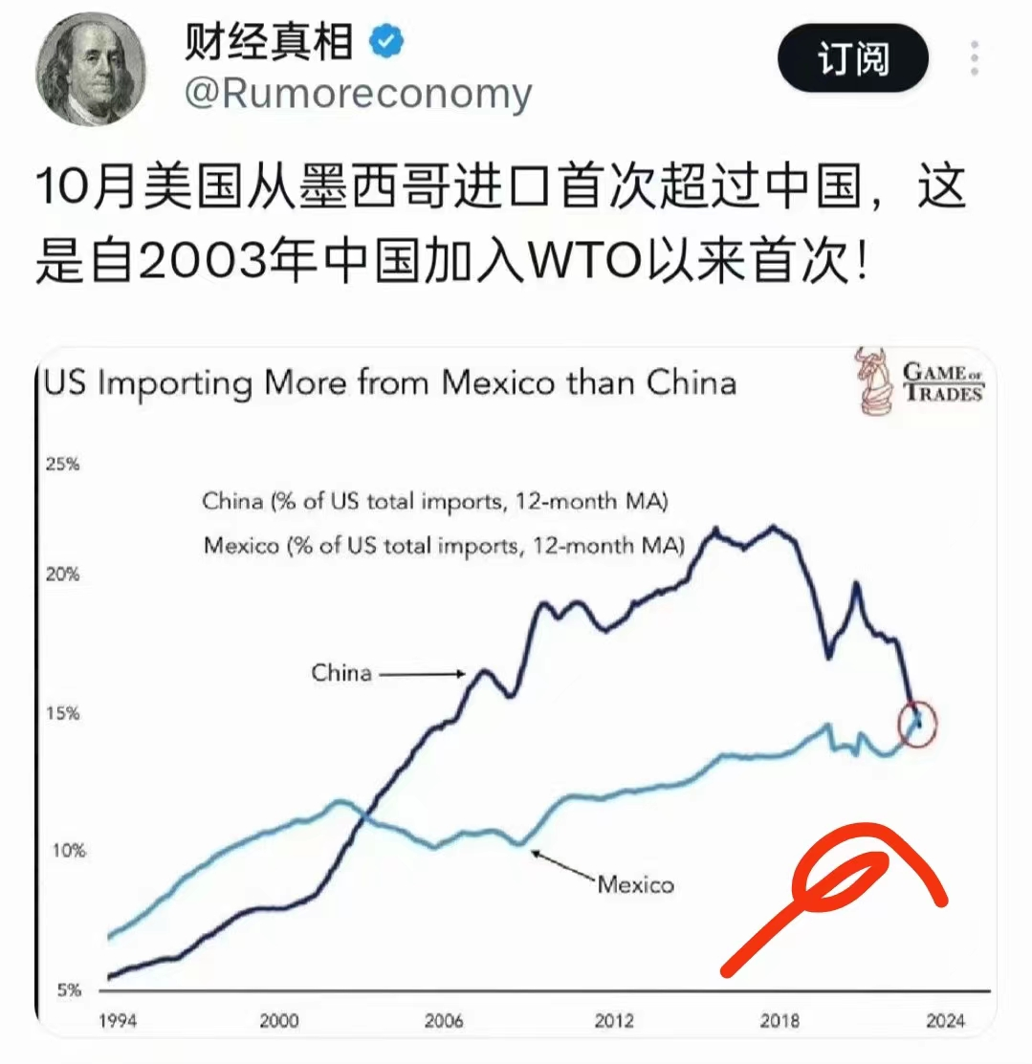

Slide 15
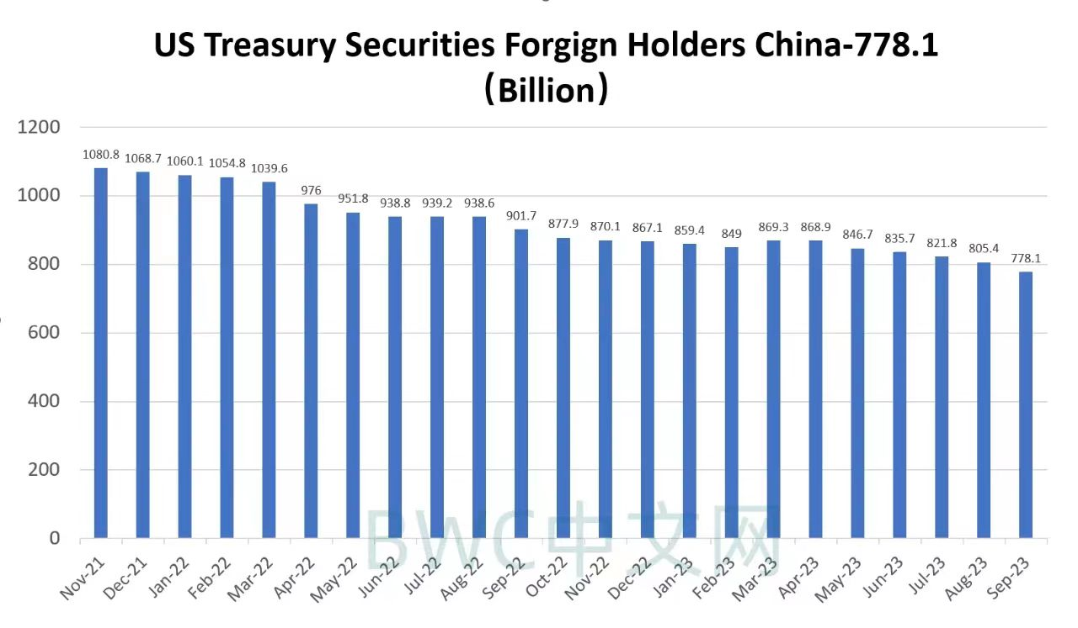

Slide 16
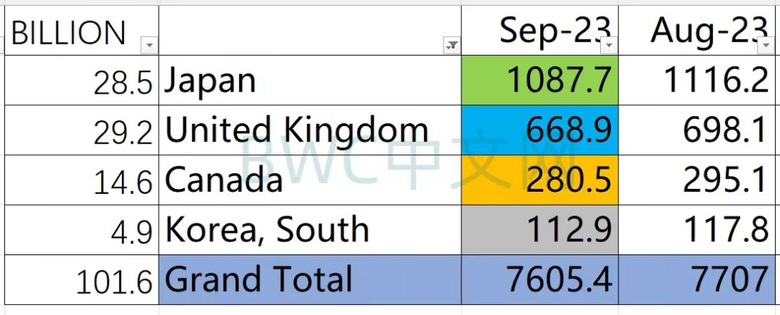
Treasury securities holdings ，2023

Slide 17
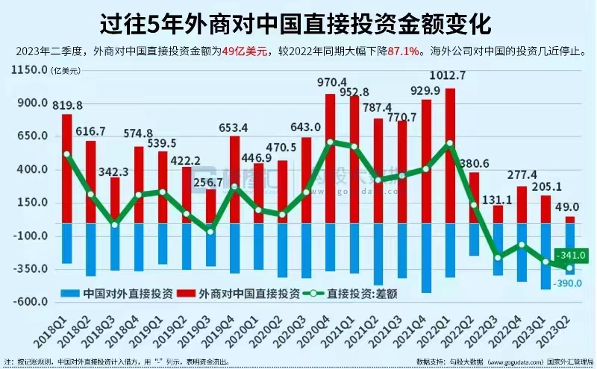
FDI （in red）

Slide 18
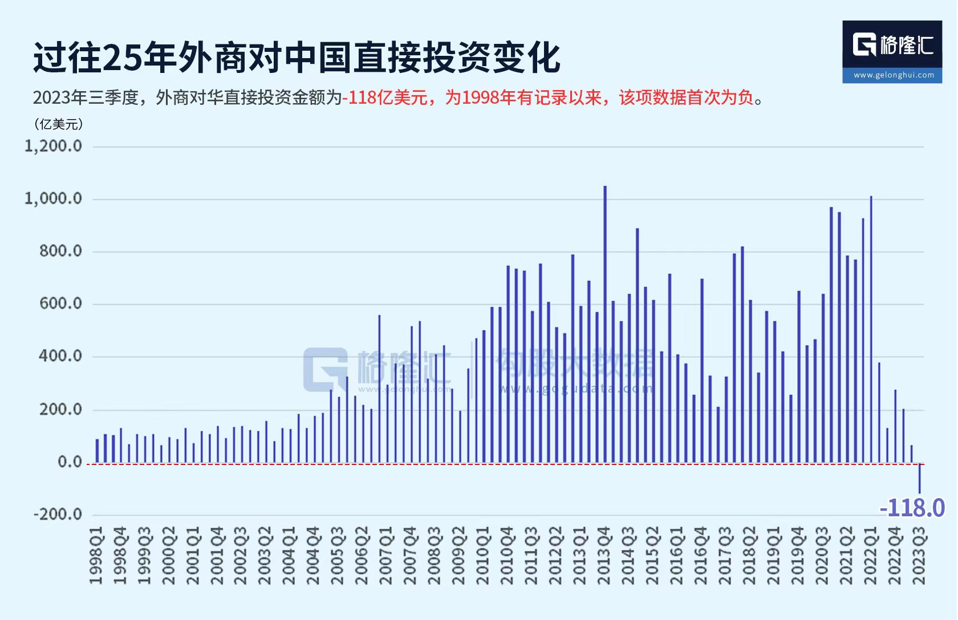
FDI

Slide 19
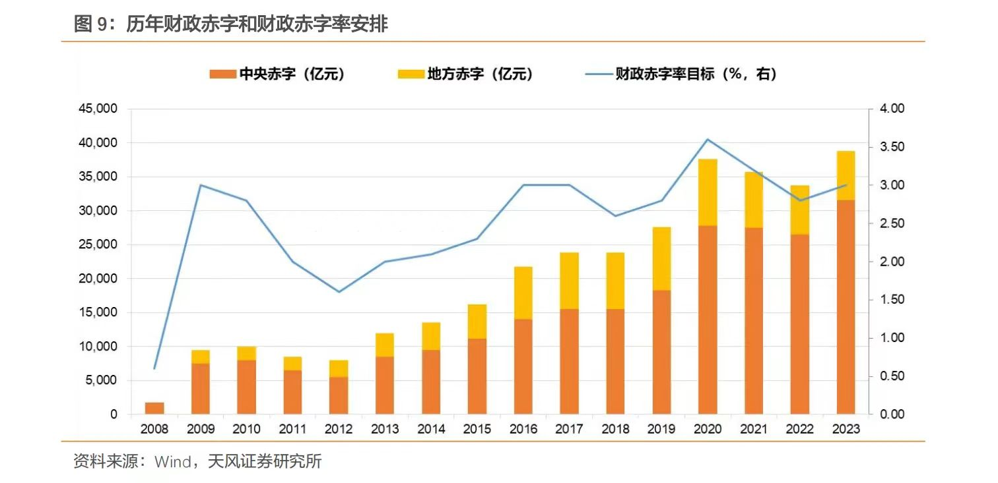
II. Debt
The ratio of fiscal deficit/GDP in China

Slide 20
The ratio of deficit/GDP

Slide 21
The ratio of deficit/GDP in the USA

Slide 22
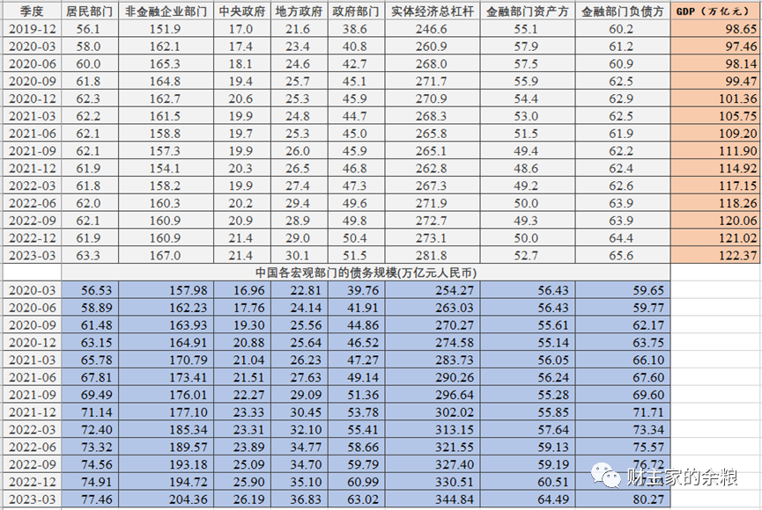

Slide 23
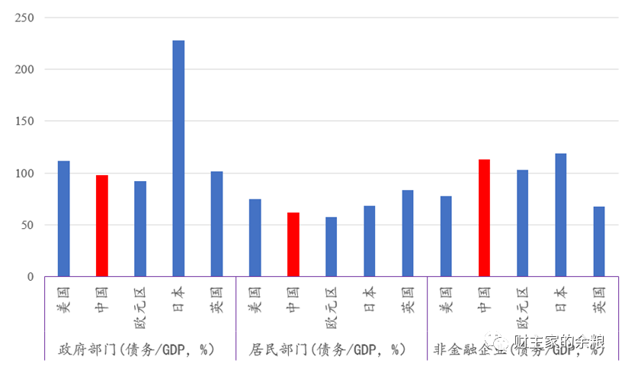
The adjusted ratio of Governmental Debts/GDP in 2022

Slide 24
Visible government debt at local and provincial level is not a problem, but invisible or hidden debt presents a problem.
One trillion Yuan treasury bonds were issued to help provincial and local governments in October，2023.

Slide 25
Official Interest rate （USA）

Slide 26
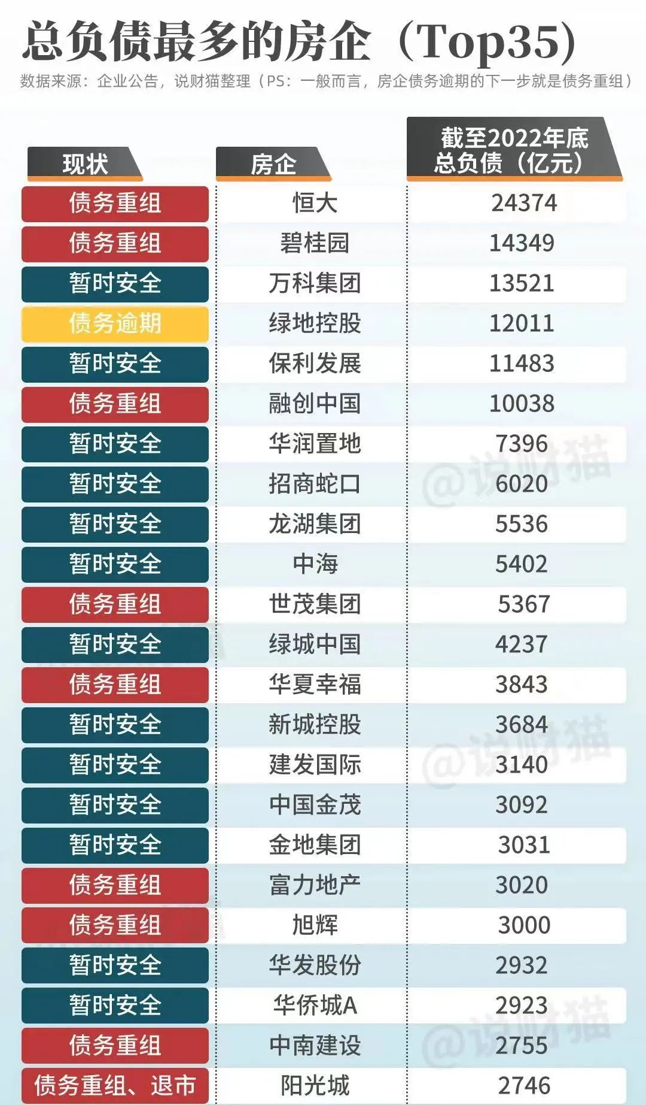

Slide 27
III. Financial Stability
Banks are OK.

Slide 28
The index of stock market is at low level.

Slide 29
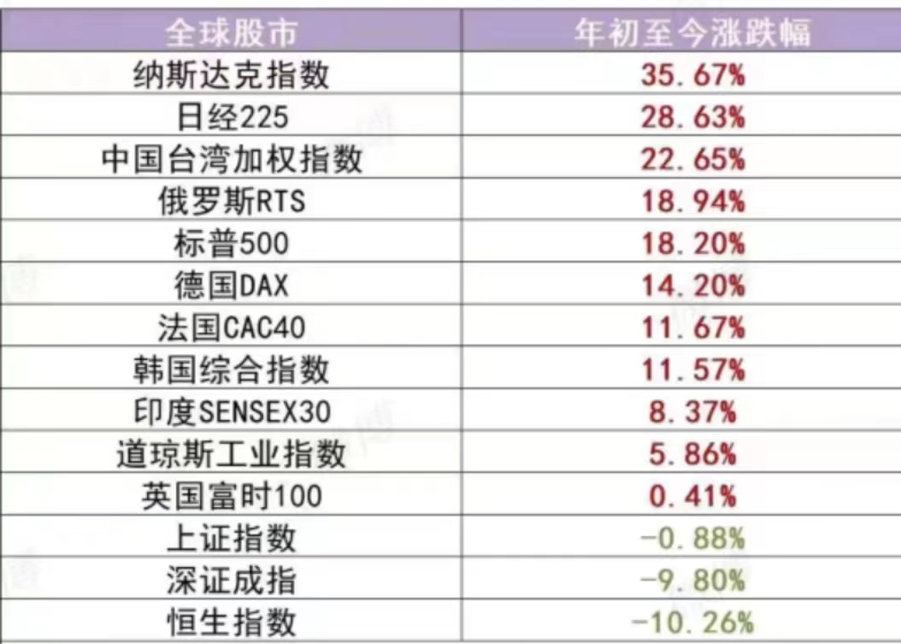

Slide 30
Conclusion
It is remained to be seen that a small decline in the curves is just a fluctuation or a turning point.
Inflation is under control.
Public debt seems to be not a problem but probably a potential problem for Local governments in the future.
Financial stability is no problem.

Slide 31
A Central Committee under the leadership of Central Committee of CPC was established in November. Prime Minister Li Qinag is Director.
Duty：enhancing the leadership over financial work；responsible for the policy-making，coordinating，implementation and supervision of financial stability and development；and consider and approval of important policies in financial issues.

