Slide 1
BETWEEN INFLATION, FINANCIAL INSTABILITY AND DEBT: THE PATTERNS OF ECONOMIC GROWTH IN THE POST-CRISIS WORLD
XI Annual Conference on the Global Economy
“Re-balancing of the world economy: in search of new models for global development”
November 29, 2023
Salikhov Marcel
FIEF/HSE
m_salihov@fief.ru
https://t.me/IEFnotes

Slide 2
2022 conference title was «On the brink of recession:
What is the scale of possible crisis?
Commodity prices indexes, 1992 – 2022 (October)
Inflation rate in major developing economies
Source: national statistics & central banks
Notes:
Стагфляция 2020-х гг. – это новая норма?
Возможен ли возврат к устойчивым темпам экономического роста в развитых странах до 2030 г.?
В какой степени долговое бремя будет ограничивать рост развивающихся экономик?

Slide 3
Economic activity was robust in 2023
GDP growth rates of major developed economies
GDP growth rates of major developing economies
Source: national statistics, OECD, IMF

Slide 4
Energy prices pressure had faded to a larger extent
TTF gas prices returned to pre-crisis levels ...
… as demand had fallen by 22-25%
Gas demand change in 2Q23 compared to 2019-21 average levels
and increased LNG inflows partially substituted Russian pipeline gas
Source: EEX, Eurostat, ENTSO-G
Notes:
Стагфляция 2020-х гг. – это новая норма?
Возможен ли возврат к устойчивым темпам экономического роста в развитых странах до 2030 г.?
В какой степени долговое бремя будет ограничивать рост развивающихся экономик?

Slide 5
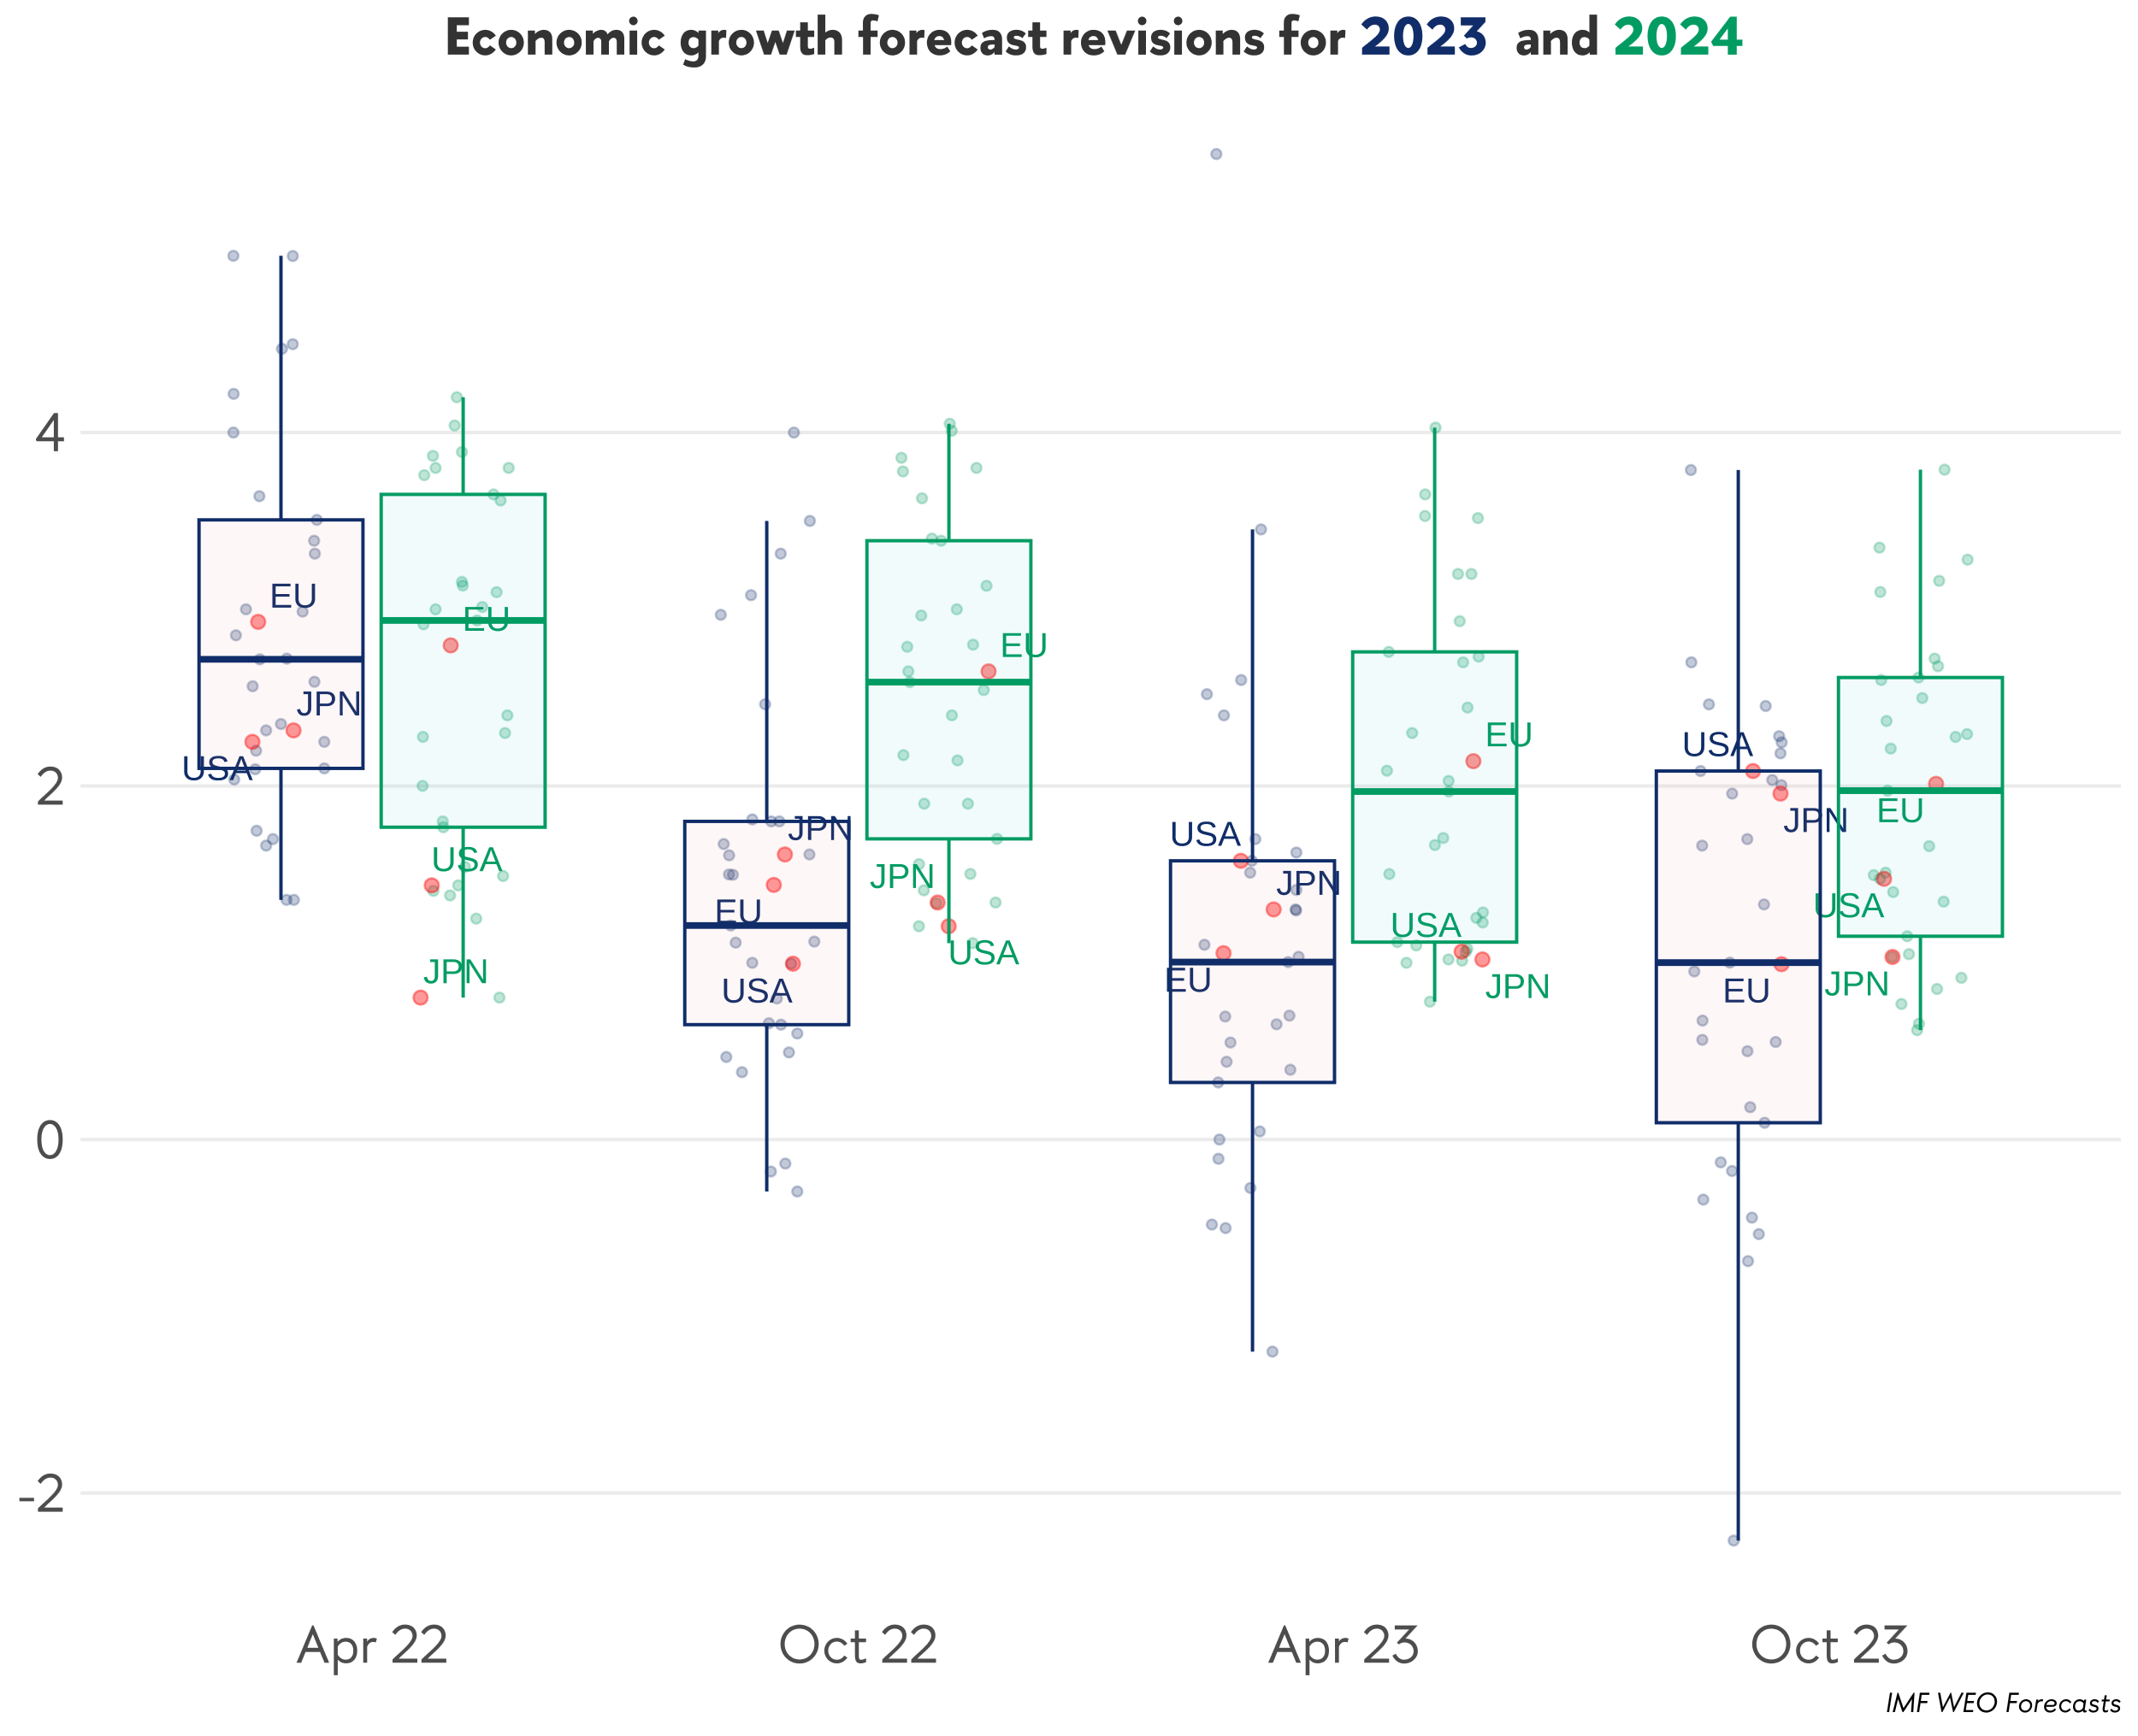
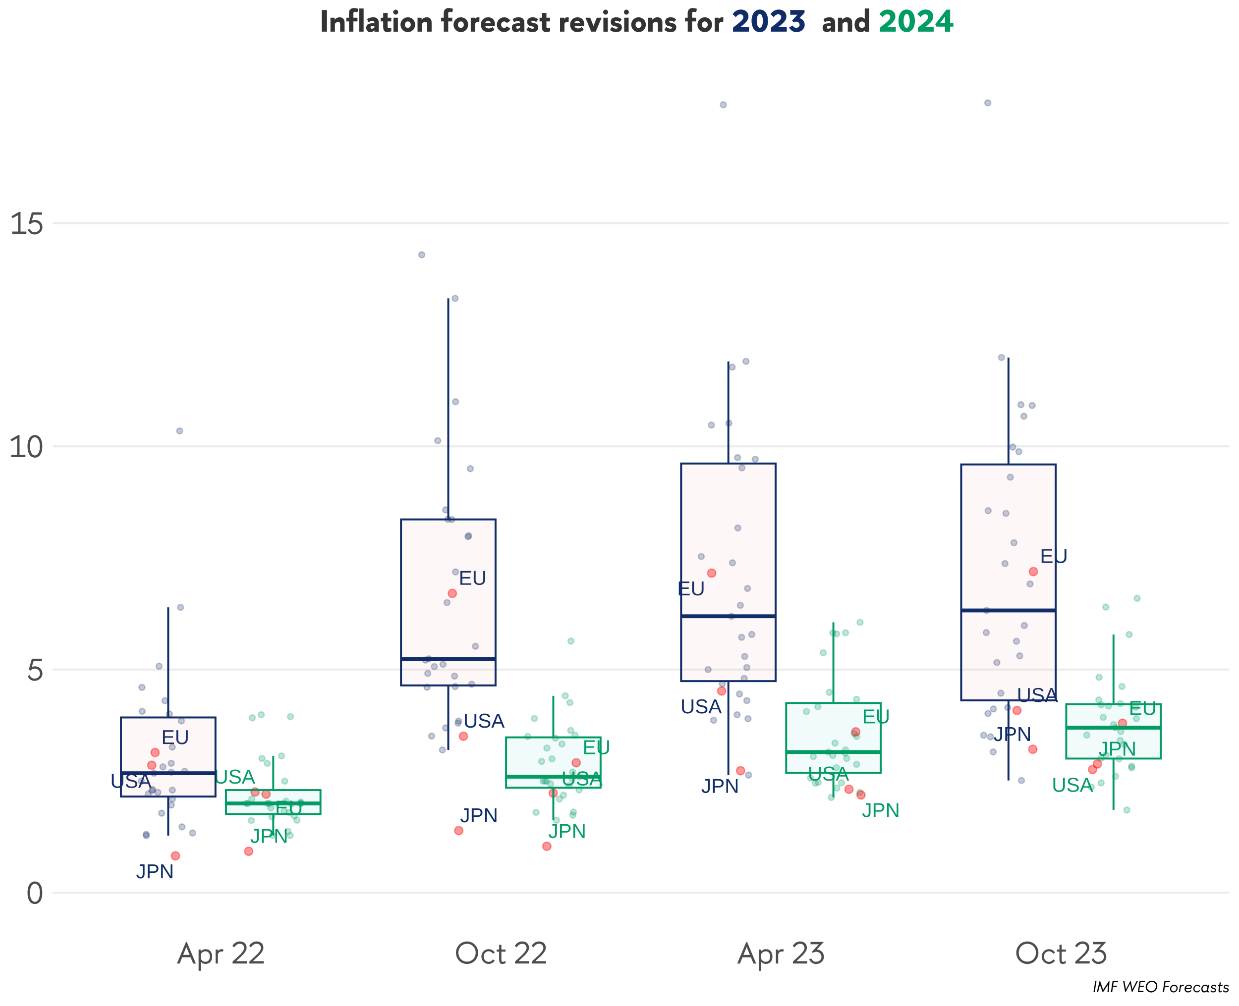
Global economy looks stronger than was expected
Source: national statistics, OECD, IMF

Slide 6
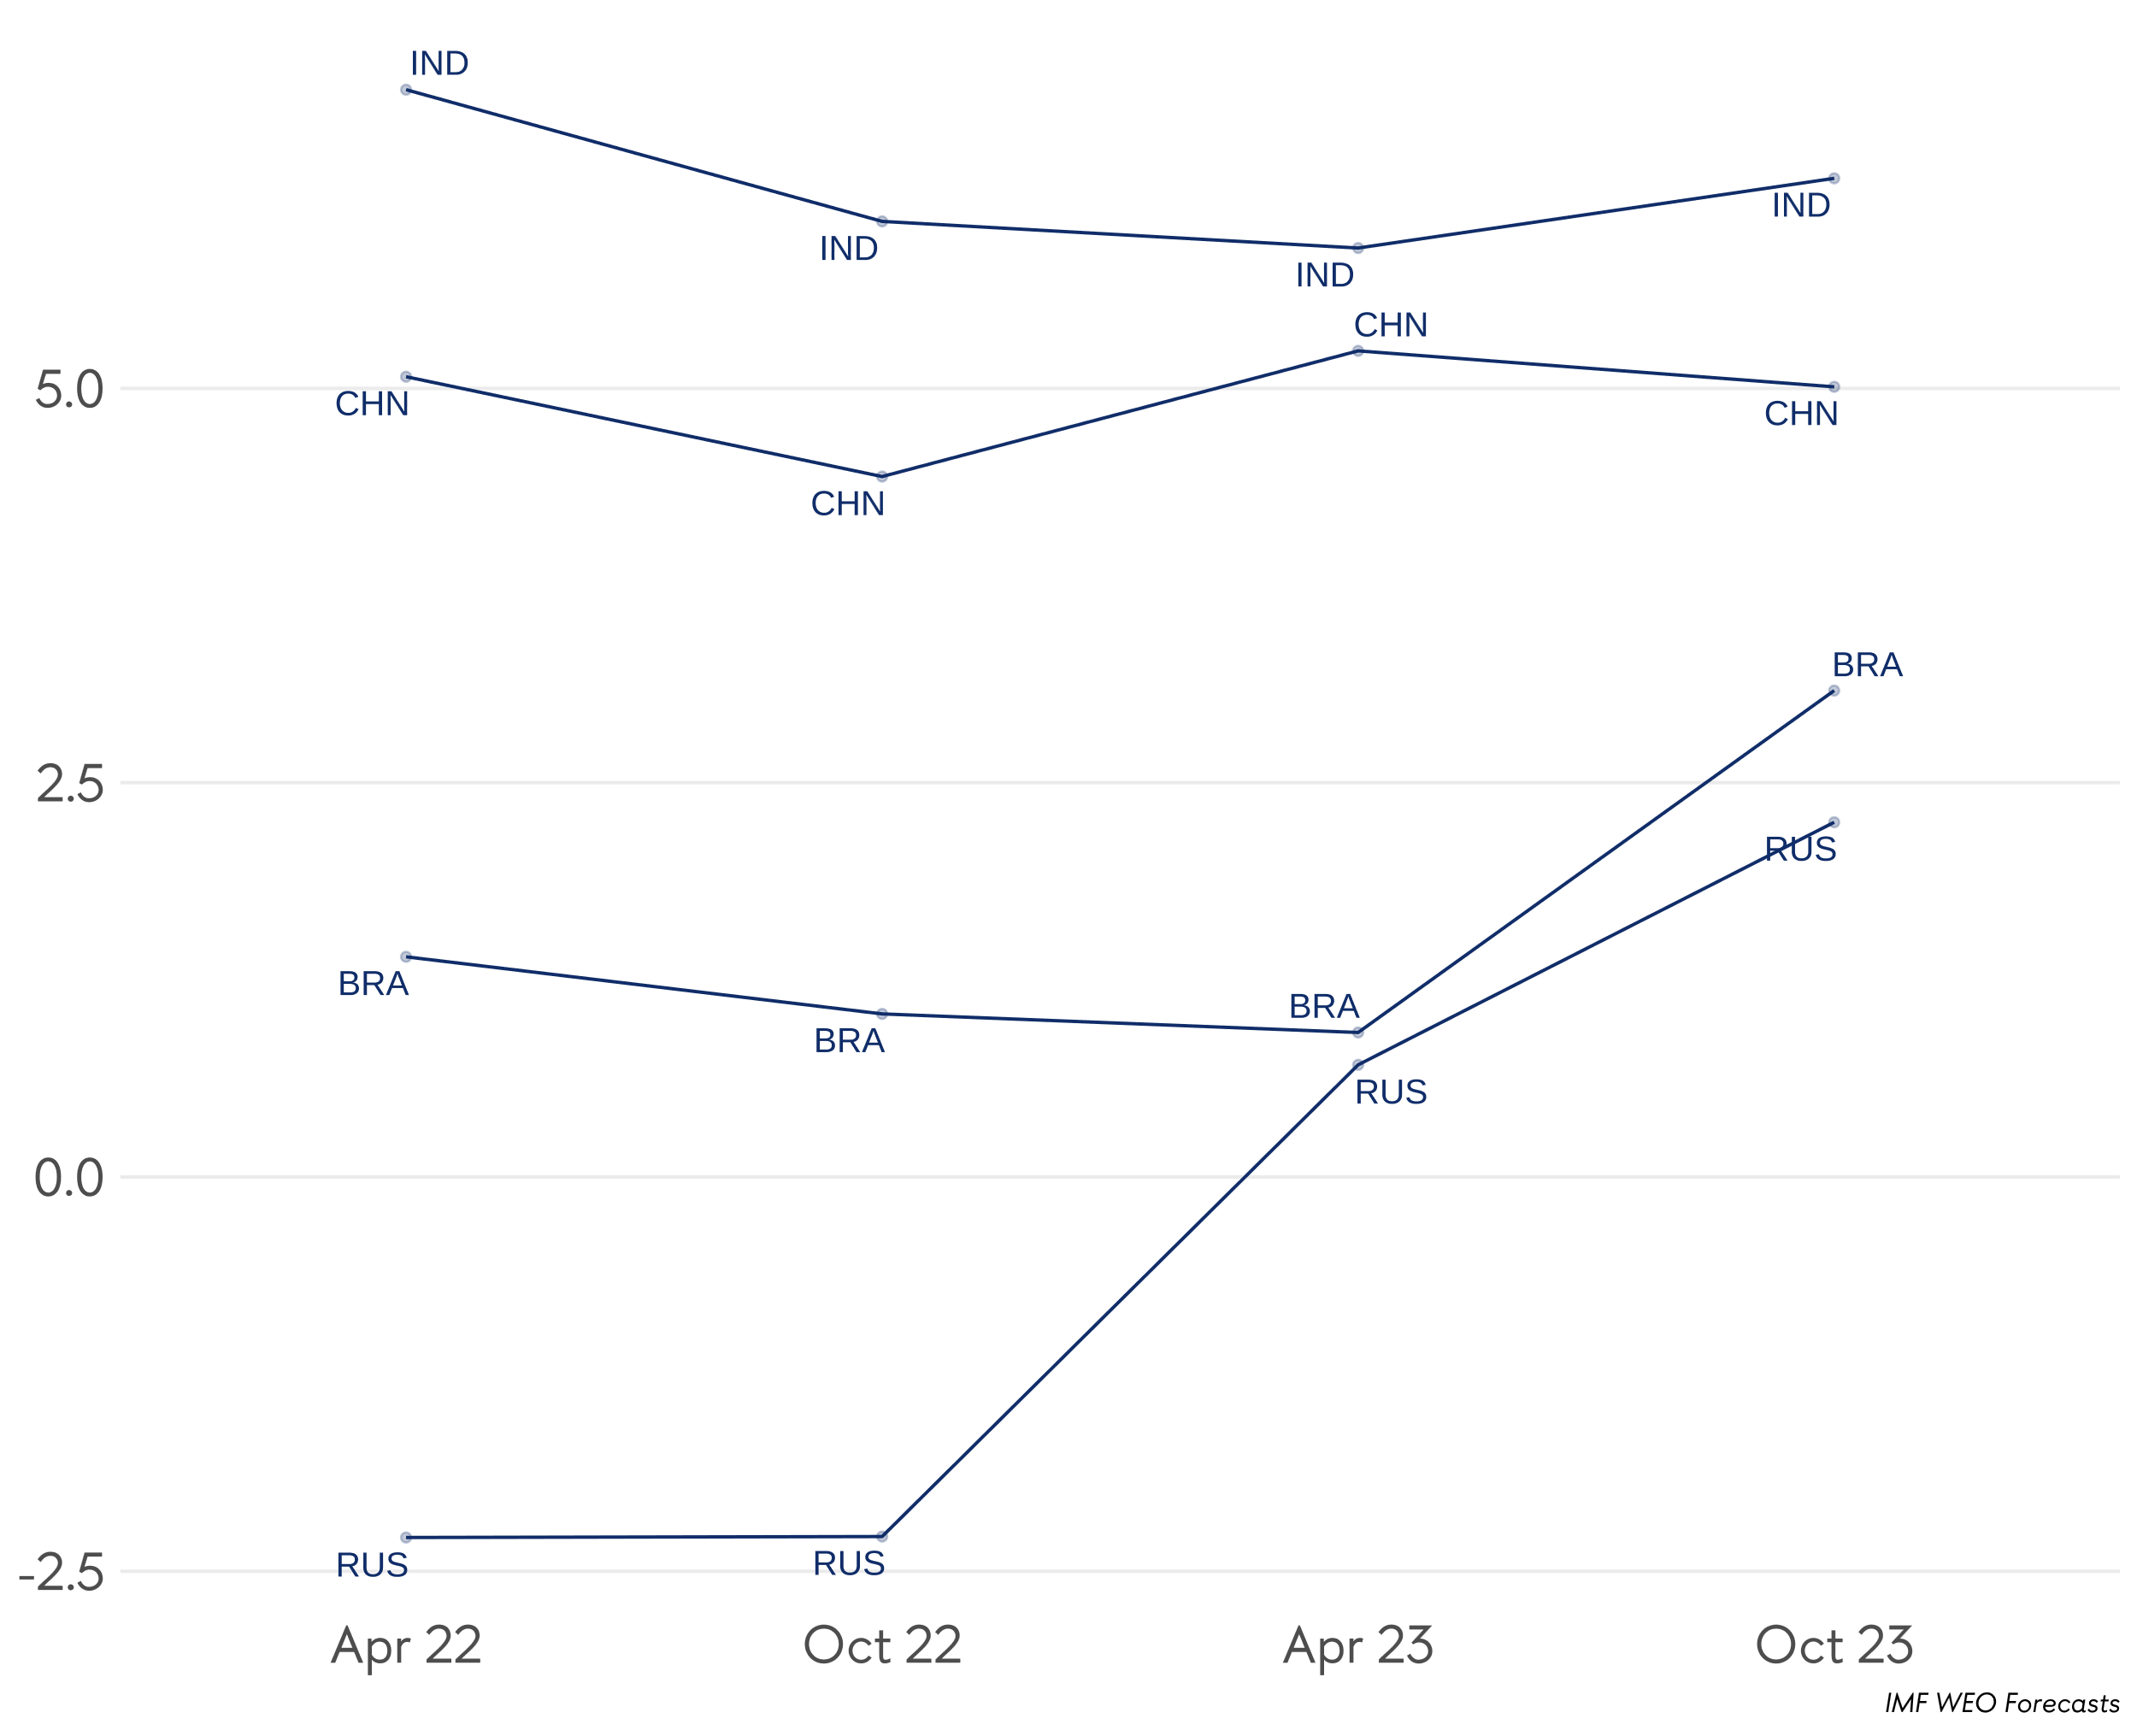
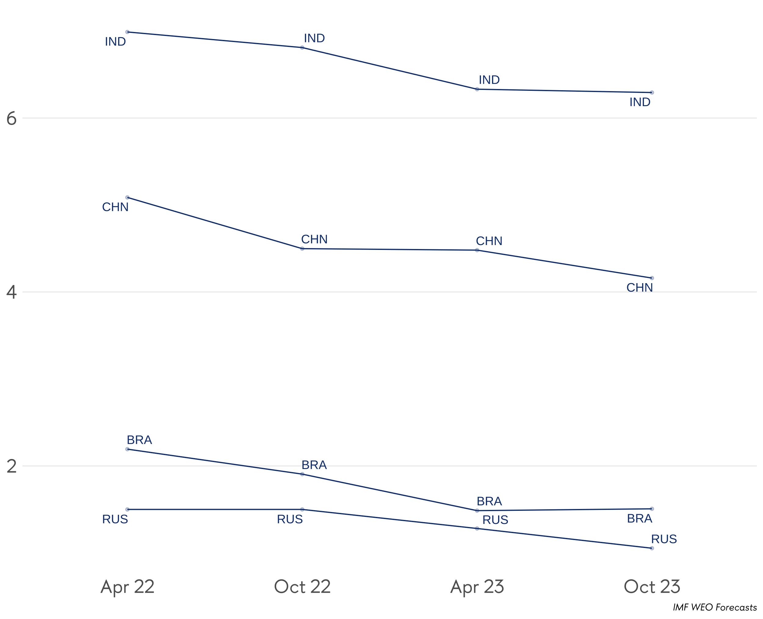
EM economies are stronger in 2023, weaker in 2024
2023
2024
Source: IMF

Slide 7
Inflation peaked out but is still above targets
Inflation rate in major developed economies
Inflation rate in major developing economies
Source: national statistics & central banks
Notes:
Стагфляция 2020-х гг. – это новая норма?
Возможен ли возврат к устойчивым темпам экономического роста в развитых странах до 2030 г.?
В какой степени долговое бремя будет ограничивать рост развивающихся экономик?

Slide 8
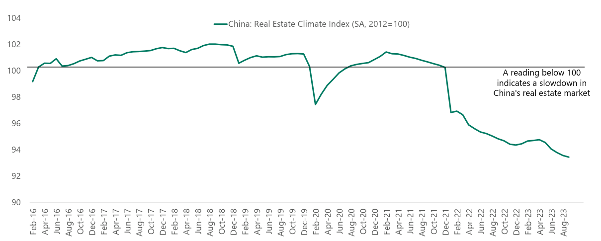
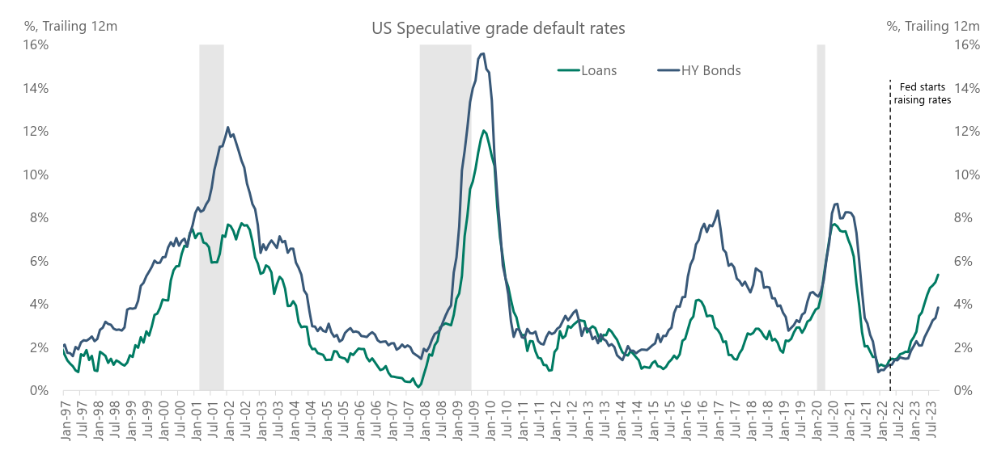
Soft landing is the probable outcome, but …
China real estate sector (25% of GDP) in in deep recession
Higher interest rates increase the debt service burden
The US fiscal deficit remains large and must be cut
Fragmentation of global markets is a risk, especially in commodities
Source: Apollo, FRED, IMF
Notes:
Market is pricing that monetary policy will remain restrictive and above r-star (2.5%) for the next five years. Put differently, the market is currently pricing a “no landing” scenario where monetary policy will have to put downward pressure on GDP growth and inflation for the next five years. In short, the market is extremely bullish on the economic outlook over the next five years.
FOMC and Fed estimates of r-star are saying that the Fed funds rate will move down to 2.5%. But the market disagrees and says that rates will stay around 4% for the next five years, see again the chart below.
The key question for markets is if we can get a soft landing in both inflation and in the labor market, i.e., in both parts of the Fed’s dual mandate.
With inflation slowing and the labor market softening, the risks are rising that both inflation and employment are weakening faster than markets currently expect.

