Slide 1
Marek Dabrowski
Between inflation, financial instability and debt: the patterns of economic growth in the post-crisis world
Presentation at the XI Annual Conference on the Global Economy on ‘Re-balancing of the world economy: in search of new models for global development’, Higher School of Economics, Faculty of the World Economy and Politics, Moscow, November 29-30, 2023

Slide 2
Plan of presentation
Focus on AEs and large EMEs
Short-term perspective
Restrictive monetary policy ⇒ lower inflation
No immediate global financial stability risk
Low unemployment
Lower growth
High public debt
Long-term perspective
Labor shortage and population aging
Slow TFP growth
Danger of protectionism

Slide 3
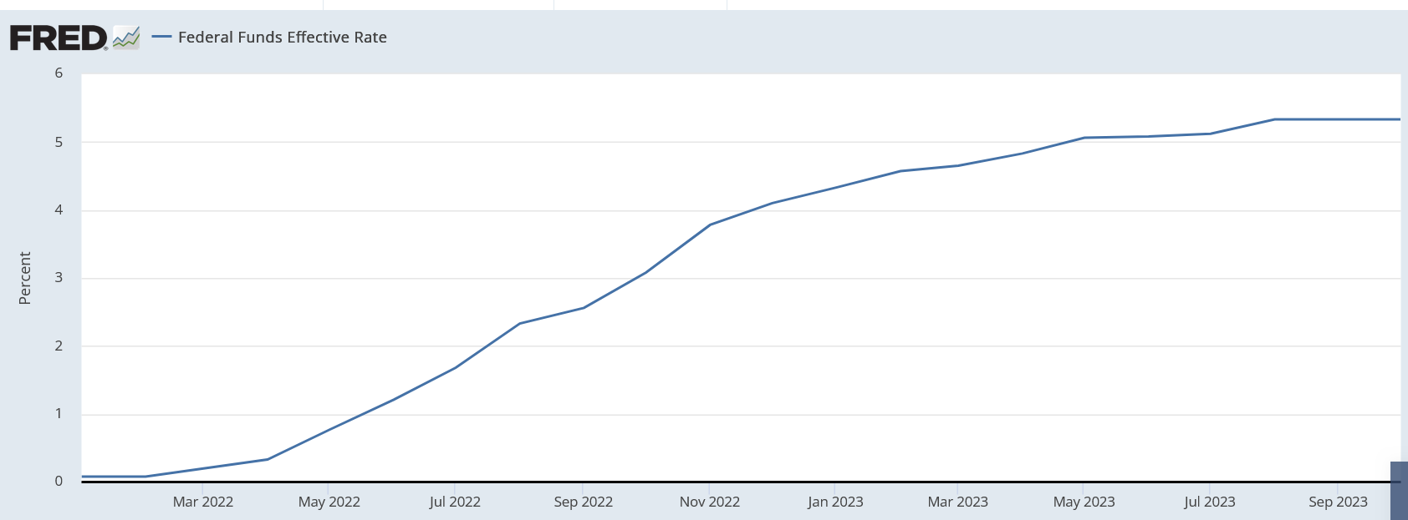

Slide 4
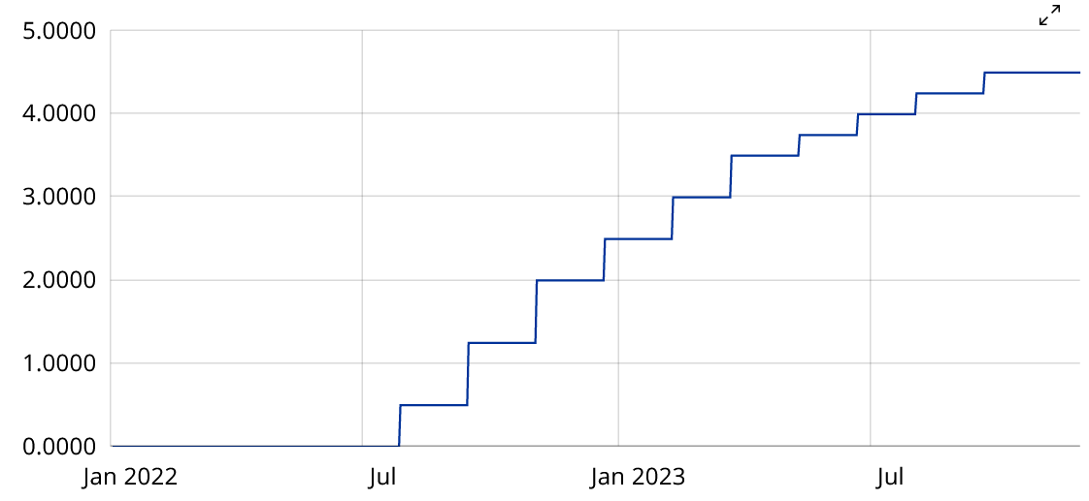
ECB – main refinancing operations rate

Slide 6
Body
BRUEGEL​

Slide 7
Body
BRUEGEL​

Slide 9
Factors of economic growth
Labor
Investment
Total factor productivity (TFP)

Slide 10
Global labor supply mismatch
Shortage of labor in Europe, North America, and East Asia
Surplus of labor in South and Central Asia, Africa and MENA
Obstacles to large-scale inter-regional migration
Structural and institutional growth barriers in Africa and MENA
Limited capacity of other measures (increasing retirement age, labor market participation of female labor force, etc.)

Slide 11
Body
BRUEGEL​

Slide 12
Slowing down TFP after 2004
End of the major impact of ICT revolution (1995-2004)
Stagnation in globalization; protectionist challenges
Increasing geopolitical tensions and conflicts
Uncertain future (further progress in ICT, robotization, AI, green transition, global security, crisis of multilateral organizations and agreements)

Slide 13
Specificities of the recent protectionist push
Traditional protectionist arguments: protecting infant industries, job protection, import substitution, consumer and health protection
Post-COVID slogans/ arguments: simplifying/ shortening supply chains, onshoring, nearshoring (reducing CO2 emission), friend shoring, reindustrialization, security concerns, geopolitical tensions (weaponization of trade and finance)

Slide 14
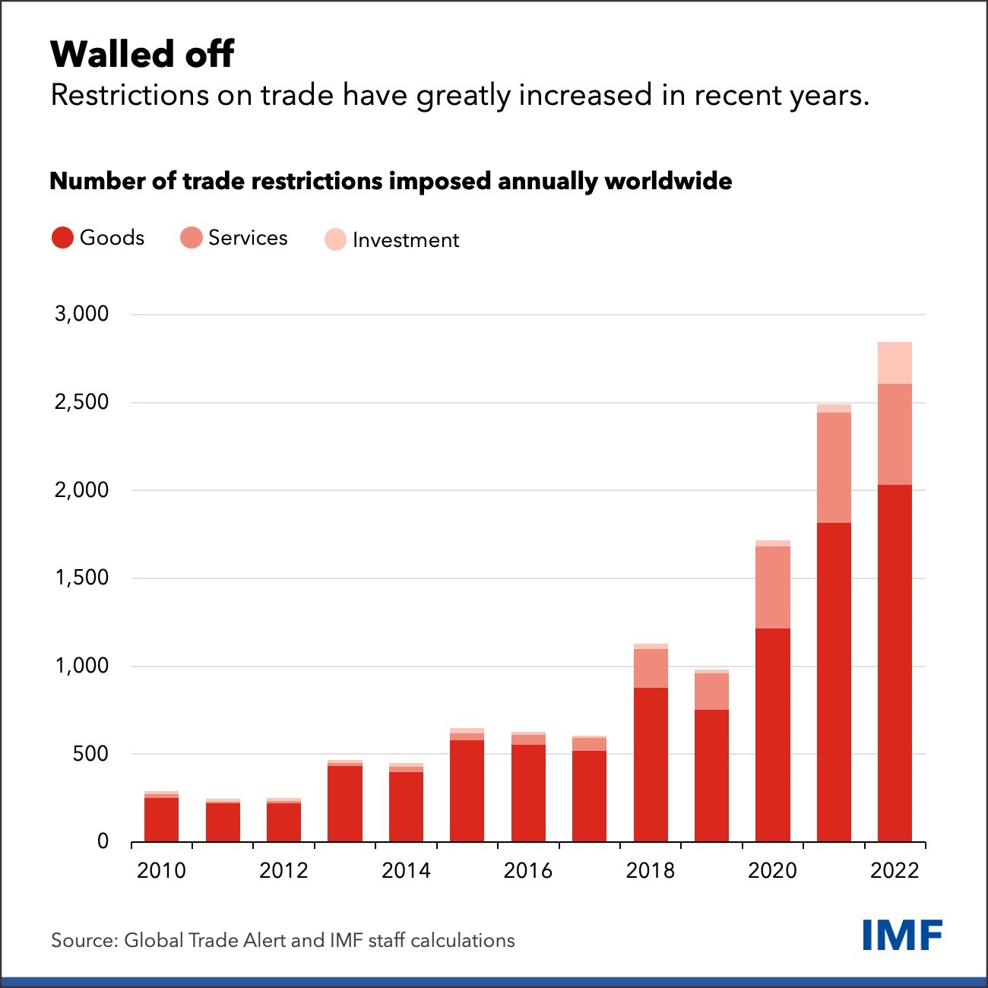
Source: https://www.imf.org/en/Blogs/Articles/2023/08/28/the-high-cost-of-global-economic-fragmentation

Slide 15
Negative consequences of protectionism
Slower global growth, especially in AEs, and latecomers to globalization (e.g., Africa)
More poverty, especially in low-income economies
More inequalities, global and national
More persistent inflation, difficult and costly disinflation
Spillover to political conflicts (a kind of vicious circle)

Slide 16
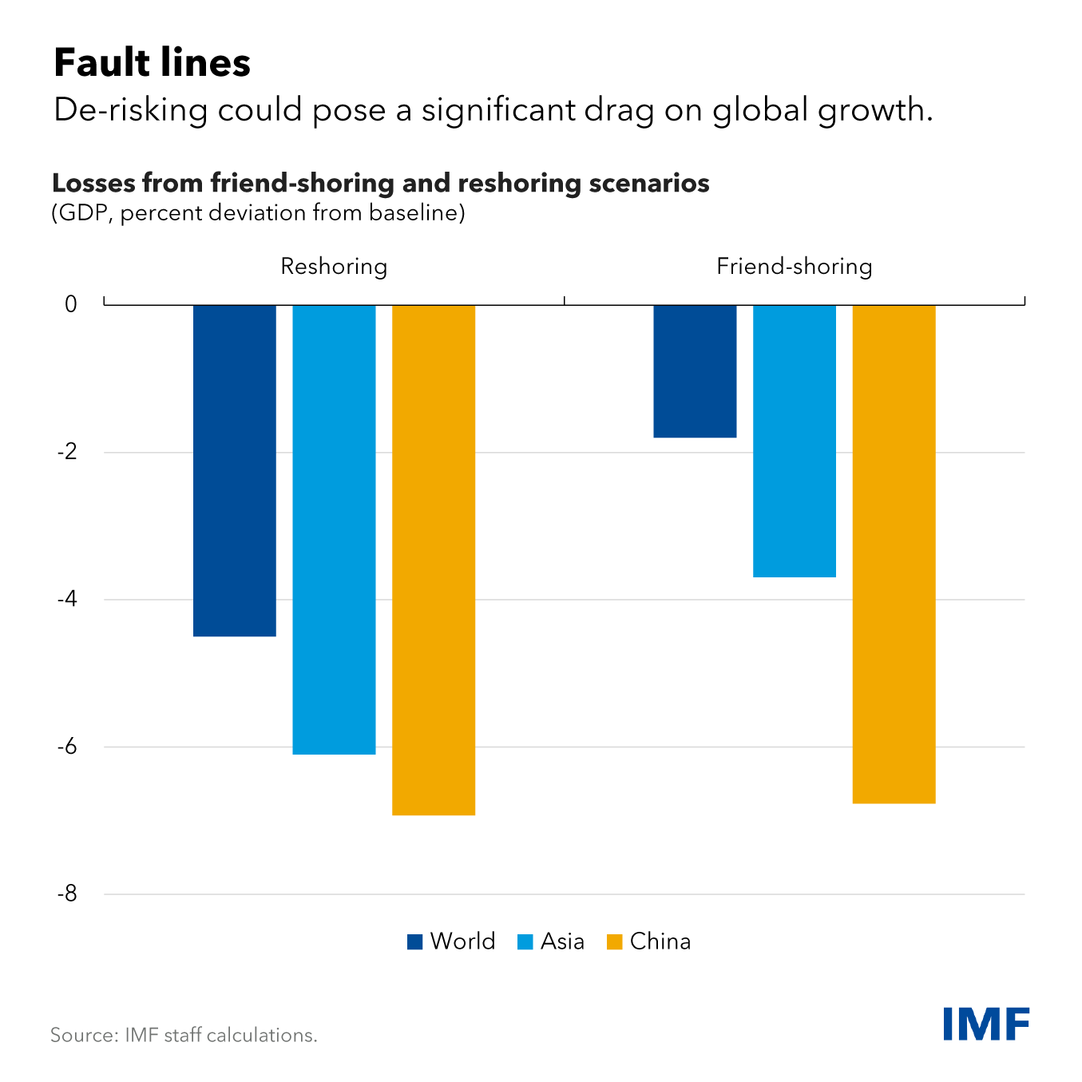
Source: https://www.imf.org/en/Blogs/Articles/2023/10/17/harm-from-de-risking-strategies-would-reverberate-beyond-china

Slide 17
Challenges ahead
Protectionist pressures
Public debt burden
Demographic headwinds (shrinking working-age population and population aging in several countries)
Deteriorating international security (wars and other conflicts)
Climate changes and green transition
Uncertain prospects of productivity growth

