Slide 1
Higher-for-longer
XI Annual Conference on the Global Economy
“Re-balancing of the world economy: in search of new models for global development”
Anastasia Podrugina, PhD, Associate Professor, School of World Economy
apodrugina@hse.ru

Slide 2
Core inflation is persistent
Source: OECD

Slide 3
Energy and food shocks are mostly over
U.S.
Germany
UK
Italy
Source: OECD

Slide 4
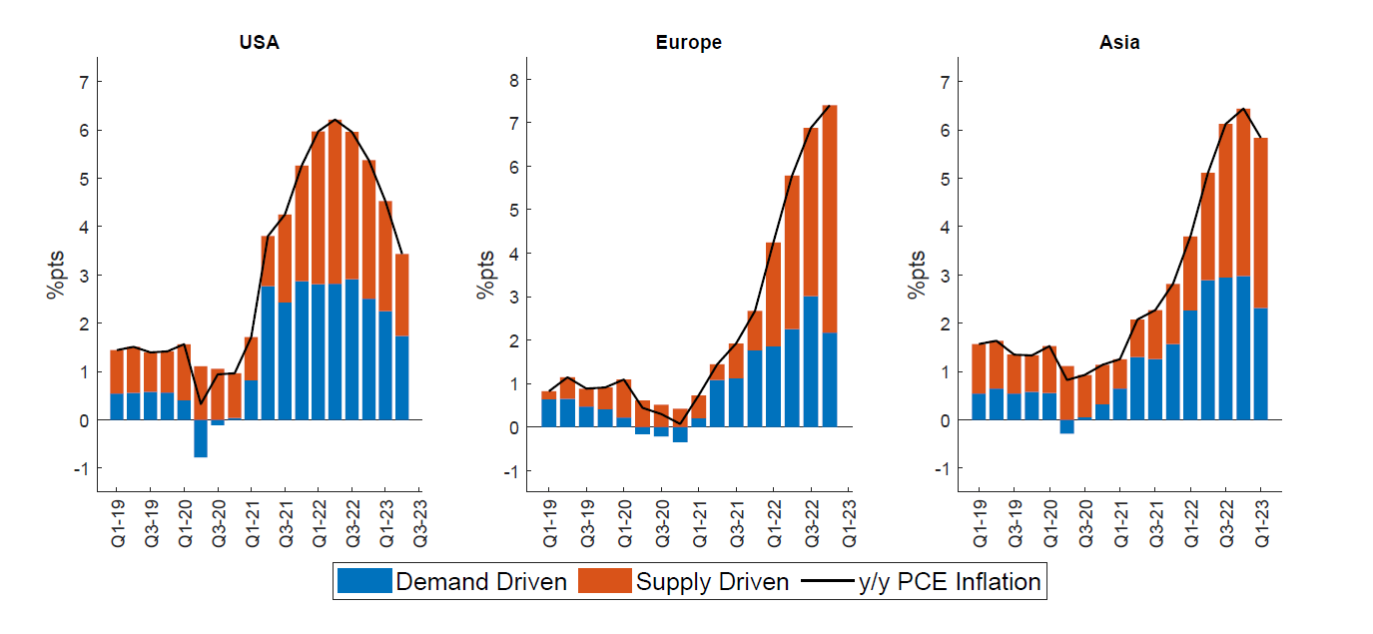
Central banks were late
Source: [IMF, 2023]
Inflation was not caused solely by supply-side factors

Slide 5
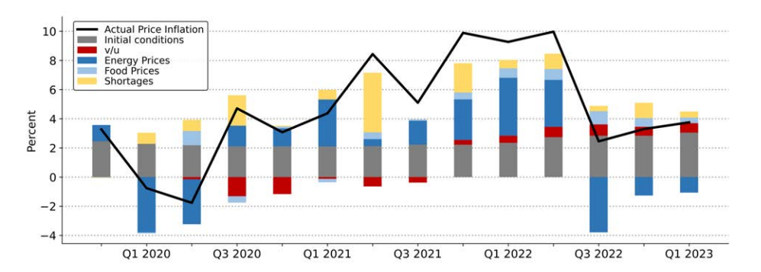
Source: [Bernanke, Blanchard, 2023]
Without pandemic inflation would have been stable
Energy and food prices shocks influenced notably
Tight labor market effect was relatively small
Unfocused fiscal stimulus contributed to inflation significantly [Cline, 2023], [Jorda, Nechio, 2023], [di Giovanni et al., 2023]

Slide 6
Real bank policy rates are positive at last
Higher-for-longer interest rate environment
Since the end of 2021
developed economies raised rates by 400 b.p.,
developing economies – by 650 b.p.
[Adrian, 2023]
Source: national central banks

Slide 7
World economy is flying a go-around, landing is delayed

Slide 8
Countries with non-fixed rate debt are at risk
Source: BIS

Slide 9
Closer look at European debt
Debt service up to 2 years
Overall situation is better
Italy and Spain are potential sources of danger
Source: ECB

Slide 10
Average maturity is higher than in 2009
Share of floaters increased for Eastern Europe
Source: ECB

Slide 11
Conclusion
Inflation is persistent and it will require long period of high interest rates to manage it
Fight with inflation poses a threat to financial stability especially to issuers of non-fixed rate debt

Slide 12
References
Adrian T., Higher-for-Longer Interest Rate Environment is Squeezing More Borrowers, IMF Blog, October 2023
Blanchard O. J., Bernanke B. S. What Caused the US Pandemic-Era Inflation?. – National Bureau of Economic Research, 2023. – №. w31417.
Cline W. Fighting the pandemic inflation surge of 2021-2022 //Economics International Inc., Working Paper. – 2023. – С. 23-1.
Firat M., Hao O., Demand vs. Supply Decomposition of Inflation: Cross-Country Evidence with Applications. IMF Working Papers – 2023.
di Giovanni J. et al. Pandemic-Era Inflation Drivers and Global Spillovers. – National Bureau of Economic Research, 2023. – №. w31887.
Jorda O., Nechio F. Inflation and wage growth since the pandemic //European Economic Review. – 2023. – Т. 156. – С. 104474.

