Slide 1
Macroeconomic indicators in Russia: Foreign Economic Trends, Outcomes and Forecasts
Alexander Knobel
Head of International Trade Departament

Slide 2
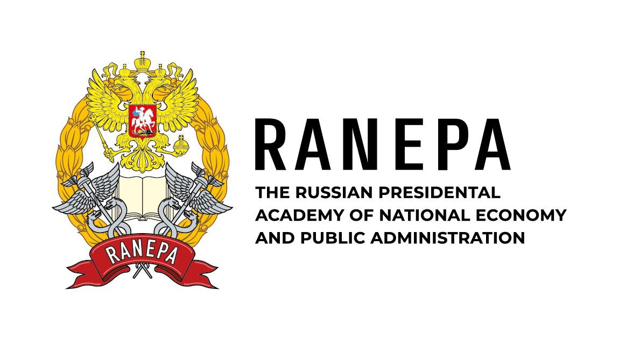
Short- and medium-term forecasts for the global economy
The world GDP and trade volume growth rates in 2022-2028
(according to the IMF, % of the previous year)
New forecasts for global growth in 2023-2024
Global economic conditions have improved but merchandise trade continued to slow
The IMF expects global growth of about 3% in 2023-2024.
According to the World Bank forecast, economic growth in the world will slow down to 2.1% in 2023 forecast but in 2024 output is expected to rise to 2.4%.
The latest OECD’s Economic Outlook predicts global GDP will grow 2.7% in 2023 , with a modest improvement of 2.9% in 2024.
Sources: IMF, World Bank, OECD.

Slide 3
International trade: fundamental trends and recent factors
Growth of non-tariff trade restrictions
Paralysis of the WTO and multilateral trade system
Trade wars
Digitalization of global economy and trade
Comprehensive focus on sustainable development and climate change agenda
Geopolitical crisis in Europe
More incentives for deglobalization and further fragmentation of trade
2018
2019
2020
2021
2022
2023
2024
Challenges for global supply chains functioning and international cooperation during COVID-19 pandemic
New wave of trade restrictions to tackle pandemic disbalances
I. Growth of protectionism, deglobalization
II. New aspects for regulation and negotiations but contradictions as well
III. GVCs reconfiguration, reorientation of the global trade flows and cooperation chains
3

Slide 4
Sanctions against Russia
In 2022 Russia became the world leader in terms of the number and scope of sanctions restrictions imposed
Initiators of sanctions contribute 60% of global GDP: EU, US, UK, Japan, Canada, South Korea and others
Financial sector: blocked CBR reserves, assets and activities of Russian banks, banks disconnected from SWIFT, restrictions from international payment systems
Trade: cancelled MFN, restrictions on exports to Russia (dual-use goods, high-tech products, including electronics and components), embargo on imports (fuels, key exports)
Energy: ban on supplies of technology and equipment for the development of oil refineries, price cap
Transport: airspace of 37 countries closed, ban on supplies of aircraft, equipment and spare parts, maintenance, US, EU, UK and Canadian seaports closed, ban on road transport operators
Private sector: many foreign companies suspended operations in Russia or decided to withdraw from the market (more than 1,000 companies, mostly global corporations).
Individual sanctions, restrictions in the sphere of sports, culture and recreation
Key risks of reorientation of foreign economic activities arise from secondary sanctions.
In 2023 focus of the US, the EU and G7 countries lies on the mechanisms to prevent sanctions circumvention
USA: the most developed regulation of secondary sanctions (about 100 companies from neutral countries are under secondary sanctions against Russia).
EU: regulatory tools are being developed, lists of goods and countries that will be subject to trade restrictions are under consideration.

Slide 5
Current macroeconomic indicators
The current account is determined mostly by the value of goods exports, which depend significantly on global prices
Russia’s balance of payments went into negative area in June2023 for the first time since 2020, with a current account deficit of $1.4 billion
On the basis of 1-3 quarters of 2023, the current account surplus fell due to a reduced surplus in foreign trade
In 2023 Q1-Q3, budget revenues also were around the same level of the previous year
Increase in expenses significantly exceeds the average inflation level in Russia
The government budget deficit hit 1.0% of GDP
Indicators (in trillion rubles) | Q1-Q3 2021 | Q1-Q3 2022 | Q1-Q3 2023 | 2023 to 2021 | 2023 to 2022
Revenues | 17,92 | 19,74 | 19,73 | 10,1% | –0,03%
Oil and gas | 6,18 | 8,51 | 5,58 | –9,9% | –34,5%
Non-oil and gas | 11,74 | 11,23 | 14,16 | 20,6% | 26,0%
Expenses | 16,48 | 19,54 | 21,43 | 30,1% | 9,7%
Surplus/deficit | 1,44 | 0,20 | –1,7 | –3,14 | –1,9
Inflation (%, from 1st January) | 5,3 | 10,7 | 5,5 | .. | ..
Indicators (in billion $) | Q1-Q3 2021 | Q1-Q3 2022 | Q1-Q3 2023
Current account | 75,2 | 195,9 | 40,9
Trade balance | 121,7 | 252,7 | 87,8
Export | 340,3 | 448,1 | 314,7
Import | 218,6 | 195,3 | 226,8
Balance of services | -14 | -14,1 | -24,8
Export | 38,6 | 36,4 | 30,3
Import | 52,6 | 50,4 | 55,1
Balance of primary and secondary income | -32,7 | -42,6 | -22,1
Sources: Bank of Russia, Ministry of Finance of RF

Slide 6
Results of 2022 and factors for further economic development
Динамика ВВП | In 2022, the Rosstat recorded a decline in Russia’s GDP of 2.1%. Russian economy contracted by 1.8% YoY in Q1 2023 and grew by 4.9% YoY in Q2 2023. As a result, it made possible to achieve positive growth in 1H 2023 (+1.6% YoY).
Inflation | The current inflation picture is changing radically, as a number of pro-inflationary factors are gaining strength, such as an increase in household incomes and a lower savings ratio, a significant strengthening of the USD against the ruble, and a large-scale increasing budget spending. In our view, inflation will get higher by the end of the year, to ~8%.
Investments | Sanctions resulted in significant damage to the investment climate. State and the state corporations become the major source of investment. The peak decline in investment activity Russian economy is experiencing nowadays, in 2023. Further recovery will be dependent on a number of factors, such as interest rates on loans, corporate profits, rebound in investment import, etc.
Real incomes of the population | Real disposable income of the population decreased in 2022. However, income from work occupies a large share in the income structure of the population. Due to the labor shortage in the domestic market, employers are increasing wages at a rate exceeding current inflation. Acceleration of inflation in the second half of 2023 and increased tax and administrative pressure are leading to a slowdown in the recovery of real disposable income of the population this year.
Retail | Retail turnover decreased by 6.5% in 2022, which is primarily due to decreased demand, as well as to some extent to a supply shortage. In the first 7 months of this year, retail trade turnover increased by 2.4% in real terms. Lower inflation, goods imports and household incomes recovery, the low-base effect of the previous year are anticipated to boost activity in retail.
Unemployment | At the end of 2022, the unemployment rate dropped to 3.9%. The downward trend continues. At the end of August 2023, the unemployment rate fell to 3.0%, which may indicate a possible labor shortage in some areas.
Growth rates of the main macroeconomic indicators of Russia
in % YoY
Indicator | 2022 | 1Н 2023
GDP | –2,1 | +1,6
Consumer Price Index | 11,94 | 3,7*
Investments in fixed assets | +4,6 | +7,6
Real disposable personal income | –1,0 | +4,7
Retail turnover | –6,5 | +2,4**
For reference:
Unemployment rate (according to ILO), % of EAN | 3,9 | 3,0***
Notes:
* – August 2023 to December 2022
** – January-July 2023 to January-July 2022
*** – August 2023

Slide 7
Macroeconomic forecasts
GDP, industrial production, retail trade turnover, real incomes and wages move to growth this year
Inflation will return to target level by the end of 2024
The level of 2021 in key indicators will be surpassed in 2024
Indicators | 2020 | 2021 | 2022 | 2023 | 2024 | 2025 | 2026
Real GDP | –2,7 | +5,6 | –2,1 | +2,0 | +1,3 | +1,7 | +1,8
Nominal GDP, trillion rubles | 107,7 | 135,3 | 153,4 | 172 | 185 | 201 | 218
Consumer price index | 4,9 | 8,0 | 11,94 | 7–8 | 4 | 4 | 4
Investments in fixed assets | –1,4 | +7,7 | +4,0 | +3,2 | +1,2 | +1,6 | +1,9
Industrial production | –2,6 | +5,3 | –0,6 | +1,6 | +1,5 | +1,8 | +1,7
Real disposable income of the population | –3,5 | +3,0 | –1,0 | +3,1 | +1,8 | +2,0 | +1,9
Retail turnover | –4,1 | +7,3 | –6,7 | +3,2 | +1,4 | +1,8 | +1,7
Real wages | +3,8 | +2,9 | –1,2 | +5,5 | +2,4 | +2,2 | +2,0

Slide 8
China’s role in trade reorientation in 2022–23
The reorientation of imports to neutral countries mainly completed by the end of 2022, exports – at the beginning of 2023. The shares of trading partners stabilized in 2023 at new levels:
the share of neutral countries in January–July increased in imports to 73.2% (+10.7 p.p. by 2022 and +24.6 p.p. by 2021), in exports to 77.7% (+26.1 percentage points by 2022 and +33.7 p.p. by 2021)
China plays a key role in redirecting trade, its share in imports increased to 41.6% (+5.3 p. p. by 2022 and +16.9 p.p. by 2021), in exports − to 23.9% (+8.8 p.p. by 2022 and +9.3 p.p. by 2021)
Major partners in 2023 (by January–July 2021):
trade with the main “unfriendly” countries (import and export) decreased: EU ( –46% & –62% ), UK (–40% & –99,7%), USA (–63% & –90%), South Korea ( –50% & –16% ), and Japan ( –54% & –40% )
imports from neutral countries have increased: China (+84% ), Turkey (+68%), Belarus (+64%) and Kazakhstan (+68%), weaker — from more remote: India (+28%) and Brazil (+21%); exports to neutral non–CIS countries have increased: China (+56% ), Turkey (+91%), India (в 6,7 раз), weaker in EAEU countries: Belarus (+20%) and Kazakhstan (+6%)
Increased trade with China in 2022– 2023
HS Group | Russian exports to China |  | Russian imports from China
 | 2022/ 2021 | 01–10 2023/ 01–10 2022 | 2022/ 2021 | 01–10 2023/ 01–10 2022
Foodstuff and agricultural products, 01–24 | 43% | 52% | 39% | 4%
Mineral products, 25–27 | 53% | 11% | 75% | 6%
Chemical industry products & rubber, 28–40 | 56% | 11% | 62% | 11%
Raw leather, furs and products, 41–43 | –29% | –34% | –22% | 2%
Wood, pulp and paper products, 44–49 | 1% | –7% | 120% | 15%
Textiles and footwear, 50–67 | 38% | 20% | 2% | 31%
Precious stones and metals, 71 | 5% | 47% | –6% | 45%
Base metals and products, 72–83 | 7% | 9% | –1% | 29%
Machinery, equipment and vehicles, 84–87, 89, 90 | 0% | 66% | 11% | 82%
Other products, 68–70, 90–92, 94–97 | –33% | 43% | –12% | 24%
Secret commodity groups, aircraft, weapons, SS, 88, 93 | –19% | 41% | –18% | 30%
Total | +43% | +12% | +13% | +50%

Slide 9
Russia's Foreign Trade Results 2023: China's Role
Export 2023:
$430 bn (–27% in value, –8% in volume compared to 2022), including:
Import 2023:
$274 bn (+8% in value, +1% in volume compared to 2022),
including:
Non-resource non-energy exports: $155 bn (–18% in value, +6% in volume compared to 2021, including industrial goods: $114 bn (–23%)
Machinery and equipment:
$128 bn ( +19% in value, +16% in volume)
From China $115 bn +33%
From “unfriendly” countries
$75 bn
–17%
To “unfriendly” countries
$90 bn
–68%
To China $109 bn +11%

Slide 10
Russian exports to China in 2022–2023 — discounts
Discounts made it possible to quickly redirect supplies, but may become a factor constraining their growth
Discount on Russian oil:
Small deviations in the average price of supplies from Russia and other countries may be caused by irregular flow within a month.
There were no systematically stable deviations until April 2022.
Since March 2022, Russian oil has been supplied to China at a discount:
In the summer of 2022 , it reached 15%
By the end of 2022 , it decreased to 4-9%
After the start of the embargo on oil supplies to the EU – increased again to 11% in May 2023
Since June 2023, it has been decreasing – in August-October, the discount was on average 4%
The total discount for January-October 2023 amounted to about $3.5 billion

Slide 11
Russian Foreign Trade Forecast: 2023-2030
Flow | 2022 | 2023 |  | 2024 |  | 2025 |  | 2026 |  | 2030
 | $ bn | $ bn | 2023/22 | $ bn | 2024/22 | $ bn | 2025/22 | $ bn | 2026/22 | $ bn | 2030/22
Export | 590,8 | 429 | –27% | 435 | –26% | 445 | –25% | 460 | –22% | 590 | –1%
Import | 255,2 | 274 | 8% | 280 | 9% | 285 | 12% | 300 | 17% | 360 | 40%
Export Forecast:
Regions: growth — South-East Asia, China, India, Middle East, North Africa. The negative trend (-70-100%) is focused on the EU, UK, Ukraine, USA. Reduction for neutral countries: Iran, Mexico, other European countries, etc.
Goods: negative trend — energy resources (various factors), except for the gradual build-up of LNG; growth - gemstones, metals, food (wheat and barley), railway wagons and equipment, power engineering equipment.
Import Forecast:
Regions: growth — EAEU, Turkey, India, Taiwan, Mexico and Azerbaijan. Reduction of imports is recorded with Ukraine, as well as with Australia, where Russian imports are largely represented by sanctioned goods.
Goods: negative trend — fertilisers, transport machine equipment (except for land transport), agricultural goods (barley, wheat, oils, dairy products); growth - other non-energy goods, including the main types of machinery and equipment.
11

Slide 12
Risks for Russia in New Reality
Sanctions are a long-term key factor in Russia's international relations.
General sustainability of the Russia`s economy under the pressure of obvious risks
According to the main macroeconomic indicators - relative stability in 2022,
In 2023: strengthening of negative factors through the reduction of oil and gas export revenues, with a more moderate growth of budget expenditures, the deficit decreased, but still remains
Inflation risks are assessed as medium, investment climate and demographic deterioration risks are more significant.
Important remaining risk indicators - deterioration of the situation on the main balance of payments indicators, uncertainty on budget expenditures
Foreign economic risks – challenges for foreign economic reorientation, secondary sanctions (gradual expansion of the US sanctions lists to include companies from neutral countries).

Slide 13
Challenges and Opportunities for Russia in the New Reality
Reorientation of foreign economic activities, launch and development of new cooperation formats in foreign markets:
In the new realitу the issues of reorientation to the alternative markets are exceptionally crucial: EAEU and CIS, Asia, Africa, South America.
According to the forecasts on foreign trade for the period 2022-2030: the highest growth rates of exports - China, India, Middle East, South-East Asia, other Asian and African countries, imports - India, China, SEA, Middle East, Turkey.
Chinese market represents the highest priority in foreign trade: interaction within the GVCs, opportunities for reorientation of external industrial and sevices cooperation.
Import dependence is high in many spheres, primarily in non-consumer goods, trade statistics and data on export potential show limited opportunities for reorientation. A new stage of import substitution
Opportunities for increasing cooperation with Russia should outweigh the growing risks of secondary sanctions; new formats of technological and financial cooperation independent from “unfriendly” countries are needed.
Key challenges - development of transport and logistics infrastructure to ensure trade reorientation, transition to alternative methods of international payments (including national currencies), ensuring sustainability of foreign economic activity and domestic markets in conditions of external turbulence.

Slide 14
Thank you for attention!

