Slide 1

Latin America in a changing world
XI Annual Conference on the Global Economy
“Re-balancing of the world economy: in search of new models for global development”
Bruno De Conti
University of Campinas
Moscow
Nov. 29th, 2023

Slide 2
outline
Introduction + Motivation
Economic complexity + External Trade in Latin America
FDI in Latin America
Final Remarks

Slide 3
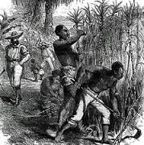
Introduction + MOTIVATION
Colonization (for more than three centuries!)
A sense of colonization (Prado Jr) prevails and still shapes LA economies and societies
Industrialization process from 1930 to 1980s
Lost decades + Opening up the economies + New International Division of Labour
          Deindustrialization

Slide 4
INTRODUCTION + MOTIVATION
Are there vectors for changes in the economic structure of LA countries?
  China?
  Pandemic & Distruption of Global Value Chains?
  Geopolitical tensions & Deglobalization?

Slide 5
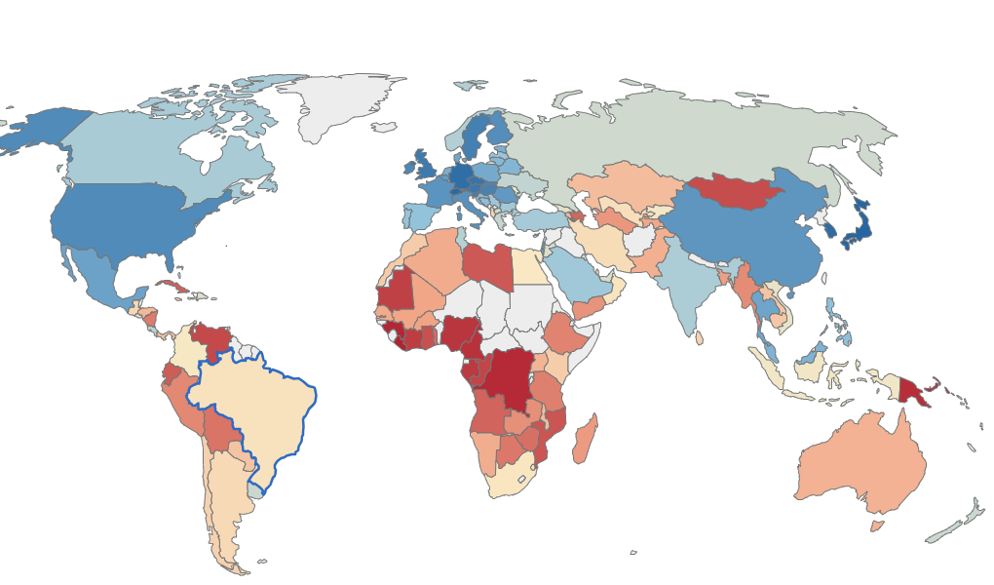

Economic complexity index
Source: ACI

Slide 6
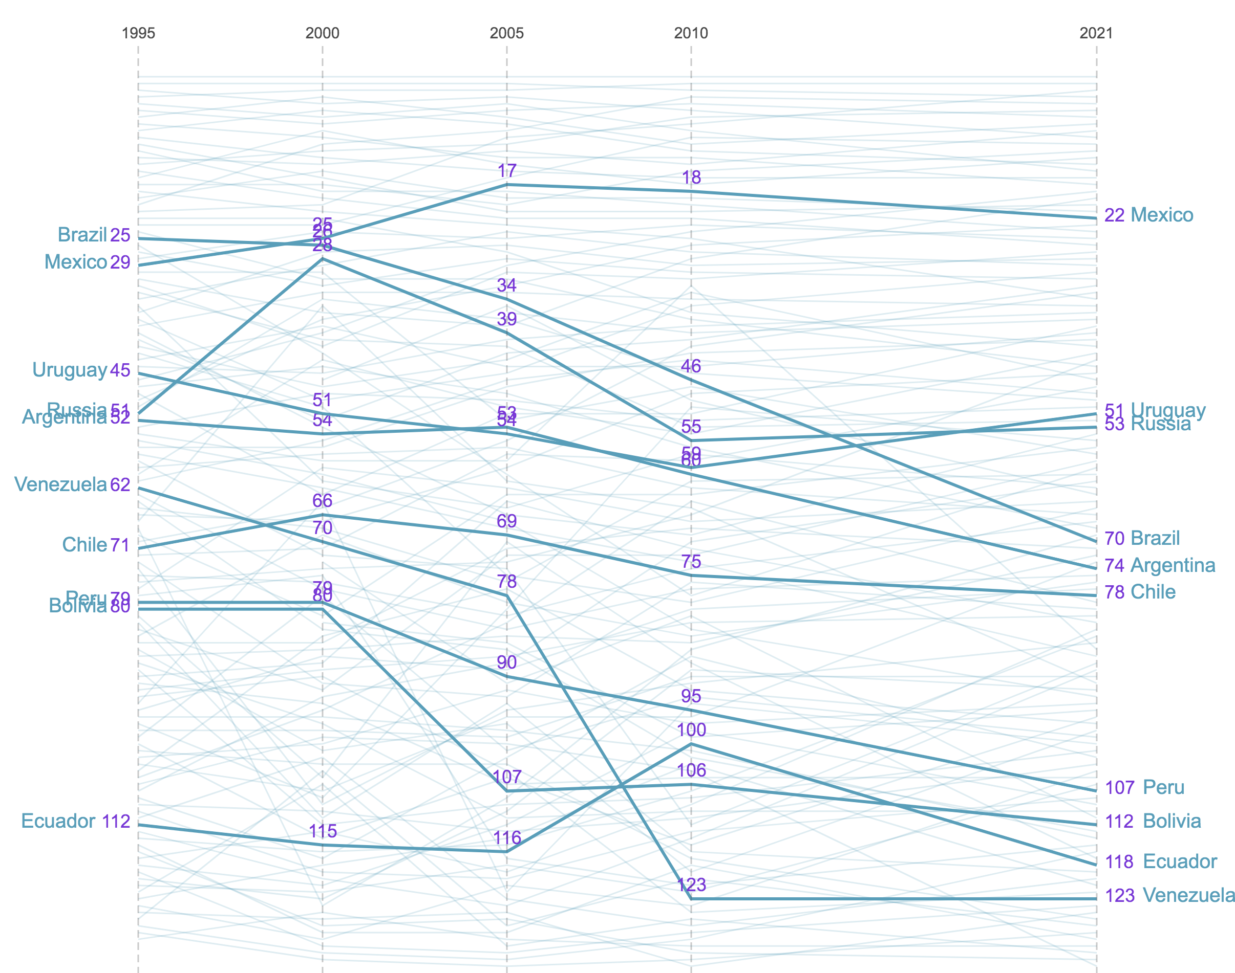
Economic complexity index
Source: ACI

Slide 7
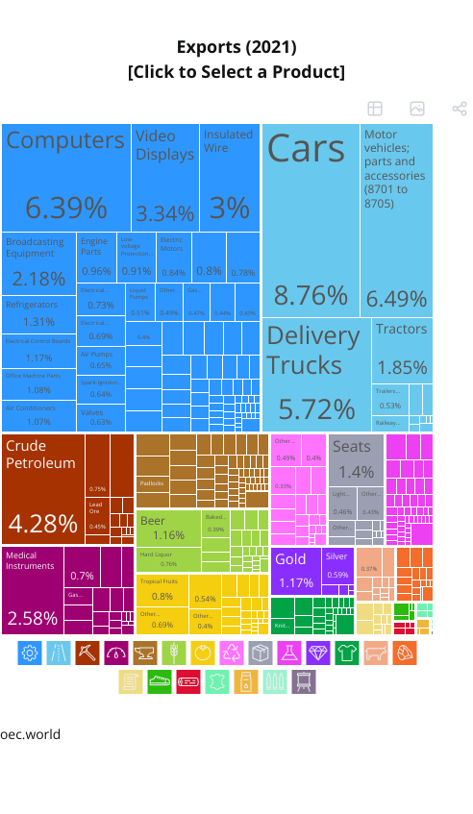
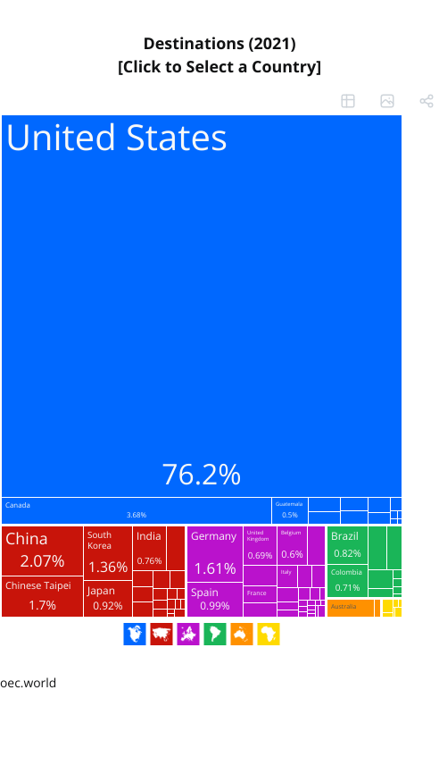
External trade in la: mexico
Source: ACI

Slide 8
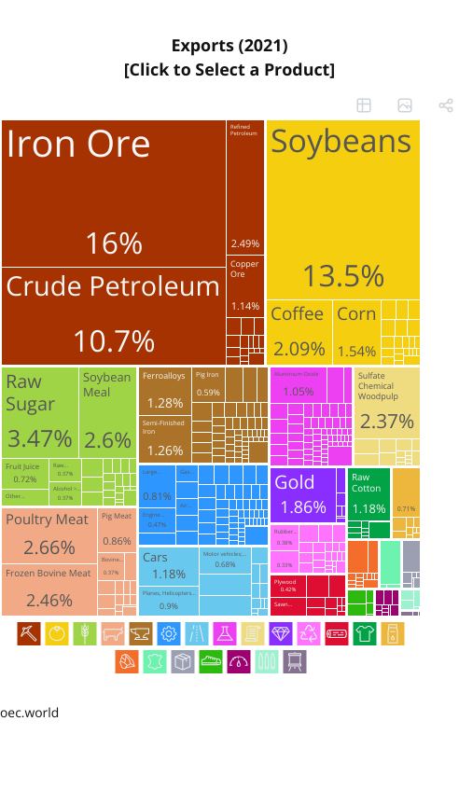
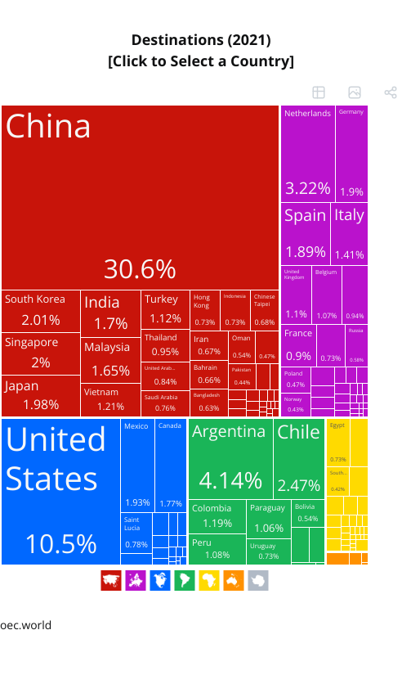
External trade in la: brazil
Source: ACI

Slide 9
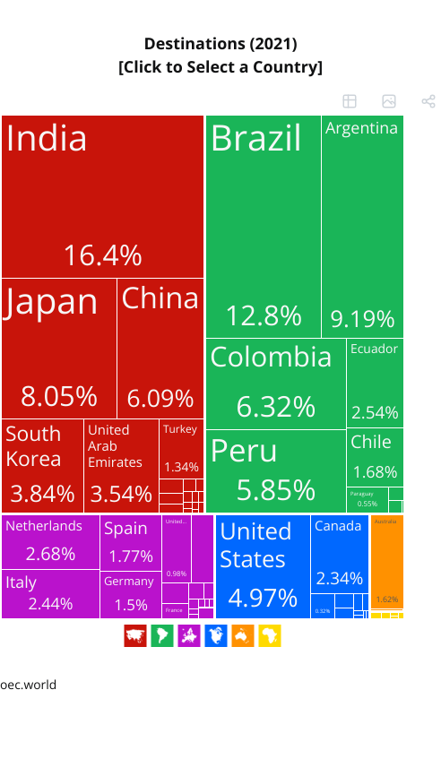
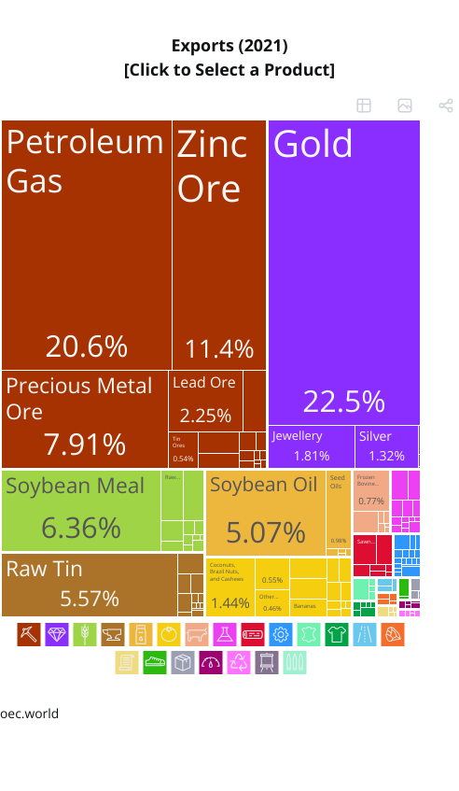
External trade in la: bolivia
Source: ACI

Slide 10
Fdi in the world

Slide 11
Fdi in the world

Slide 12
Fdi in the world
Source: ECLAC (2023)

Slide 13
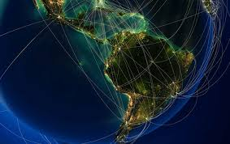
FDI in latin america
Image: Univ of Pennsylvania
OECD: 56%
EU: 63%
Source: ECLAC and OECD. Own elaboration.

Slide 14
Fdi in latin america
2022/2021 = +55.2%
Source: ECLAC (2023)
Notes:
A total of US$ 142.794 billion was received, 40.7% more than in 2020. By contrast with the global situation, however, this growth was not sufficient to return investment to pre-pandemic levels (see figure 1). Moreover, FDI inflows amounted to 2.9% of GDP, which was still below the figure for the 2010s (3.5%). Considering that FDI inflows had already been on a downward trend since 2014, this weak recovery indicates how difficult it has been proving for the region as a whole to reposition itself as an attractive destination for the establishment of new operations by transnational corporations since the cycle of booming commodity prices and high growth rates came to an end. Moreover, the Latin American and Caribbean share of total global inflows was 9% in 2021, one of the lowest proportions in the last 10 years and well short of the 14% recorded in 2013 and 2014.

Slide 15
Fdi in latin america
Source: ECLAC (2023)

Slide 16
Source: ECLAC (2023)

Slide 18
Fdi in latin america
Source: ECLAC (2023)
Notes:
Services: mainly utilities (electricity transmission, airports, etc)

Slide 19
Source: ECLAC (2023)
Notes:
technology-intensive industries (led by consumer electronics, medical devices, the manufacture of non-automotive transport equipment, and transport and storage).

Slide 20
Source: ECLAC (2023)

Slide 21
2021: Concentration in the electricity, gas and water,
telecommunications and oil refining sectors.
Source: ECLAC (2022)
Notes:
Problema dessas utilities: non-tradeable services, they do not generate US$... But, the company sends a share of the profits to the headquarter

Slide 22
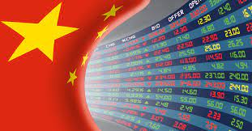
Chinese FDI
Motivations:
  Traditional ones, such as:
    New markets
    Lower costs
    Higher profits
  But also...
    “Captive demand” for Chinese inputs
    Acquisition of technology and know-how
    Setting the international standards
Image: Global Finance magazine

Slide 23
Chinese FDI
Source: De Conti & Diegues (2022)

Slide 24
Chinese FDI in Latin America
Source: Chinese Global Investment Tracker/AEI. Own elaboration.

Slide 25
Chinese FDI in Latin America
Source: Chinese Global Investment Tracker/AEI. Own elaboration.

Slide 26
Chinese FDI in Latin America
Source: Chinese Global Investment
Tracker/AEI. Own elaboration.

Slide 27
Chinese FDI in Latin America
Source: Chinese Global Investment Tracker/AEI. Own elaboration.

Slide 28
Source: Chinese Global Investment Tracker/AEI. Own elaboration.

Slide 29
Chinese FDI in Latin America
Source: Chinese Global Investment Tracker/AEI. Own elaboration.

Slide 30
Effects of the pandemic
Nearshoring / Friendshoring:

Slide 31
Energy transition
Green energy (e.g. solar, wind)
  Concerns about the social effects of the transition
Critical minerals (e.g. lithium, copper)

Slide 32
Final remarks
Great challenges in LA:
  Marginal role in the decision-making processes of transnational capital => Vulnerability to the cycles
  Decline in the manufacturing share of FDI inflows, from 40% in 2010–2019 to 29% in 2023
  Utilities do not generate hard currency => deepening of the external restriction
  FDIs to LA go rather to the sectors in which the region already has comparative advantages, reinforcing the existing productive structure
    Deepening the role of LA at the International Division of Labour

Slide 33
Is China a game changer?
  No
Was the pandemic a game changer?
  No
Is there room for more intra-regional integration?
  Ambiguous situation
Yet:
  More room for bargaigning, specially in what regards some critical minerals (eg. Lithium)

Slide 34
spasibo !
deconti@unicamp.br

