Slide 1
Rethinking public debt and central banking policies for inclusive and sustainable development in Asia-Pacific
11th Annual Conference on the Global Economy
“Rebalancing of the world economy: in search of new models for global development”
Session 3. Lost illusions: in search of new approaches to sustainable development
National Research University Higher School of Economics
Moscow, Russian Federation
30 November 2023
Mr. Vatcharin Sirimaneetham
Chief, Macroeconomic Policy and Analysis Section
Macroeconomic Policy and Financing for Development Division
United Nations Economic and Social Commission for Asia and the Pacific (ESCAP)

Slide 2
Key takeaways
Limited SDG progress in Asia-Pacific amid increasing interest rates, large development spending needs, and rising risk of public debt distress.
Rethinking public debt for the SDGs
ESCAP calls for a revisit of conventional thinking and approaches to debt sustainability assessments and proposes an ‘augmented’ approach.
Debtor countries should strike a balance between pursuing development ambitions and maintaining long-term public debt risks.
Central banking for inclusive development: through a new lens
Asia-Pacific central banks should and can do more to tackle economic inequality.
Legal and institutional amendment and risk mitigation measures are some key requirements.

Slide 3
I. Challenging development context in Asia-Pacific: limited SDG progress amid wide SDG financing gaps and rising public indebtedness

Slide 4
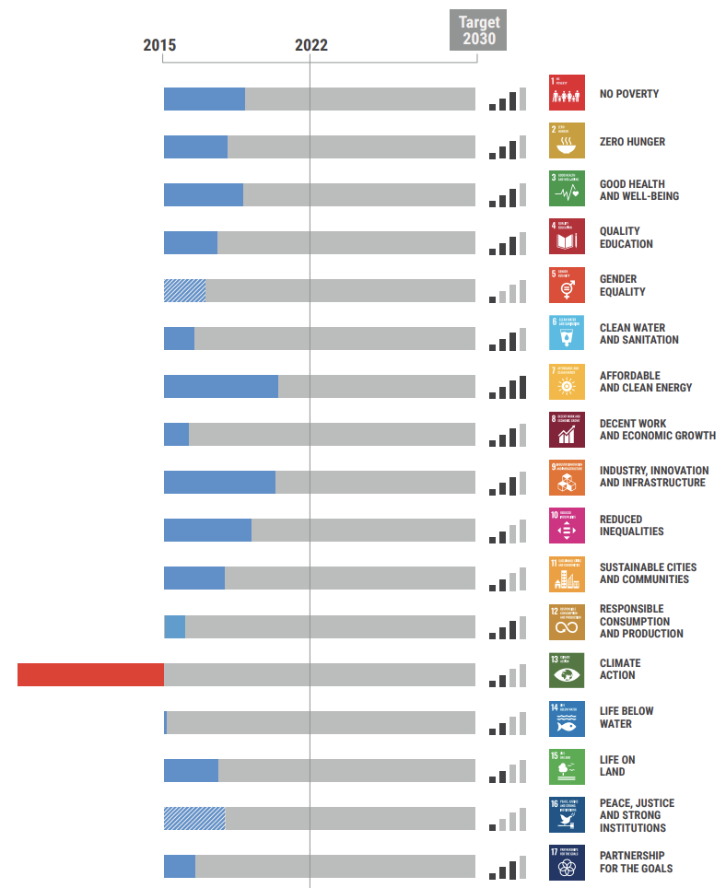
Limited SDG progress in Asia-Pacific
Source: ESCAP, Asia and the Pacific SDG Progress Report, 2023.

Slide 5
Even before the COVID-19 pandemic and global commodity price hikes, additional spending required to achieve the SDGs in Asia-Pacific by 2030 was already sizeable
Investment gap by Asia-Pacific subregions and country group, % of GDP
Source: ESCAP, Economic and Social Survey of Asia and the Pacific, 2019.

Slide 6
The government debt-to-GDP ratio in Asia-Pacific has increased to an 18-year high in 2021…
General government gross debt of developing Asia-Pacific region, % of GDP
Source: IMF, World Economic Outlook database (October 2022).

Slide 7
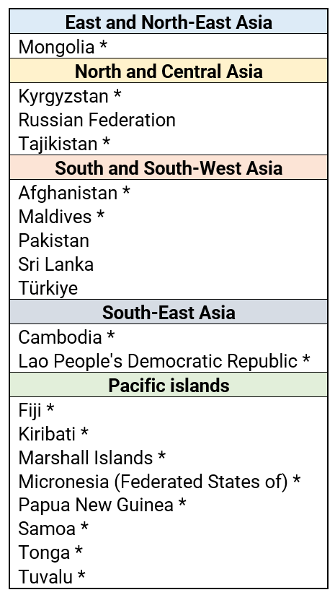
More Asia-Pacific countries are being rated as having a high risk of debt distress
Number of economies at a high risk of debt distress
Source: Joint IMF-World Bank Debt Sustainability Analysis 2012-2022, countryecononmy.com, Moody’s, Fitch Ratings, S&P Global
Note: * is countries in special situations (LDC, LLDC and SIDS).

Slide 8
II. Revisiting the public debt-development nexus:
time for new thinking and assessment approaches

Slide 9
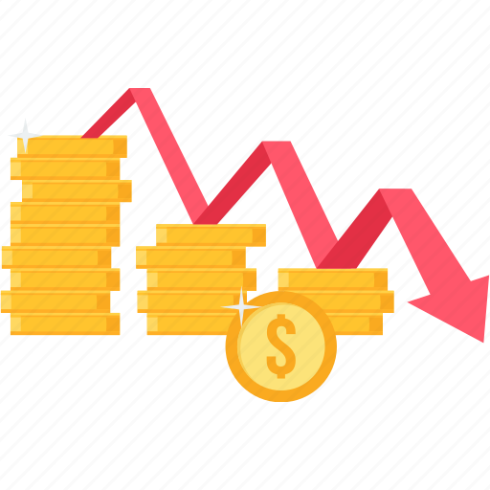
Fiscal policy options to increase fiscal resources for the SDGs are available
Public revenue mobilization, including tax and non-tax policy measures
Value-for-money, impactful public spending
Effective public debt management
Development transfers and concessional loans
Public debt relief, including through common international principles and norms
Yet, more fundamentally, do current approaches to assess public debt sustainability support SDG achievement and climate action in developing countries?

Slide 10
ESCAP’s new thinking on how public debt can foster sustainable development
Current thinking
High public debt is bad for economic growth and stability
There is a common ‘optimal’ public debt level that can be applied to different countries
New thinking
Public debt is a powerful tool for development, if used judiciously and with a long-term horizon
“Appropriate” public debt level is country-specific, depending on progress and ambitions on sustainable development.
Current approaches on debt sustainability analysis focus on maintaining ‘debt sustainability’ in the short term, leading to fiscal consolidation and limited governments’ access to financial resources for SDGs.
Need to revamp conventional debt assessment tools that have a short-term horizon.

Slide 11
How to move forward: ESCAP public debt sustainability analysis can ‘augment’ short term-focused conventional approaches
Augmented public debt sustainability analysis
Additional spending needs to meet SDGs
Structural development policies
National SDG financing strategies
Stress tests and contingent liabilities

Slide 12
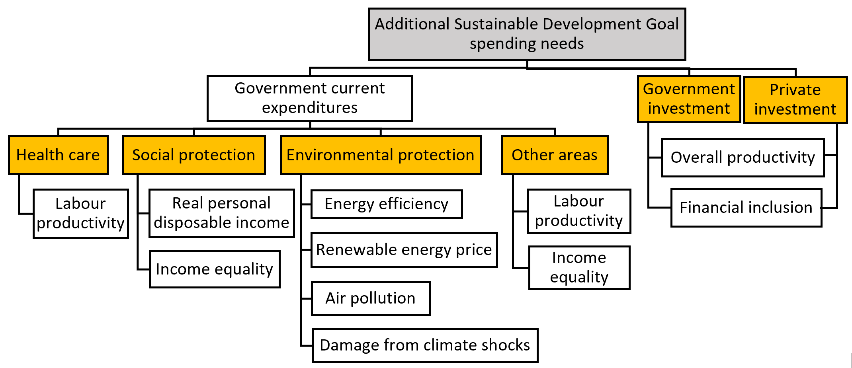
Investing in the SDGs could push up public debt level in the short run, but offers socioeconomic and environmental benefits which help reduce public debt in the long run

Slide 13
Application to Mongolia: policy scenarios
Additional SDG spending needs
17% of GDP per year on average during 2021-2030
Transport infrastructure and climate actions each account for about 40% of total cost
Structural development policies
Green economy
National SDG financing strategies
Public finance
Diversified economy
Livestock management
FTA potential
Stress tests and contingent liabilities
Private finance
Reduce debt burden
Green loans
Global coal demand and prices
Macroeconomic shocks
Contingent liabilities
Pricing carbon emissions
Enabling business environment
Increase fiscal resources
PPP environment
Slower growth in China
Higher interest rate
Weaker currency
Natural disasters
National development bank
Climate risks

Slide 14
SDG spending and policy reforms for a more diversified, greener Mongolian economy is good for its people…
Poverty incidence ($5.50 per day threshold)
Higher public and private spending
Higher household incomes and consumption
Higher employment and labour productivity
reduced poverty and inequality
Source: ESCAP, Economic and Social Survey of Asia and the Pacific, 2023.
Note: Results are shown as differences from the baseline values.

Slide 15
… and the environment
Carbon emissions
Higher environmental spending and fossil fuel prices
Lower carbon emissions
Higher energy efficiency and renewable energy use, and reduced biodiversity loss
Better air quality
Source: ESCAP, Economic and Social Survey of Asia and the Pacific, 2023.
Note: Results are shown as differences from the baseline values.

Slide 16
Government debt comes down in the long run … balancing ‘temporarily’ higher debt for large socioeconomic and environmental gains
Government debt-to-GDP ratio in Mongolia
Public debt rises initially …
Large SDG spending needs
Rising interest payments amid higher risk premium and borrowing costs
Higher tax revenue: carbon tax and reduced tax avoidance
Fiscal savings: carbon subsidy cancellation and spending efficiency
Lower borrowing costs: greater debt transparency
… but trends down afterwards
Source: ESCAP, Economic and Social Survey of Asia and the Pacific, 2023.

Slide 17
Broader policy implications for debtor countries and the international community
Balancing SDGs with public debt sustainability
Resource mobilization strategies that offer social and environmental benefits
International financial institutions and credit rating agencies can support the balancing act
Avoid panelizing governments for bold fiscal plans for people and the environment
More effective global debt resolution framework
Strengthen G20 Common Framework for Debt Treatment, e.g. make vulnerable middle-income countries eligible
Meeting fiscal rules should keep in view of economic situation and development context
View government’s efforts on debt relief negotiations positively rather than as a sign of a forthcoming default
Improve the borrowing contracts, e.g. promote state-contingent clauses
Promote common principles and norms for debt restructuring

Slide 18
III. Central banking policies for inclusive development: through a new lens

Slide 19
Fiscal and structural development policies are commonly used to address economic inequality
Tax fair
Spend smart
Deploy digital technologies
More progressive tax
Structural development policy to promote equality in the first place
Sustained creation of productive jobs, e.g. manufacturing sector
Labour empowerment
Keep technology changes at a manageable pace
Fiscal policy to address economic equality
Digitalizing tax system to increase tax compliance
Universal health, education and social protection coverage

Slide 20
Much less discussed is the role of central banks in reducing income inequality
Why?
Perceived failure of developmental central banking in the 1980s
Criticisms on recent unconventional monetary policy measures, e.g. quantitative easing in developed economies
In practice, central banks are already supporting inclusive development by maintaining price and financial stability.
Around half of central banks in Asia-Pacific refer to financial access, literacy and/or consumer protection as their objectives.
Several central banks go further by fostering inclusive economic growth as part of their mandates.
“Should” and “can” central banks play more role in promote equitable development?

Slide 21
Three central banking areas to promote inclusive development
Central banking area
Monetary policy conduct
Official reserve management
Current objective
Safety & liquidity
Adequate cash in circulation
Additional social consideration
Income and wealth distribution
Digital currency for financial inclusion
Currency issuance
Price stability
Investment with social impacts

Slide 22
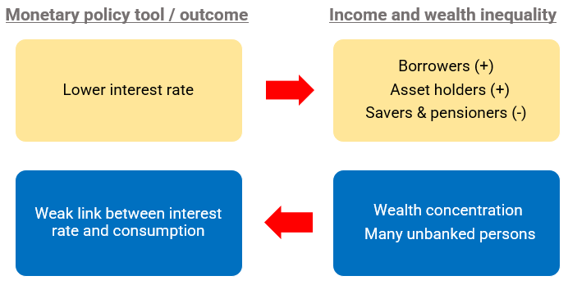
Central banks as policymakers: Inequality-mindful monetary policy conduct
Central banks should be concerned with inclusive development

Slide 23
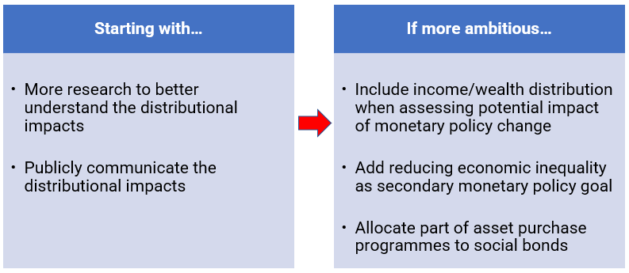
How can monetary policy be more equality mindful?

Slide 24
Central banks as investors: Social-oriented official reserve management
Much of $9.1 trillion official reserves in Asia-Pacific is not directly promoting inclusive development
Reserve portfolio allocations (median, %)
Factors limiting investment in nontraditional asset classes
Prohibitive central bank rules
Inadequate official reserves
Lack of ESG-aligned reserve allocation strategies
Source: World Bank (2020).

Slide 25
How can official reserve management be more pro-social?
Starting with…
Determine whether existing mandate allows allocations into non-traditional assets
Examine how social-tilted investment strategies would affect portfolio performance
If more ambitious…
Add social impact as secondary reserve management goal
Set up an investment committee to make reserve allocation decisions
Use excess reserves as seed capital for local social projects

Slide 26
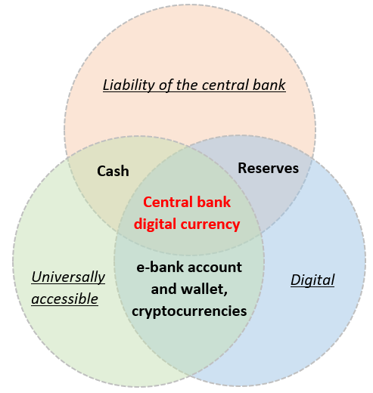
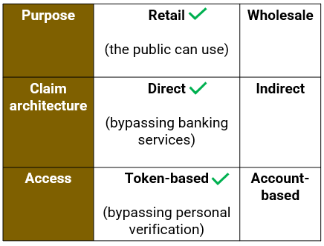
Central banks as currency issuers: A central bank digital currency (CBDC)
CBDC could improve financial access with certain designs
Source: Chorzempa (2021).

Slide 27
More Asia-Pacific central banks are moving beyond the research stage
Research (28)
- Australia (3)
- Azerbaijan
- Bangladesh
- Bhutan
- China
- Fiji
- Hong Kong, China (3)
- India
- Indonesia
- Japan
- Macao, China
- Malaysia
- Mongolia
- Nepal
- Pakistan
- Philippines
- Singapore (2)
- Solomon Islands
- Sri Lanka
- Thailand
- Tonga
- Vanuatu
- Viet Nam
Proof of concept (17)
- Georgia
- Hong Kong, China (2)
- Islamic Republic of Iran
- Japan
- Kazakhstan
- Lao PDR
- Malaysia
- New Zealand
- Palau
- Republic of Korea
- Singapore
- Thailand (3)
- Türkiye
Pilot (5)
- China
- India
- Republic of Korea
- Russian Federation
- Singapore

Slide 28
Actions by central banks alone are not enough
Central banks to…
Identify associated risks and mitigation measures
Other policymakers to…
Ensure speedy, affordable internet connection
Expand the coverage of personal identification system
Examine whether non-CBDC options are available
Enhance financial education
Improve digital literacy
Financial disintermediation
Digital bank run
Operational and reputational risks

Slide 29
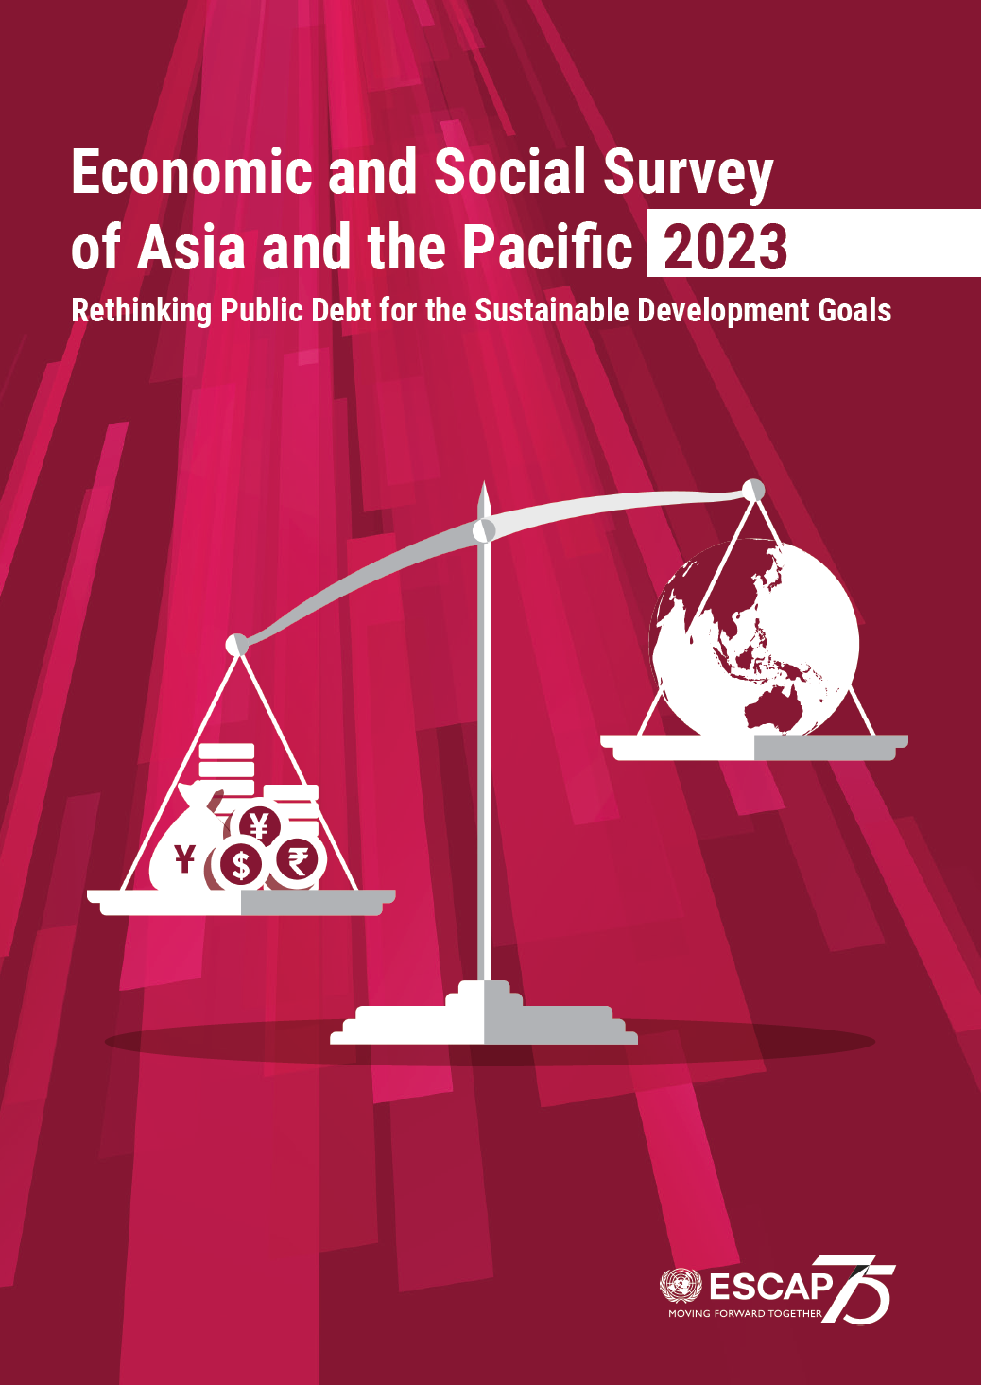
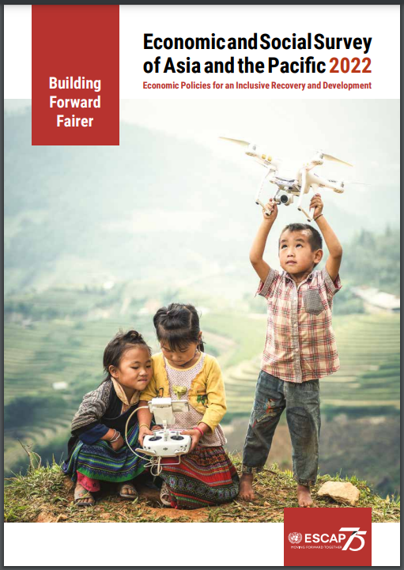
Economic and Social Survey of Asia and the Pacific
Thank you
Macroeconomic Policy and Financing for Development Division, ESCAP
escap-mpdd@un.org

