Slide 1
11th conference on Global economy
China’s Сapital Formation in the Volatile Time
Department of Global Economy
November 30, 2023
Leonid M. Grigoryev, Darya Zharonkina
BRICS JOURNAL OF ECONOMICS, 2023 Volume 4 Number 2, pp. 4-24.
Notes:
https://brics-econ.arphahub.com/article/105980/list/1/

Slide 2
Key issues of Chinese economy
Fast growth for so long has brought GDP PPP (2017) per capita from $1,5 to $20 th. Next step?
Demographic experiment has its difficult sides…
Global trade is growing no so fast for potential capacity of economy… may be in 2023…
All the institutes have been formatted for fast growth – rearrangement requires time.
Decisions of Congress in 2012 were difficult to achieve: domestic consumption V export.
Energy and Climate program is for $15 trillion… till 2060…
Social inequality is substantial and affecting housing…
Construction and Housing Development Cs. is under stress of underfinancing from customers.
We observe “Japanese” effect: High investment with “Low” growth (5-6%).
It may be called “middle income trap” (normally from 5% to 2%) – Chinese style.
Potential growth and other trends indicate probably – seeking the New Normal path.
Below – our analysis of Capital Formation and Growth in 2000s, esp. recently…

Slide 3
Source: IMF

Slide 4
China’s tremendous success in development may be measured in the very straightforward way: in 1992 GDP per capita (PPP 2017) was only $1,25 th. – by 2022 it had reached $20 th.
In this period China has crossed few lines between clusters and moved (slide 3) from 6th to 3d one. Now it is within the range of countries with middle income.
Reduction of the annual GDP growth rate from 10-11% to 5-6% (since 2011??) is naturally called for “trap” theory.
In the last two decades, the economy of China has undergone substantial changes related to capital formation that resulted in a specific Chinese hybrid of market-driven demand for fixed assets and a planned instrument of structural changes.
The purpose of our study: explore the major characteristics of the uniquely high rate of capital formation, close to 45% of GDP (slide 5), that for many years has supported growth and structural changes in China.
Starting hypothesis: during the period of 2012-2019, growth rates of investments by sector and industry are either planned or decision driven; in the pandemic crisis year the changes are “event driven”; the changes that occur after the crisis are “adaptation driven”.

Slide 5
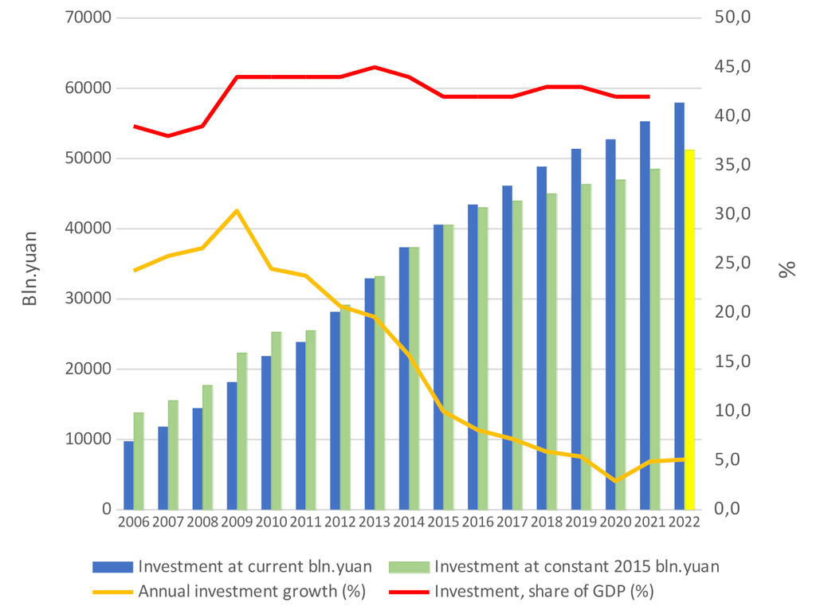
Investment in fixed assets, 2006-2022
Source: compiled by the authors using data from the World Bank (2023), the National Bureau of Statistics of China. (2022).

Slide 6
China does not have immunity from external shocks (Covid-19, sanctions) and domestic problems (population aging, slower growth of working-age population, rise in wages, dependence of growth on investment in the private economy).
Economic growth slowdown caused a dramatic shift from 10.5% average growth rate of GDP in 2000-2008 to 7.1% in 2012-2019. Personal consumption fared slightly better, export demonstrated wide fluctuations, but the general proportions were rigid.
2006-2012 as a period of adaptation to the Global Financial crisis or Great Recession; 2012-2019 as a period of slowdown – it appears intentional… 2020-2022 as a period of crises and a reduction in the intensity of capital formation.
The coronavirus pandemic hit hard the Chinese economy in 2020 (GDP growth 2.2%), leading to structural changes in household consumption (-2.7%), exports (3.8%), and investment (2.7%).

Slide 7
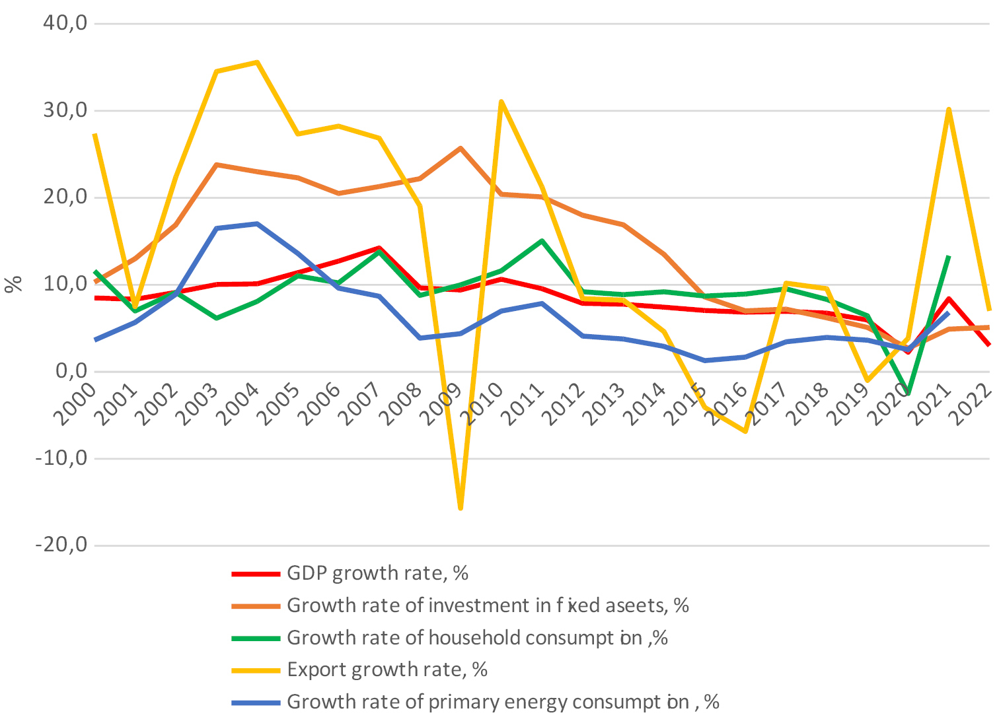
Key macroeconomic aggregates, 2000-2022.
Source: compiled by the author using data from World Bank (2023), BP Statistical Review of World Energy (2022), National Bureau of Statistics of China (2022).

Slide 8
Characteristics of the capital formation mechanism in China
Main drivers of capacity building were high capital formation rate, education and aggressive export policy.
We observe some stable parameters (slide 9) of investment process (available data) across 2006-2022, indicating the “invisible hand of Gosplan”.
The analysis presented next supports the hypothesis of a hybrid investment mechanism.
There is also a high correlation (slide 10) between investments, profits and revenues in manufacturing, as well as impressive performance.
There are also changes due to global circumstances, such as the increase in the share of investment in medicine during the pandemic because of higher domestic and external demand for related products.

Slide 9
Gross profit to revenue ratio
in manufacturing, 2012-2021
Gross profit to investment ratio, 2012-2021
 | 2012 | 2019 | 2020 | 2021
Production of consumer goods (excluding cars, medicine, computers) | 0,08 | 0,07 | 0,08 | 0,07
Production of intermediate goods | 0,05 | 0,05 | 0,05 | 0,06
Production of automobiles | 0,08 | 0,06 | 0,06 | 0,06
Production of medicine | 0,11 | 0,13 | 0,15 | 0,22
Production of computers | 0,05 | 0,05 | 0,05 | 0,06
 | 2012 | 2019 | 2020 | 2021
Production of consumer goods (excluding cars, medicine, computers) | 0,68 | 0,58 | 0,87 | 0,66
Production of intermediate goods | 0,33 | 0,25 | 0,32 | 0,47
Production of automobiles | 0,54 | 0,38 | 0,43 | 0,50
Production of medicine | 0,52 | 0,47 | 0,43 | 0,67
Production of computers | 0,54 | 0,31 | 0,32 | 0,37
Source: compiled by the authors using data from the National Bureau of Statistics of China (2021)
Source: compiled by the authors using data from the National Bureau of Statistics of China (2021)

Slide 10
Coefficients of correlation between investments, profits and revenues in the manufacturing industry, 2006–2021.
2006 | Investment | Revenue | Profit | 2012 | Investment | Revenue | Profit
Investment | 1 |  |  | Investment | 1
Revenue | 0,845 | 1 |  | Revenue | 0,771 | 1
Profit | 0,823 | 0,806 | 1 | Profit | 0,899 | 0,803 | 1
2019 | Investment | Revenue | Profit | 2020 | Investment | Revenue | Profit
Investment | 1 |  |  | Investment | 1
Revenue | 0,730 | 1 |  | Revenue | 0,768 | 1
Profit | 0,844 | 0,870 | 1 | Profit | 0,893 | 0,870 | 1
2021 | Investment | Revenue | Profit
Investment | 1
Revenue | 0,742 | 1
Profit | 0,806 | 0,865 | 1
Source: compiled by the authors using data from the National Bureau of Statistics of China (2021)
The hypothesis of a hybrid investment mechanism is supported.

Slide 11
Investment and its structure by one-digit sectors of the economy
From 2006 to 2021, there was a stable growth in investment both at current prices as well as in real terms.
There was no decline in the rate of capital accumulation in GDP, which could be expected since it was the government’s explicit goal.
In the period of 2006 – 2011 - right before CP 18th Congress of 2012 – Chinese GDP per capita escalated from $6 th. to nearly $10 th.(cluster 4)
It remains to be seen whether, after recovering from the crisis, the government of China intends to reduce the share of capital formation in GDP from 42-43% to the average global levels of about 25%. So far, this has not been observed…

Slide 12
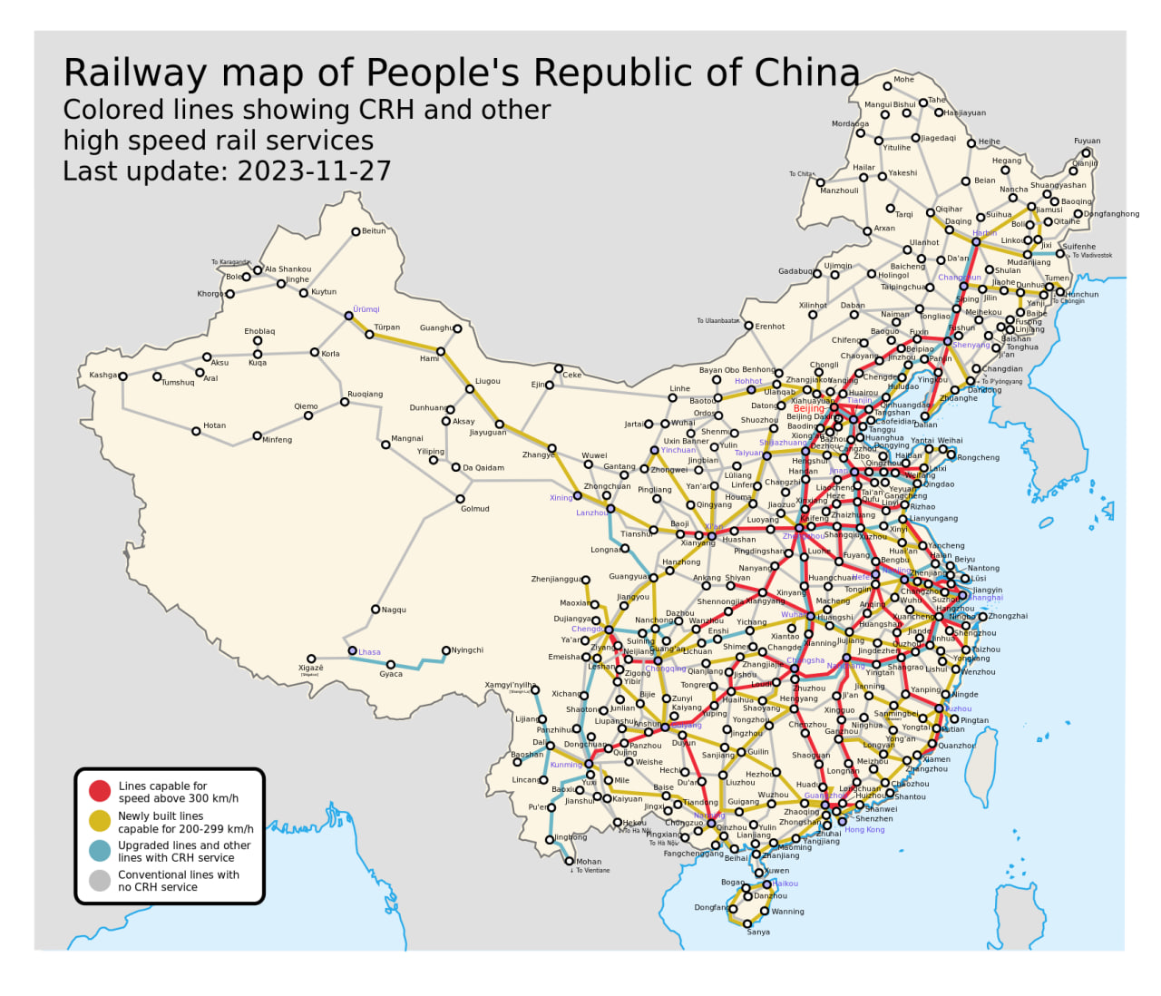
China's very first high-speed railway (HSR) came into operation in 2008.
Since 2009 (968 km), the scale of China's high-speed rail network has exploded to cover 42,000 kilometers by the end of 2022, accounting for more than 70 percent of all high-speed railway lines in the world.
The HSR building boom continues with the HSR network set to reach 70,000 km in 2035.

Slide 13
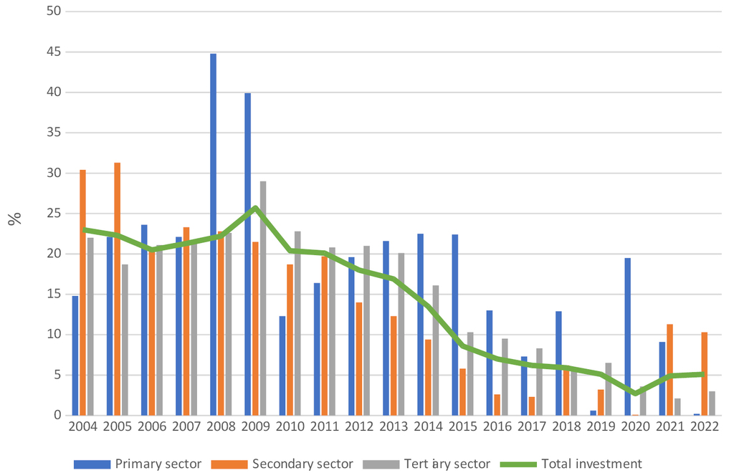
Annual growth rate of investment by sector, 2004-2022.
Source: The National Bureau of Statistics of China (2022)

Slide 14
Composition and annual growth of investment in fixed assets (excluding rural areas) at current prices, 2006-2021 (%)
 | Share |  |  |  |  |  | Annual growth
Sector | 2006 | 2008 | 2009 | 2010 | 2019 | 2022 | 2019 | 2020 | 2021 | 2022
Total absolute value (bln. yuan) | 9754 | 14459 | 18177 | 21183 | 51361 | 57955 | 5.4 | 2.9 | 4.9 | 5.1
Manufacturing | 28.2 | 31.3 | 30.3 | 30.9 | 31.0 | 32.7 | 3.1 | -2.2 | 13.5 | 9.1
Real Estate | 22.9 | 23.8 | 22.2 | 23.8 | 23.4 | 20.6 | 9.1 | 5 | 4.4 | -8.4
Water Conservancy, Environment, and Public Facilities Management | 8.0 | 8.3 | 9.2 | 9.2 | 12.4 | 11.9 | 2.9 | 0.2 | -1.2 | 10.3
Transport, Storage and Post | 11.9 | 10.5 | 12.0 | 11.5 | 9.3 | 9.0 | 3.4 | 1.4 | 1.6 | 7.8
Hotels and Catering Services | 1.0 | 1.2 | 1.2 | 1.2 | 0.8 | 3.0 | -1.2 | -5.5 | 6.6 | 7.5
Leasing and Business Services | 0.7 | 0.9 | 1.0 | 1.0 | 2.5 | 3.0 | 15.8 | 5 | 13.6 | 14.5
Scientific Research and Technical Services | 0.5 | 0.5 | 0.5 | 0.5 | 1.1 | 1.4 | 17.9 | 3.4 | 14.5 | 21.0
Education | 2.3 | 1.6 | 1.7 | 1.5 | 2.0 | 2.3 | 17.7 | 12.3 | 11.7 | 5.4
Health and Social Service | 0.7 | 0.7 | 0.9 | 0.8 | 1.2 | 2.0 | 5.3 | 26.8 | 19.5 | 26.1
Source : compiled by the authors using data from National Bureau of Statistics of China (2022)

Slide 15
A shift from investment to consumption led to a decline in investment in the largest sectors of the Chinese economy: real estate and manufacturing
The picture we observe casts certain doubts on the prospects of reducing the capital formation rate in GDP (slide 13).
Manufacturing and Real estates shares were stable…
Share of Water Conservancy, Environment, and Public Facilities Management was increased obviously by Central decision
Obviously, it cannot be one-time dramatic reduction in investments. Yet, as the manufacturing sector is crucial for export and the housing sector for the social and financial stability we may see today and expect in the future certain changes in the structure, but not in the overall rate.

Slide 16
Shares and growth rates of export by type (%), 2006-2022
 | Shares of export (%) |  |  | Annual growth (%)
 | 2006 | 2019 | 2022 | 2019 | 2020 | 2021 | 2022
Total value (bln dollar) | 969 | - | - | 2498 | 2588 | 3362 | 3594
Electrical machinery and equipment and parts thereof | 23.48 | 26.84 | 26.57 | 0.91 | 3.61 | 29.88 | 6.89
Machinery, mechanical appliances, nuclear reactors, boilers; parts thereof | 19.26 | 16.68 | 15.36 | -3.1 | 5.61 | 24.45 | 0.80
Other machinery, mechanical appliances | 5.19 | 8.14 | 7.86 | 2.41 | 0.47 | 28.00 | 7.90
Plastics and articles thereof | 2.29 | 3.37 | 3.99 | 5.02 | 14.52 | 36.0 | 9.5
Optical, photographic, cinematographic, measuring, checking, precision, medical or surgical equipment | 3.37 | 2.92 | 1.96 | 2.09 | 9.99 | 21.51 | -27.93
Transport | 3.97 | 4.48 | 5.58 | -12.42 | -9.63 | 66.17 | 20.25
Other made-up textile articles | 1.25 | 1.12 | 1.05 | 0.15 | 171.01 | -44.62 | -10.01
Toys, games and sports requisites; parts and accessories thereof | 2.34 | 2.5 | 2.88 | 10.07 | 14.54 | 42.4 | 1.45
Articles of iron or steel | 2.59 | 2.77 | 3.07 | 5.65 | 2.53 | 34.49 | 15.5
Organic chemicals | 1.6 | 2.27 | 2.84 | -5.04 | 0.31 | 45.00 | 23.37
Pharmaceutical products | 0.16 | 0.37 | 0.39 | 3.41 | 44.06 | 191.89 | -63.67
Source: compiled by the authors using data from The International Trade Centre (International trade in goods statistics by product exports, 2006-2022).

Slide 17
During the given period, both stable investment growth rates and volatility are clearly seen, indicating the logic of state planning. We believe a significant decline in the share of investments in ferrous metal production may be interpreted as a planned decision and the growth of the share of investments in the medical products field in 2019-2021 as a mixture of state planning and market demand.
Export shares were rather stable (slide 15)

Slide 18
Shares and growth rates of investment in manufacturing by industries (%), 2006-2021.
 | Shares (%) |  |  |  |  | Annual growth (%)
 | 2006 | 2012 | 2019 | 2020 | 2021 | 2019 | 2020 | 2021
Total value, bln.yuan | 2628,4 | 12336,7 | 21384,9 | 21377,3 | 22623,4 | 3,1 | -2,2 | 13,5
Production of Computers, Communication and and Other Electronic Equipment | 6,4 | 4,8 | 8,2 | 9,3 | 10,7 | 16,8 | 12,5 | 22,3
Production of Non-metallic Mineral Products | 7,1 | 9,7 | 10,1 | 9,8 | 10,6 | 6,8 | -3 | 14,1
Production of Special Purpose Machinery | 4,1 | 6,8 | 7,3 | 7,1 | 8,4 | 9,7 | -2,3 | 24,3
Production of Electrical Machinery and Apparatus | 4,2 | 6,7 | 6,5 | 6,1 | 7,1 | -7,5 | -7,6 | 23,3
Production of Medicines | 2,9 | 2,9 | 3,2 | 4,1 | 4,2 | 8,4 | 28,4 | 10,6
Production of Automobiles | - | 6,5 | 6,3 | 5,5 | 5,0 | -1,5 | -12,4 | -3,7
Production of Raw Chemical Materials and Chemical Products | 9,6 | 9,1 | 7,2 | 7,1 | 7,8 | 4,2 | -1,2 | 15,7

Slide 19
Export growth fluctuations added uncertainty to Chinese domestic economic development during the Covid lockdowns. In contrast to investment, export showed two dramatic slowdowns in 2020 and 2022.
The average growth rate for sixteen years (2006-2022) is 8.5 % but in the last four years the rates noticeably differed from this figure: 0.2% in 2019, 3.6% in 2020, 29.9% in 2021 and 6.9% in 2022.
Delayed deliveries in 2021 yielded almost 30% growth and a total of 43% over these four years (11,6% average). Difficulties in export expansion had been visible since 2019, but we can assume they were due to contractual, financial and logistical complications for export operations.
Some of changes in export dynamics can be easily attributed to the global Covid-19 specific demand: finished textile product exports almost tripled in 2020, and medical exports doubled in 2021.

Slide 20
Conclusion
Chinese economy continues its fast economic growth in spite of external shocks and internal demographic problems, inequality, and post-pandemic health issues. It is true that 5-6% growth rates are less impressive than the previous 10%, but they are well above the global averages. The engines of this growth are still capital formation and export.
The country has not attained the objective to increase the share of personal consumption in GDP and decrease the capital formation rate.
Macroeconomic proportions and inequality in the economy and society remain essentially the same. Interrelations between revenues, profits and investment in industries of manufacturing show similar characteristics from 2006 to 2021.
The picture of changing sectorial and industry shares of real investment reflects tremendous efforts of planning authorities and companies to catch up with changes in domestic and global market demand. In a span of a few years - especially in 2020–2022 - investments in some industries demonstrated substantial fluctuations, reflecting export instability and changing plans. Chinese authorities are clearly focusing on high-tech production in the electronics and machinery sectors and, after the start of the pandemic, medicine, by building new physical capital in the relevant industries.

